Slide 1
2024 Data Standards: Updates for End Users
Confidential and Proprietary | © Copyright 2023 Bitfocus, Inc., All Rights Reserved.
Notes:
Took off Implementation

Slide 2
Timeline 2024 HMIS Data Standards
Formal Approval of Implementation Plan (Bitfocus)
Program Structure Mapping
Initial Communication to HMIS Users
Formal Approval of Implementation Plan (Community)
Program Structure Mapping
Updating New HMIS Paper Forms
Report Data Mapping
Program Structure Mapping
Draft of New HMIS Paper Forms Published
HMIS Structure Updates Published to HMIS
Community Screen Configurations
Program Structure Updates
FY 2024 Go live date in HMIS
Sage is updated for 2024 APR, CAPER, and CE APR uploads
New Paper Forms Required by Agencies
June 2023
July 2023
August 2023
September 2023
October 2023

Slide 3
FY 2024 HMIS Data Standards
Language Updates
Changes to Existing Data Elements
Changes/Updates by Funding Type
Changes/Updates by Project Type
Coordinated Entry
Data Elements Retiring
Brief Overview of Anticipated Changes
HUD has announced updates to the 2024 HMIS data standards, effective October 1, 2023. Changes include field modifications, retirements, and new additions.
Note: Not all changes are captured in this presentation.

Slide 4
Language Changes
"Domestic Violence Victims" will be changed to "Domestic Violence Survivors"
"Client Refused" will now be "Client prefers not to answer"
"Veteran's Administration (VA) Medical Services" will be "Veteran's Health Administration (VHA)"
"Approximate date homelessness started" will become "Approximate date this episode of homelessness started"
"Client location" will be "Enrollment CoC"

Slide 5
Changes to Existing Data Elements
Veteran Status
The specific definition will be removed from the Data Standards Manual.
Referring to the VA Data Guide for the current legal definition is required.
Name
The client may provide their Preferred Name. “Legal name” is not required unless required by the funder.
Race and Ethnicity
Combine Race and Ethnicity into a single data element. (Eliminate 3.05 data element)
New response options will include:
Hispanic/Latina/e/o
Middle Eastern or North African
Additional Race and Ethnicity Detail (If Additional Race and Ethnicity, please specify)

Slide 6
Changes to Existing Data Elements cont.
Gender (Element 3.06)
Updated response options will include:
"Female" Woman (Girl, if child)
"Male" Man (Boy, if child)
"Gender other than" Non-Binary
Culturally Specific Identity (Two-Spirit)
Transgender
Questioning
Different Identity (If Different Identity, please specify via text box)
Living Situation
The response option 'Rental by client with housing subsidy' will be expanded to include the following options once selected:
Family Unification Program Voucher (FUP)
Foster Youth to Independence Initiative (FYI)
Permanent Supportive Housing
Other permanent housing dedicated to formerly homeless persons

Slide 7
Changes/Updates by Funding Type
Social Security Number
CoC, ESG, and SAMHSA PATH funded projects will only need to enter the last four digits of the SSN.
Other funding types will continue to require the full SSN.
Translation Assistance Needed
CoC, ESG, and SAMHSA PATH funded projects must answer this NEW data element.
This information will help provide translation assistance to those in need.
Sexual Orientation
CoC PSH funded projects will be required to answer this data element.
Collecting this data will enhance our understanding and support for individuals in the system.

Slide 8
Changes/Updates by Project Type
RHY (Runaway and Homeless Youth)
'Youth' will now be referred to as 'client' for clearer terminology.
'Post-natal care for mother' will be updated to 'post-natal care for client (person who gave birth)' to be more inclusive.
HOPWA (Housing Opportunities for Persons With AIDS)
'Substance abuse disorder services treatment' will be changed to 'Substance use services/treatment' for better clarity.
'Receiving public HIC/AIDS Medical Assistance' will be removed.
'Client went to jail/prison' will now be 'jail/prison.'
'Client died' will be updated to 'deceased.'

Slide 9
Changes/Updates by Project Type cont.
VA (Veterans Affairs)
'Space Force' will be added to the Branch of Military list.
'Extended Shallow Subsidy' will now be 'Shallow Subsidy.'
New additions to Financial Assistance:
Start Date of Financial Assistance
End Date of Financial Assistance
Additional options to Financial Assistance Types:
Shallow Subsidy Financial Assistance
Landlord Incentive
Client Incentive
Updates to Percent of Area Median Income (AMI):
30% or less
31% to 50%
51% to 80%
81% or greater
HP Targeting Criteria - New Additions:
Past experience of homelessness (street/shelter/transitional housing) (any adult)
Head of household is not a current leaseholder/renter of unit
Head of household has never been a leaseholder/renter of unit
Single parent/guardian household with minor child(ren)

Slide 10
Coordinated Entry
What IS Changing
Data Element CE Participation Status (2.09) will be added.
The CE Participation Status will work together with the Project ID collected in 2.02 Project Information.
The combination of these elements will determine where referrals are made, depending on whether the project receives Coordinated Entry (CE) referrals.
What is NOT Changing
Major CE changes until FY 2026
4.21 Coordinated Entry Activity
Data Elements, 4.19 Coordinated Entry Assessment will not change.
Data Elements, 4.20 Coordinated Entry Event will not change.

Slide 11
Data Elements Retiring:
Ethnicity
Wellbeing
Worst Housing Situation
Last Permanent Address

Slide 12
Questions?

Slide 13
RESOURCES
HUD Exchange
FY2024 HMIS Data Standards Manual
FY2024 HMIS Data Dictionary
Alameda County HMIS Website
Reach out for help!
hmissupport@achmis.org
HUD and Bitfocus, Inc.

Slide 14
Alameda County HMIS: Consent Refused Data Entry Guide
Confidential and Proprietary | © Copyright 2023 Bitfocus, Inc., All Rights Reserved.
Notes:
Took off Implementation

Slide 15
Consent Refused Data Entry Guide Overview
Clients don't have to give written permission to store their personal information in HMIS.
Personal information includes names, birthdates, social security numbers, and other data that, when combined with non-identifying information, could identify the person.
If one person in a household refuses consent, all members will use de-identified data entry.
For clients receiving services from domestic violence agencies, in dangerous situations, or under 13, no identifying information should be entered into HMIS.

Slide 16
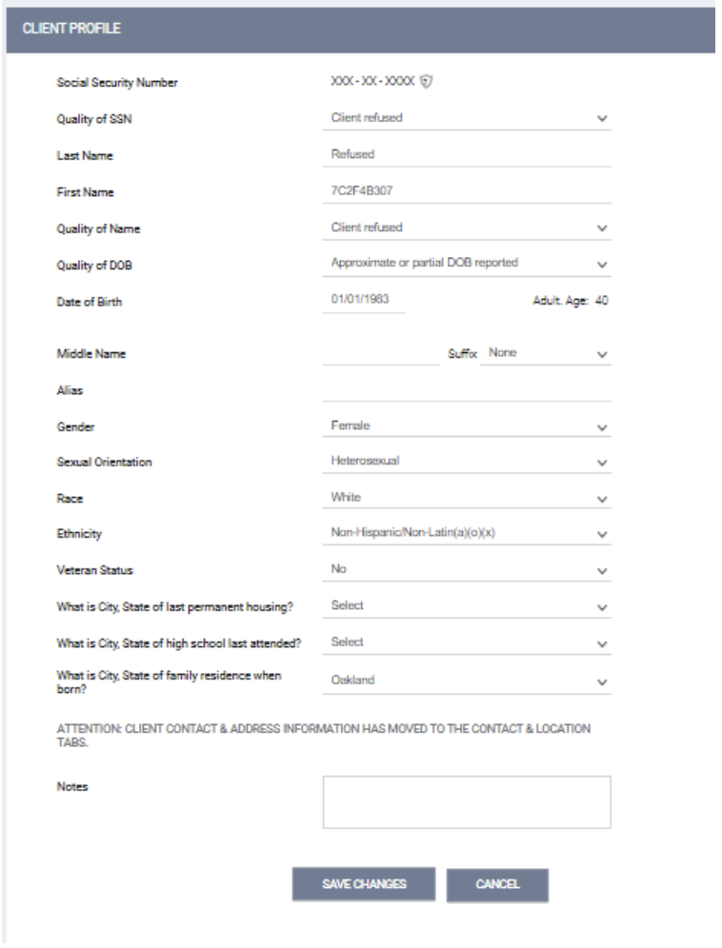
De-identifying a New Data Entry Protocol
Click "Add Client" from the search screen.
Use '000-00-0000' for Social Security and indicate "Client Refused" for Quality of SSN.
Enter "Refused" for the last name.
Temporarily use "Refused" for the first name and indicate "Client Refused" for Quality of Name.
Enter a partial-birth date (01/01/__) and the client's birth year. Select "Approximate or partial DOB reported" for Quality of DOB.
Leave Middle Name and Suffix blank.
Provide real data for Gender, Race, Ethnicity, and Veteran status.
Save the information.
Copy the UII for First Name by editing it.
Profile will look like this:

Slide 17
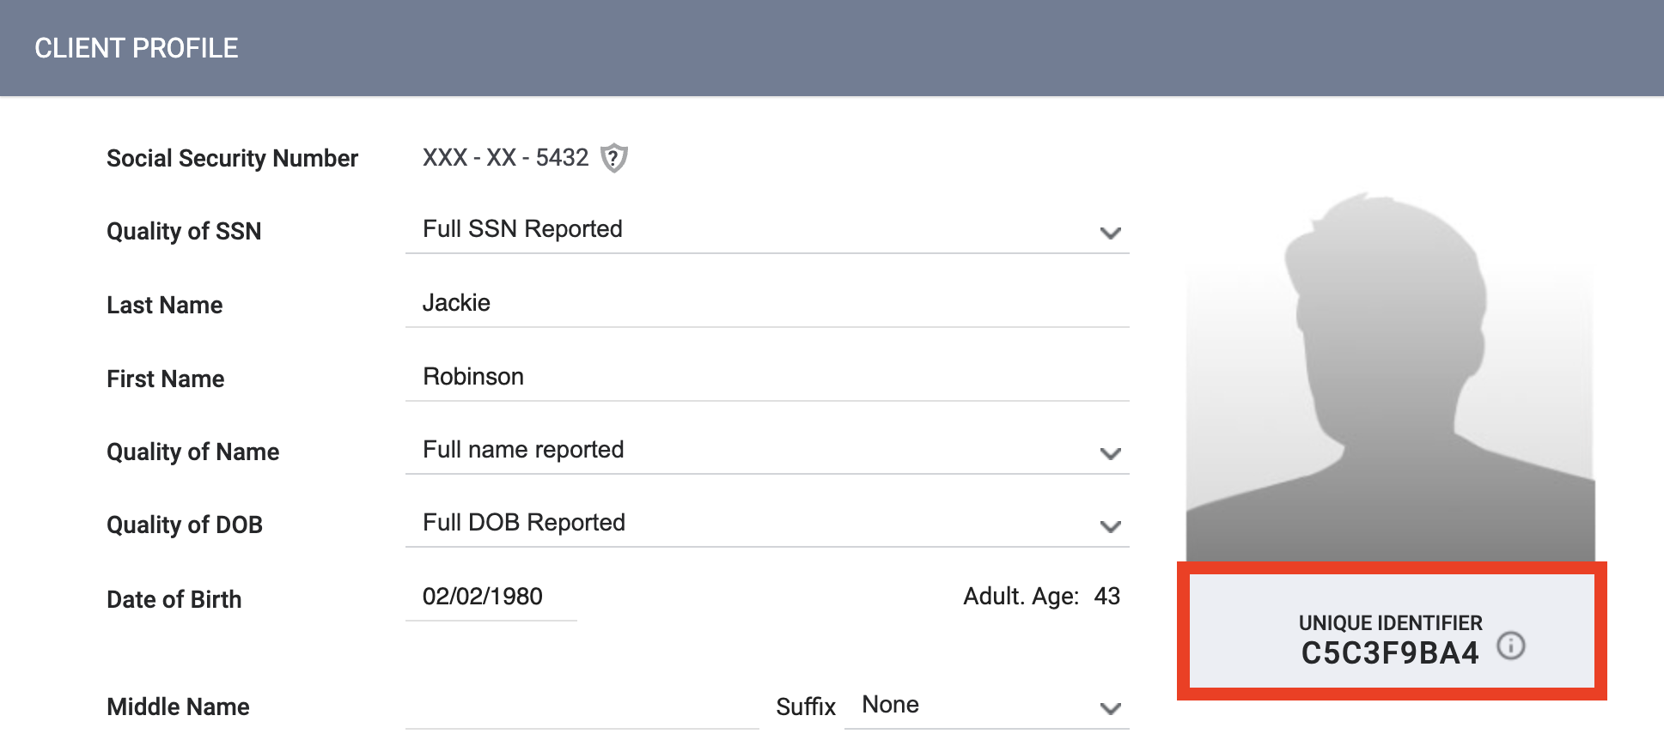
De-identifying a New Data Entry Protocol cont.
Follow the steps mentioned and contact the Help Desk, hmissupport@achmis.org if assistance is needed.
As a service provider working with a de-identified client record, keep the Clarity unique identifier and any other identifying information needed to identify and update the client's record in Clarity.
Ensure that you store this information securely in a way that meets agency, HUD, and ACHMIS security requirements.

Slide 18
Questions?

Slide 19
2024 Data Standards: Updates for Liaisons
Confidential and Proprietary | © Copyright 2023 Bitfocus, Inc., All Rights Reserved.
Notes:
Took off Implementation

Slide 20
Timeline 2024 HMIS Data Standards
Formal Approval of Implementation Plan (Bitfocus)
Program Structure Mapping
Initial Communication to HMIS Users
Formal Approval of Implementation Plan (Community)
Program Structure Mapping
Updating New HMIS Paper Forms
Report Data Mapping
Program Structure Mapping
Draft of New HMIS Paper Forms Published
HMIS Structure Updates Published to HMIS
Community Screen Configurations
Program Structure Updates
FY 2024 Go live date in HMIS
Sage is updated for 2024 APR, CAPER, and CE APR uploads
New Paper Forms Required by Agencies
June 2023
July 2023
August 2023
September 2023
October 2023

Slide 21
FY 2024 HMIS Data Standards
Language Updates
Changes to Existing Data Elements
Changes/Updates by Funding Type
Changes/Updates by Project Type
Coordinated Entry
Data Elements Retiring
Brief Overview of Anticipated Changes
HUD has announced updates to the 2024 HMIS data standards, effective October 1, 2023. Changes include field modifications, retirements, and new additions.
Note: Not all changes are captured in this presentation.

Slide 22
Language Changes
"Domestic Violence Victims" will be changed to "Domestic Violence Survivors"
"Client Refused" will now be "Client prefers not to answer"
"Veteran's Administration (VA) Medical Services" will be "Veteran's Health Administration (VHA)"
"Approximate date homelessness started" will become "Approximate date this episode of homelessness started"
"Client location" will be "Enrollment CoC"

Slide 23
Changes to Existing Data Elements
Veteran Status
The specific definition will be removed from the Data Standards Manual.
Referring to the VA Data Guide for the current legal definition is required.
Name
The client may provide their Preferred Name. “Legal name” is not required unless required by the funder.
Race and Ethnicity
Combine Race and Ethnicity into a single data element. (Eliminate 3.05 data element)
New response options will include:
Hispanic/Latina/e/o
Middle Eastern or North African
Additional Race and Ethnicity Detail (If Additional Race and Ethnicity, please specify)

Slide 24
Changes to Existing Data Elements cont.
Gender (Element 3.06)
Updated response options will include:
"Female" Woman (Girl, if child)
"Male" Man (Boy, if child)
"Gender other than" Non-Binary
Culturally Specific Identity (Two-Spirit)
Transgender
Questioning
Different Identity (If Different Identity, please specify via text box)
Living Situation
The response option 'Rental by client with housing subsidy' will be expanded to include the following options once selected:
Family Unification Program Voucher (FUP)
Foster Youth to Independence Initiative (FYI)
Permanent Supportive Housing
Other permanent housing dedicated to formerly homeless persons

Slide 25
Changes/Updates by Funding Type
Social Security Number
CoC, ESG, and SAMHSA PATH funded projects will only need to enter the last four digits of the SSN.
Other funding types will continue to require the full SSN.
Translation Assistance Needed
CoC, ESG, and SAMHSA PATH funded projects must answer this NEW data element.
This information will help provide translation assistance to those in need.
Sexual Orientation
CoC PSH funded projects will be required to answer this data element.
Collecting this data will enhance our understanding and support for individuals in the system.

Slide 26
Changes/Updates by Project Type
RHY (Runaway and Homeless Youth)
'Youth' will now be referred to as 'client' for clearer terminology.
'Post-natal care for mother' will be updated to 'post-natal care for client (person who gave birth)' to be more inclusive.
HOPWA (Housing Opportunities for Persons With AIDS)
'Substance abuse disorder services treatment' will be changed to 'Substance use services/treatment' for better clarity.
'Receiving public HIC/AIDS Medical Assistance' will be removed.
'Client went to jail/prison' will now be 'jail/prison.'
'Client died' will be updated to 'deceased.'

Slide 27
Changes/Updates by Project Type cont.
VA (Veterans Affairs)
'Space Force' will be added to the Branch of Military list.
'Extended Shallow Subsidy' will now be 'Shallow Subsidy.'
New additions to Financial Assistance:
Start Date of Financial Assistance
End Date of Financial Assistance
Additional options to Financial Assistance Types:
Shallow Subsidy Financial Assistance
Landlord Incentive
Client Incentive
Updates to Percent of Area Median Income (AMI):
30% or less
31% to 50%
51% to 80%
81% or greater
HP Targeting Criteria - New Additions:
Past experience of homelessness (street/shelter/transitional housing) (any adult)
Head of household is not a current leaseholder/renter of unit
Head of household has never been a leaseholder/renter of unit
Single parent/guardian household with minor child(ren)

Slide 28
Coordinated Entry
What IS Changing
Data Element CE Participation Status (2.09) will be added.
The CE Participation Status will work together with the Project ID collected in 2.02 Project Information.
The combination of these elements will determine where referrals are made, depending on whether the project receives Coordinated Entry (CE) referrals.
What is NOT Changing
Major CE changes until FY 2026
4.21 Coordinated Entry Activity
Data Elements, 4.19 Coordinated Entry Assessment will not change.
Data Elements, 4.20 Coordinated Entry Event will not change.

Slide 29
Data Elements Retiring:
Ethnicity
Wellbeing
Worst Housing Situation
Last Permanent Address

Slide 30
Questions?

Slide 31
RESOURCES
HUD Exchange
FY2024 HMIS Data Standards Manual
FY2024 HMIS Data Dictionary
Alameda County HMIS Website
Reach out for help!
hmissupport@achmis.org
HUD and Bitfocus, Inc.

Slide 32
Alameda County HMIS: Consent Refused Data Entry Guide
Confidential and Proprietary | © Copyright 2023 Bitfocus, Inc., All Rights Reserved.
Notes:
Took off Implementation

Slide 33
Consent Refused Data Entry Guide Overview
Clients don't have to give written permission to store their personal information in HMIS.
Personal information includes names, birthdates, social security numbers, and other data that, when combined with non-identifying information, could identify the person.
If one person in a household refuses consent, all members will use de-identified data entry.
For clients receiving services from domestic violence agencies, in dangerous situations, or under 13, no identifying information should be entered into HMIS.

Slide 34
De-identifying a New Data Entry Protocol
Click "Add Client" from the search screen.
Use '000-00-0000' for Social Security and indicate "Client Refused" for Quality of SSN.
Enter "Refused" for the last name.
Temporarily use "Refused" for the first name and indicate "Client Refused" for Quality of Name.
Enter a partial-birth date (01/01/__) and the client's birth year. Select "Approximate or partial DOB reported" for Quality of DOB.
Leave Middle Name and Suffix blank.
Provide real data for Gender, Race, Ethnicity, and Veteran status.
Save the information.
Copy the UII for First Name by editing it.
Profile will look like this:

Slide 35
De-identifying a New Data Entry Protocol cont.
Follow the steps mentioned and contact the Help Desk, hmissupport@achmis.org if assistance is needed.
As a service provider working with a de-identified client record, keep the Clarity unique identifier and any other identifying information needed to identify and update the client's record in Clarity.
Ensure that you store this information securely in a way that meets agency, HUD, and ACHMIS security requirements.

Slide 36
Questions?

