Slide 1
Marin Agency Lead Meeting
January 2021

Slide 2
Agenda
New User Requests and Access to Coordinated Entry
Federal Reports!
System Performance Measures Report (SPMs)
Housing Inventory Count (HIC)/ Point In Time Count (PIT)
Overlapping Enrollments
New Clarity Human Services Features

Slide 3
New User Requests
Notes:
Sara

Slide 4
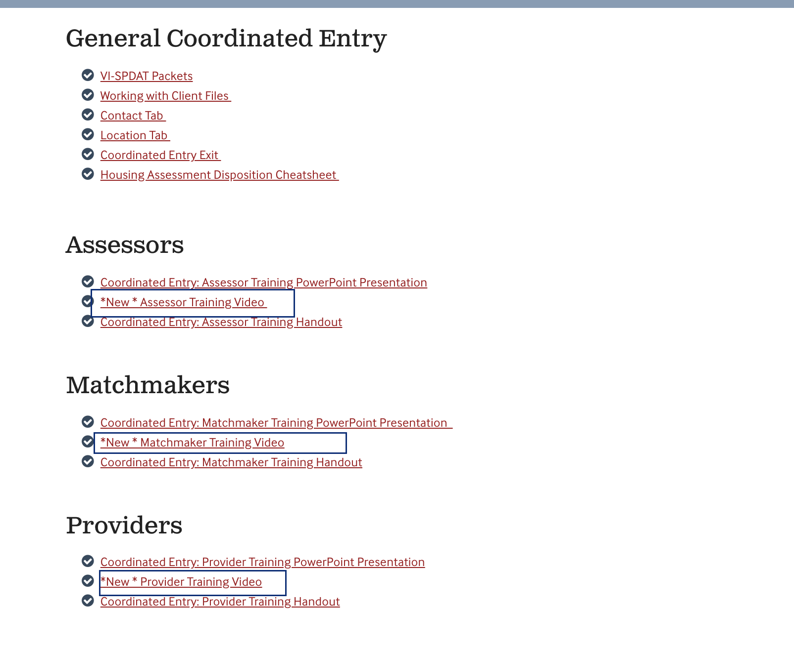
Coordinated Entry Access
Access to CE requires a user account.
*New*- users who will be doing Coordinated Entry (CE) work are now required to complete the CE training(s) prior to getting access to the CE Agency in HMIS.
There are three CE training videos
Assessor (administering the VI-SPDAT)
Matchmaker (MHA staff who will be making referrals)
Provider (staff responsible for processing referrals at their agency)
All training videos can be found on the Marin HMIS website under Training > Coordinated Entry
Notes:
sara

Slide 5
New User Requests
How to request a new user account.
New user requests are submitted to the Bitfocus Help Desk.
Email marin@bitfocus.com or call (415) 429-1400
Agency Leads are the only staff who can request new user access.
Users are required to complete the Clarity General Training and CE Training (if applicable) prior to getting access to HMIS.
What information do you need to give to the Help Desk?
Staff name
Email
Additional Agency Access to CE Agency (if applicable)
MHA Staff only- Indicate if the person will need a Matchmaker Access Role
*The New User article on the Marin Help Center web page has been updated to reflect the new process.
Notes:
sara

Slide 6
Federal Reports

Slide 7
System Performance Measure (SPMs)
Notes:
Lindsay

Slide 8
System Performance Measure Report
Used to measure a CoCs progress in meeting the needs of people experiencing homelessness in their community and to report this progress to HUD.
LoT homeless
Jobs and income growth of people experiencing homelelsssness
Success at reducing the number of individuals and families who become homeless.
Successful placement from street outreach.
Successful housing placement to or retention
Due March 1, 2021
Bitfocus will be doing outreach to agencies with specific data that needs to be addressed. Emails to come soon!

Slide 9
Point in Time Count (PIT) and Housing Inventory Count (HIC)
Notes:
Lindsay

Slide 10
HIC/PIT
What is the Housing Inventory and Point-in-Time Count?
Each year communities participate in a comprehensive one day tally of people living in shelters and/or unsheltered settings. This point-in-time (PIT) count provides critical information both locally and nationally about the demographics and trends of people experiencing homelessness in our community.
There are three parts to the count:
The sheltered PIT count
The unsheltered PIT count (waived this year)
The Housing Inventory Count (HIC)
Notes:
Lindsay

Slide 11
HIC
The HIC is conducted annually and reports on shelter and housing programs (ES, TH, RRH, PSH), including non-participating HMIS programs (e.g. DV programs). The HIC includes:
Bed/unit capacity
Federal funding source
HMIS participation
Location (geocode and address)
Other project details
Utilization rate based on clients in shelter/housing during one night in January (point-in-time count)
Notes:
Lindsay
Bitfocus may contact you to ask questions about inventory counts, population, etc.

Slide 12
PIT
The Point In Time (PIT) Count is conducted annually in late January, on the same day as the HIC.
The report includes sheltered (ES, TH, Safe Haven) and unsheltered clients, including clients in non-participating HMIS programs (e.g. DV programs)
Number of households and clients served the night of the PIT.
Information is broken out by both household type as well as specific demographics.
Race, gender, age, chronic homeless status, HIV/AIDS, disabling conditions, veteran status, etc...
Notes:
Lindsay
Completed using HMIS data as well as surveys providers fill out

Slide 13
What you can do...
Data Quality
Demographic data: birth dates reflect minor/adult status correctly, all other demographics are as complete as possible.
Enrollment/exit data: dates, head of household, group enrollments are correct.
Move-in Date (Permanent Housing projects only): ensure the residential move-in date reflects the date that the client started residing in permanent housing
Data Corrections
Work with the Help Desk to correct any data you can’t fix yourself
Communication
Respond to the Bitfocus Community Administration Team outreach promptly
Notes:
Lindsay

Slide 14
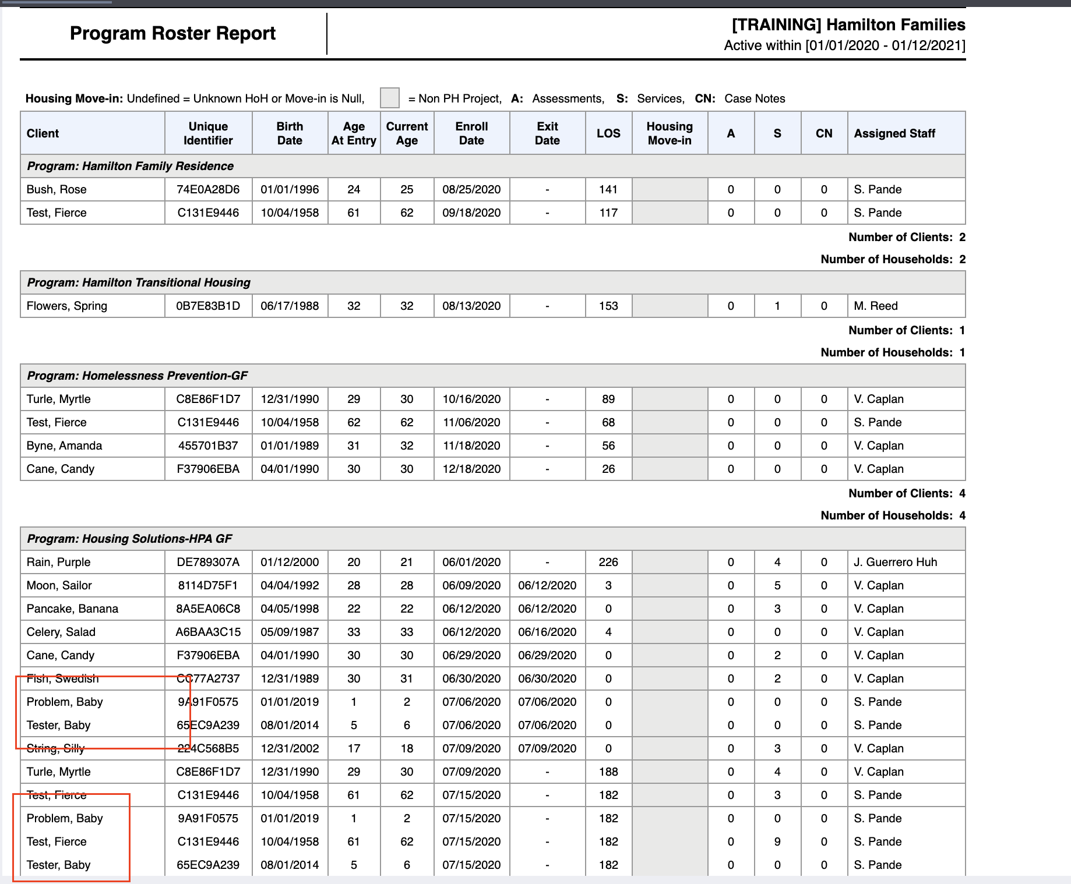
What you can do...
Run the [GNRL-106] Program Roster Report and make sure it is up to date
Are there clients enrolled that have actually moved out?
Are exit dates accurate?
Are all household members enrolled in the program
Are start dates accurate?
PH/RRH projects only: is the client’s housing move-in date populating on the report?
Notes:
Lindsay

Slide 15
Overlapping Enrollments

Slide 16
Overlapping Enrollments
During the LSA, we have contacted many agencies asking you to resolve overlapping enrollments.
What is an overlapping enrollment ?
A client’s record in HMIS shows the client is household in more than one shelter or housing program at the same time.
A client can only sleep in once place at a time. HMIS should reflect this.
Notes:
Sara

Slide 17
Considerations
RRH
An enrollment into a RRH program is not considered housed. Adding the move-in date will count the client as housed.
Providing a deposit for a client doesn't necessarily count the client as housed. If you discontinue working with the client before they have moved into their permanent housing location, do not enter a move-in date.
You are not required to enter a move-in date if the client enters into ES or TH.
Shelter
Entry/Exit shelter: an enrollment into the project indicates the client is sleeping there.
Night-by-night shelters: a bed night indicates the client is sleeping there.
Project start date = the first night the client started sleeping at the shelter, record the first bed night.
Project exit date = the day after the client’s last bed night.
Permanent Housing
A move-in date indicates that the client is permanently housed and is sleeping in a permanent housing location. Move-in date may be after the Project Start Date.
Notes:
Sara

Slide 18
Example
A client is enrolled in at Mill Street Shelter which is a night-by-night shelter with bed night services recorded from 1/1/20-5/1/20.
The client is also enrolled at The Voyager Shelter from 4/1/20-6/30/20, which is an entry/exit shelter.
Is this an overlapping enrollment?
Yes, because there are bed nights recorded at Mill Street that overlap with the enrollment at The Voyager, indicating that the client was sleeping in two places at once which is not physically possible.
Notes:
Lindsay

Slide 19
Example
A client is enrolled in Ritter ESG Rapid Rehousing program with a move-in date of 6/1/20 and the client is still enrolled.
The client is also enrolled in Oma Village PH program on 7/1/20 with no move-in date and the client is still enrolled.
Is this an overlapping enrollment?
No, this is NOT an overlapping enrollment because the client doesn’t have a move-in date for Oma Village. If the client has moved into Oma, entered the client’s move in date once that occurs.
Notes:
Sara

Slide 20
Example
A client is enrolled in CalWORKs Rapid Rehousing program with a move-in date of 11/15/20. The client is still enrolled.
The client is referred to and enrolled in Oma Village PH program on 11/1/20. The client moves into their unit on 11/15/20, and move-in date 11/15/20 is entered.
CalWORKs RRH program continues case management with the client for several months and they exit the program on 1/15/21.
Is this an overlapping enrollment?
No, this is NOT an overlapping enrollment because the client is not receiving rental assistance from CalWORKs. RRH projects routinely provide case management even after move-in.
Notes:
Lindsay

Slide 21
Example
The client is enrolled in New Beginning Center Shelter (entry/exit shelter) on 3/1/20 and was exited on 6/1/20.
The client was enrolled in MHA Mainstream (permanent housing) on 5/1/20 with a move in date recorded for the same date, 5/1/20.
Is this an overlapping enrollment?
Yes, because the client is enrolled at a shelter on 5/1/20 indicating they are sleeping there and also have a move-in date into MHA Mainstream which is permanent housing on 5/1/20. If the client didn’t move into permanent housing until 6/1/20, enter the move-in date as 6/1/20--start date is still 5/1/20 because that’s when MHA started working with the client.
Notes:
Sara

Slide 22
New Features

Slide 23
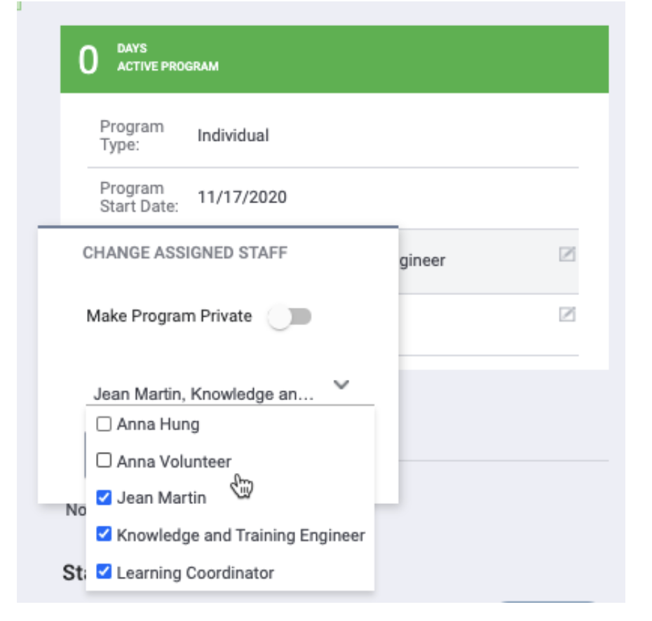
Assign Multiple Staff Members to a Program Enrollment
You can now assign multiple staff members to a program enrollment.
Notes:
Sara

Slide 24
Favorite Reports
You can now mark reports as favorites. Favorite reports maintain the parameters from the last time you run them.
Notes:
Sara

