Slide 1
Coordinated Entry: Assessor Training
Marin County

Slide 2
Agenda
Part 1: Refresher
Switching Agencies
Client Profiles
Searching for a client
What to do if you see duplicate profiles
Creating a client profile
ROI
Managing households
Contact and Location Information
Part 2: New Items
CE Enrollment
Current Living Situation
CE Assessment
Referral to the CQ
CE Events and Services
Uploading Documentation
Exit
Reports
Resources

Slide 3
Part 1- Refresher

Slide 4
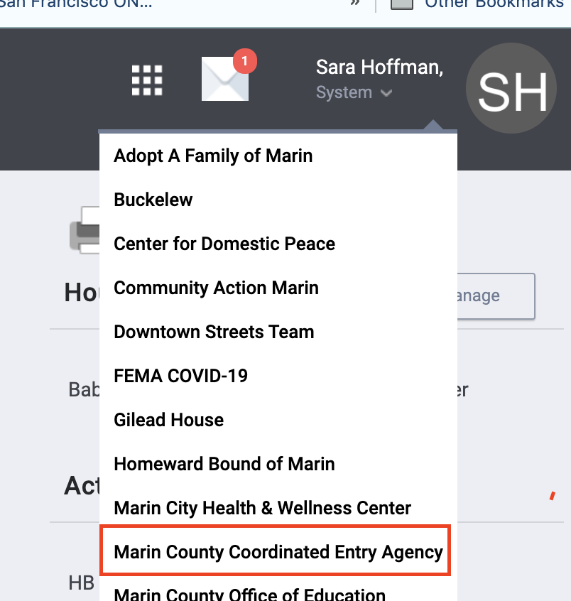
Switching Agencies
Work related to Coordinated Entry should be done under the Marin County Coordinated Entry Agency
Users will need to switch agencies in Clarity

Slide 5
Client Profiles

Slide 6
Looking up clients Clarity
Search for client or head of household
Search by name partial name, DOB or SSN
If unable to find head of household, create a new profile

Slide 7
Duplicate Profiles
If you discover multiple profiles for a client, you should:
Identify which profile should be the primary
Contact the Bitfocus Help Desk to get the records merged together
Provide the unique identifiers for each profile

Slide 8
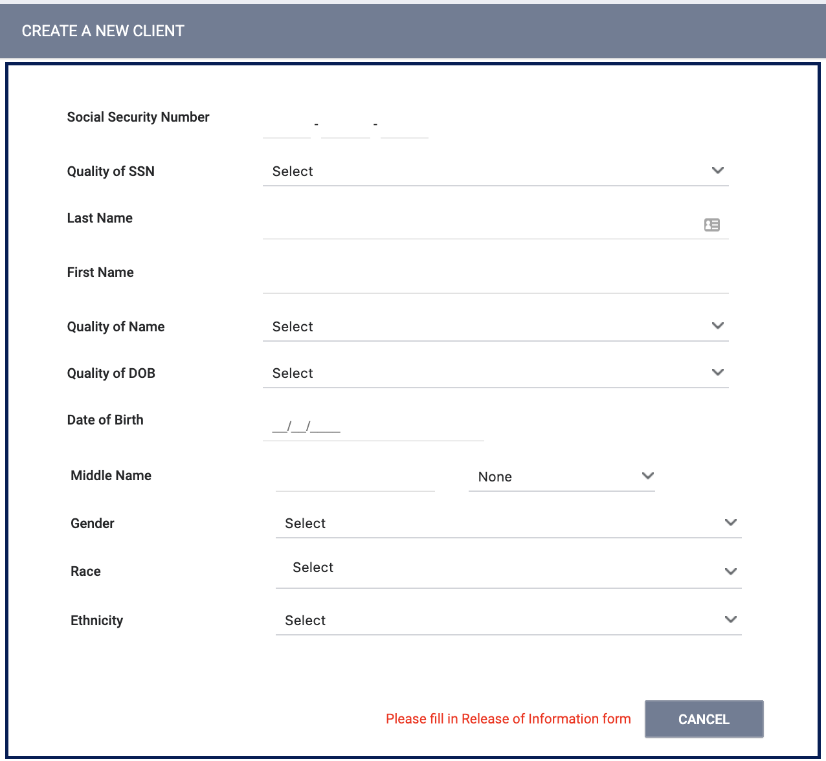
Creating New Profiles
Please be sure to collect as much information as possible
Avoid using “Client refused” or Data Not Collected” whenever possible
For existing profiles, confirm that all information is correct

Slide 9
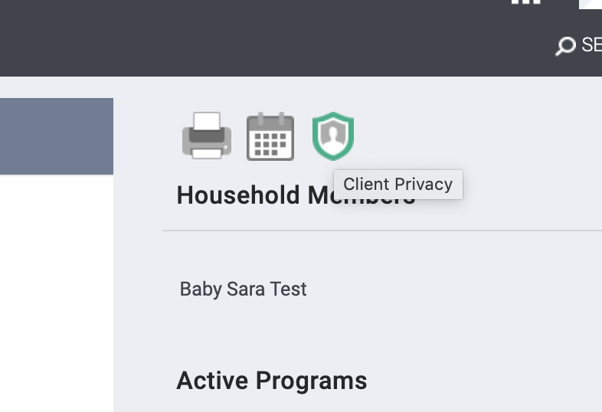
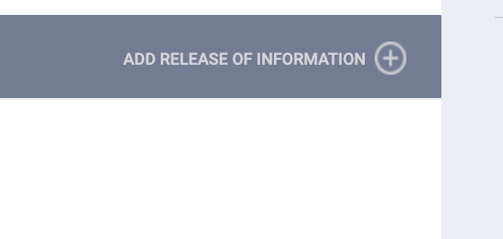
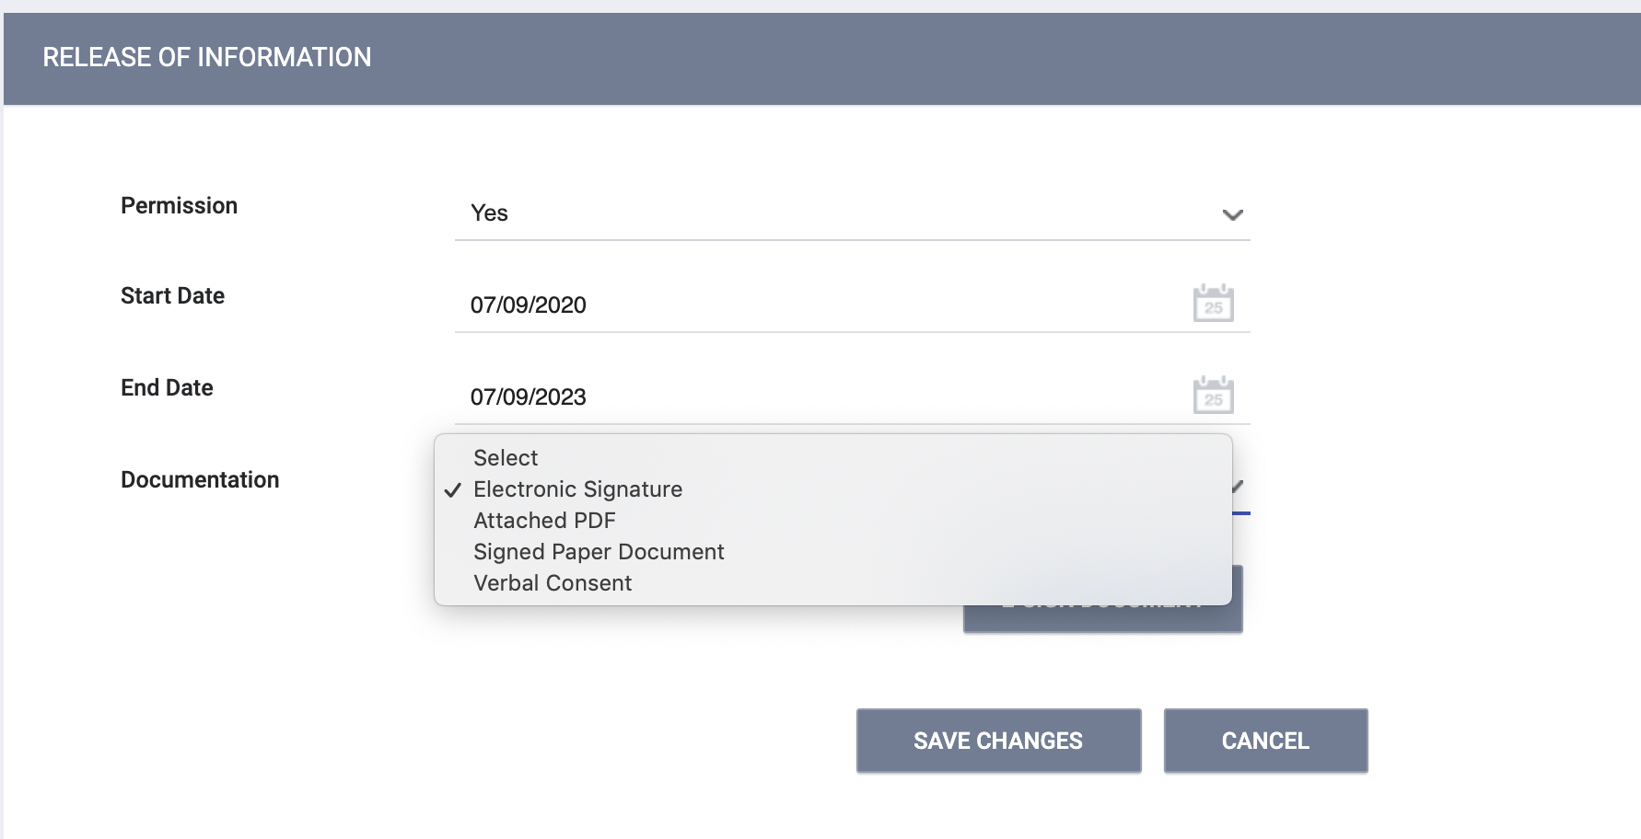
Release of Information (ROI)
A release of information should be added for every client
You can upload a signed PDF or complete by E-signing

Slide 10
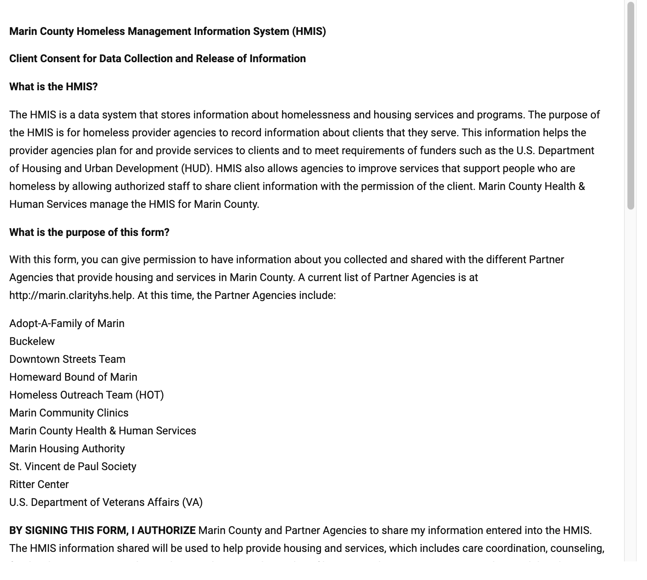
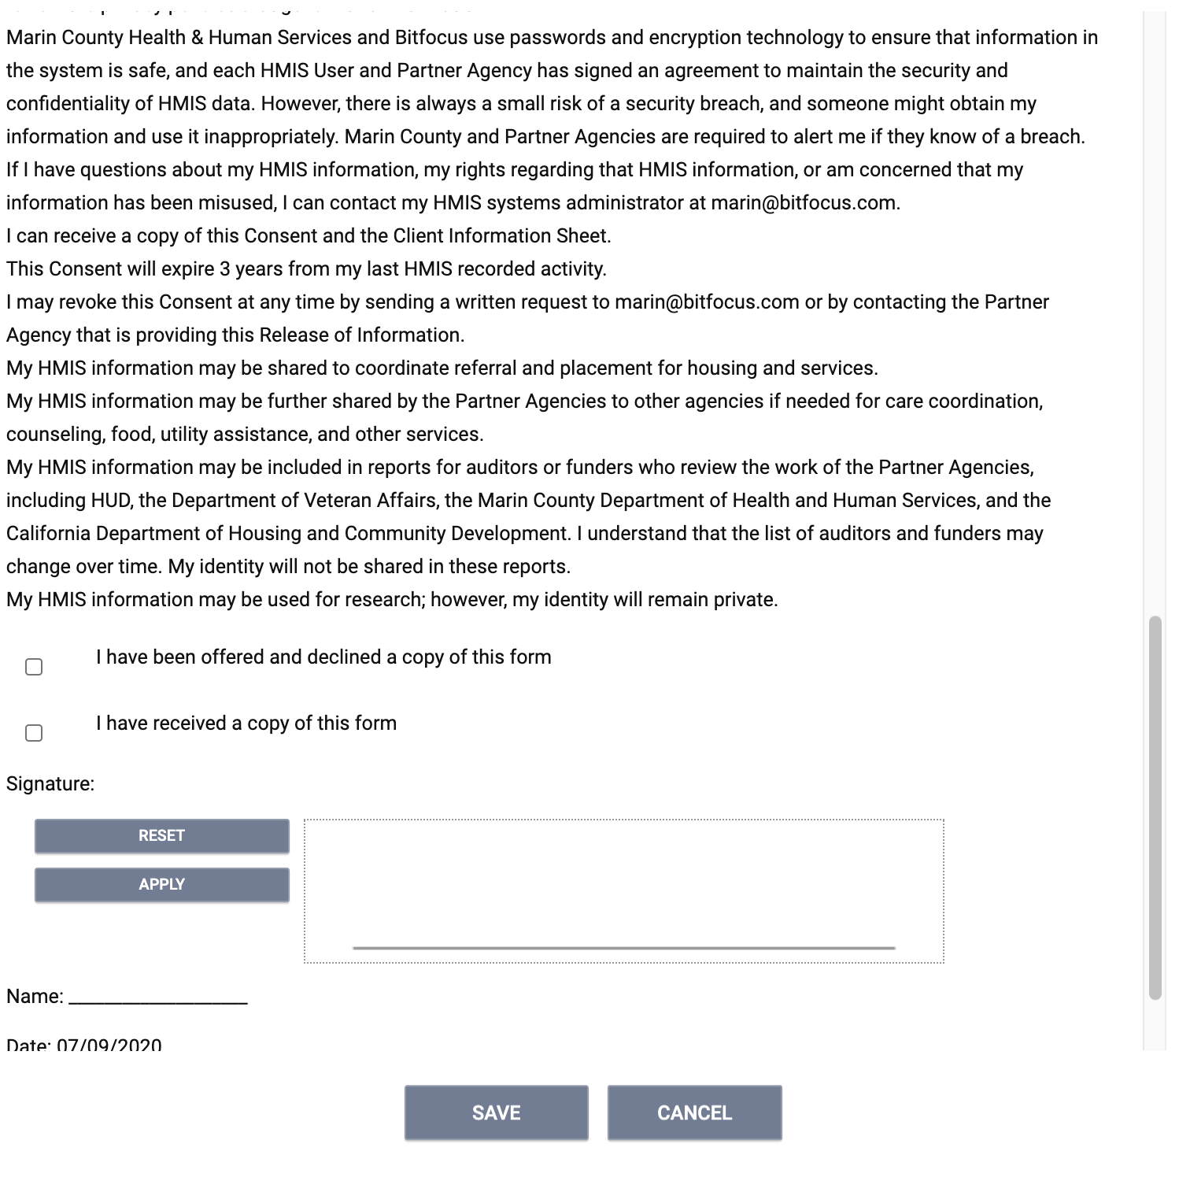
Release of Information (ROI)
E-Signature

Slide 11
Release of Information (ROI)
If the client does not consent, you should set the ROI permission to No and mark the record “Private”.
We always want to encourage the client to consent when possible. This increase coordination of care.

Slide 12
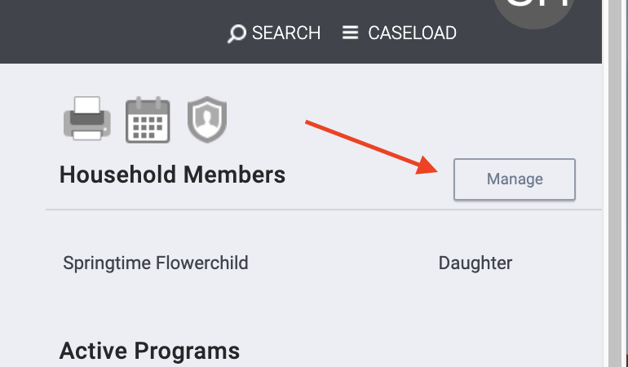
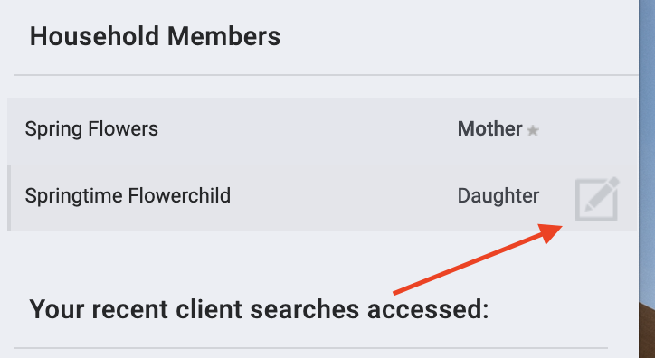
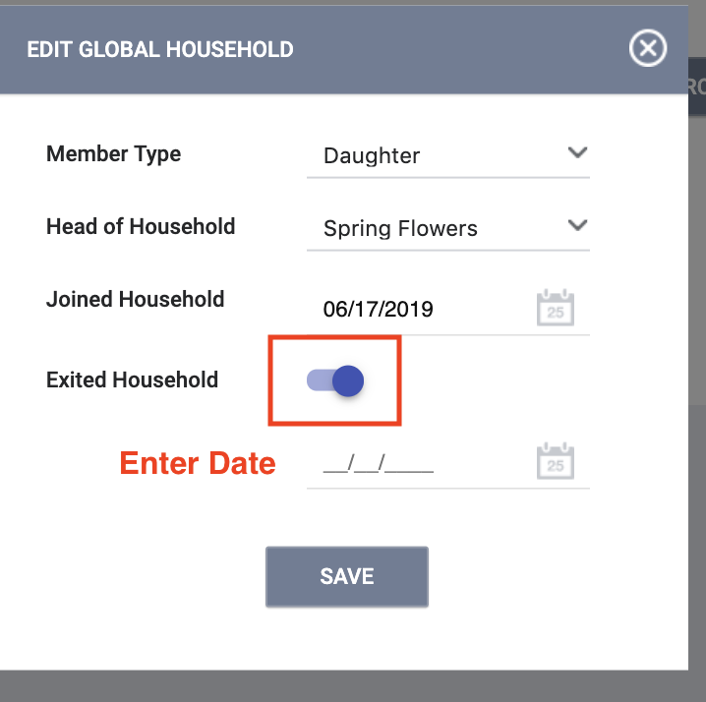
Managing Households
If the client is part of a family but is moving forward individually, you will need to remove the client from the household
1
2 3
Notes:
Use Spring Flowers to show how to remove family member

Slide 13
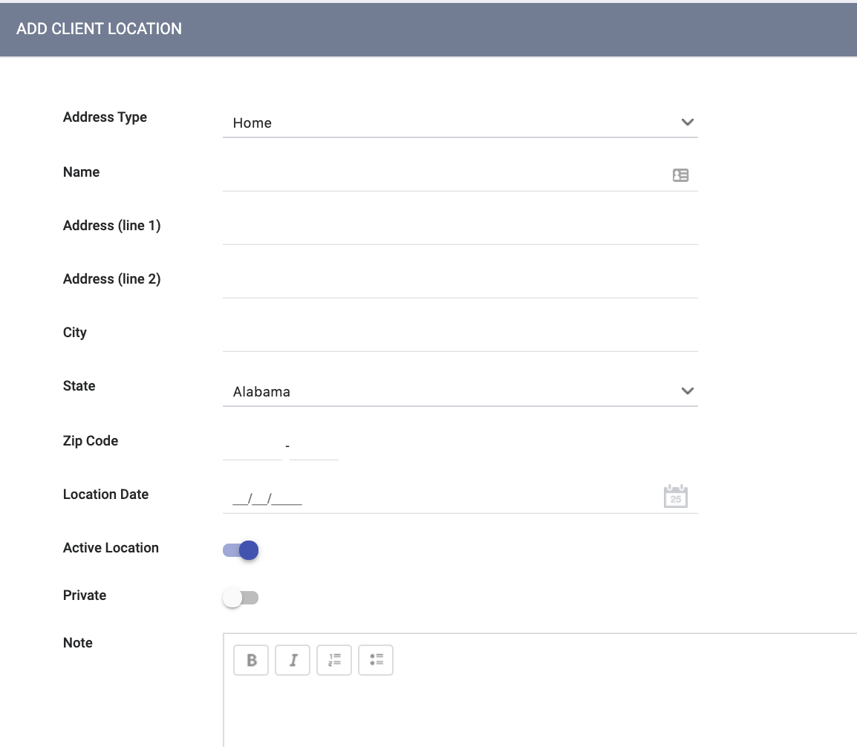
Update the Location Tab
Location can be added manually or by using the GPS icon
The active toggle should be turned on to indicate the client’s current location

Slide 14
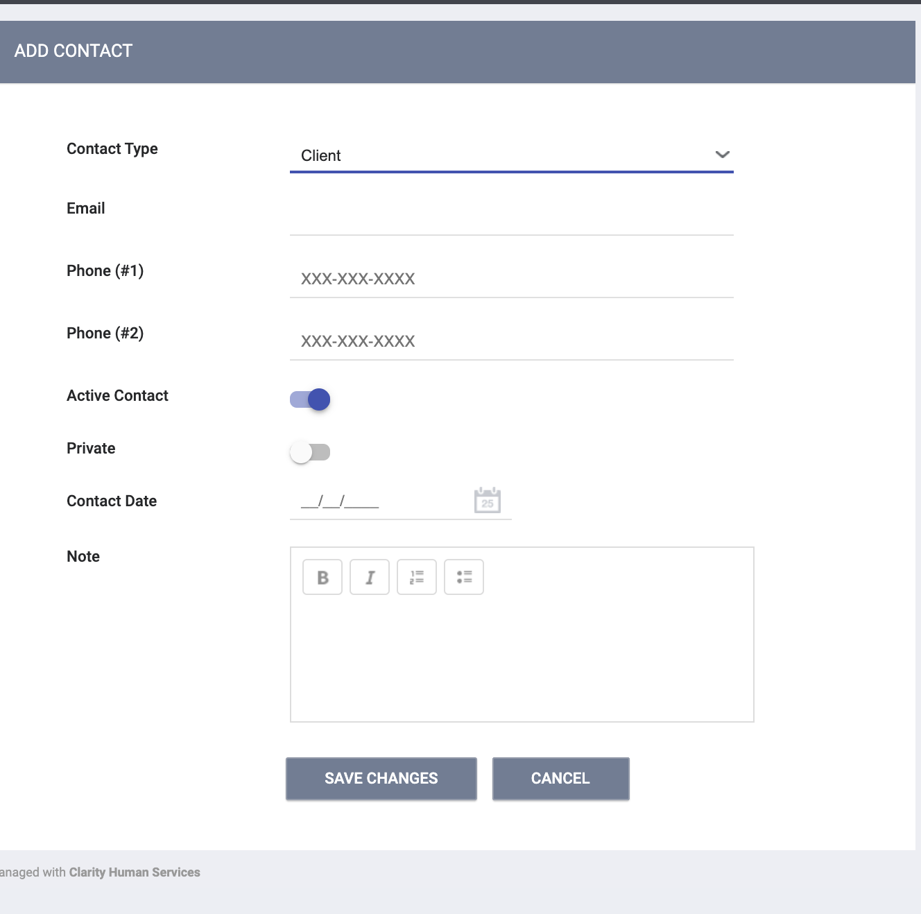
Update Contact Information
More than one contact can be added per client

Slide 15
Part II- New CE Workflow

Slide 16
CE Enrollment

Slide 17
Coordinated Entry Enrollment
All clients who are eligible for CE should be enrolled into a CE program
HUD requirement
Enrollments are completed to show that clients are actively being engaged in CE
Eliminates duplication of staff efforts and burden on the client
Information cascades forward to other fields/screens in ONE

Slide 18
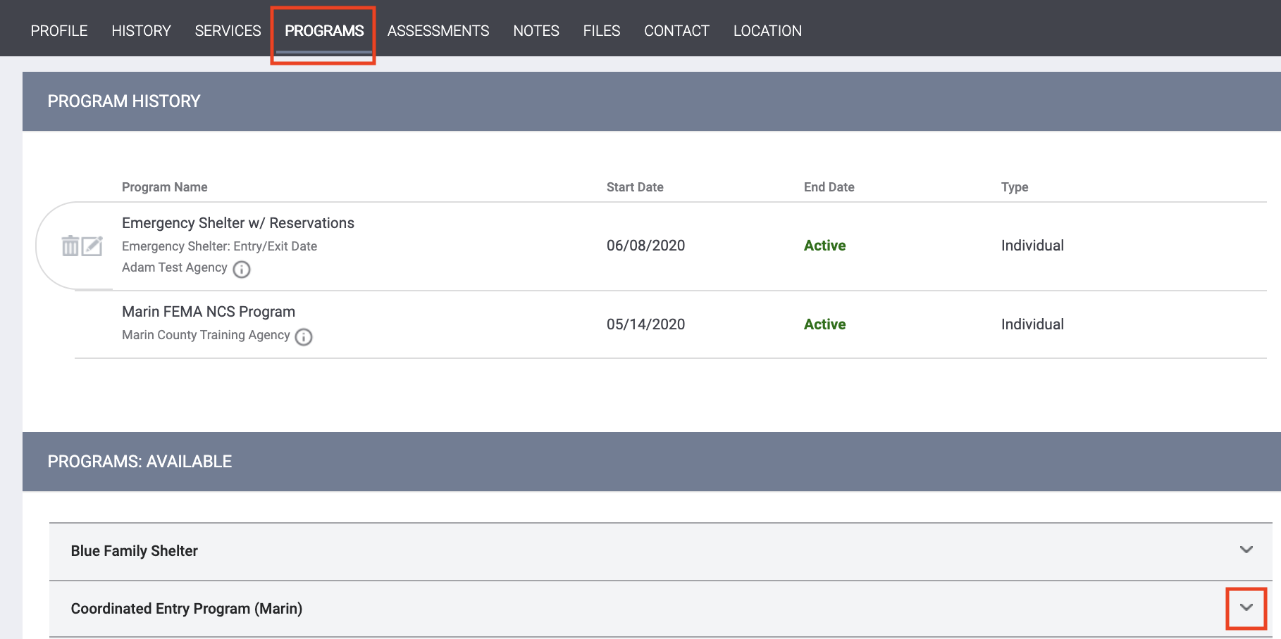
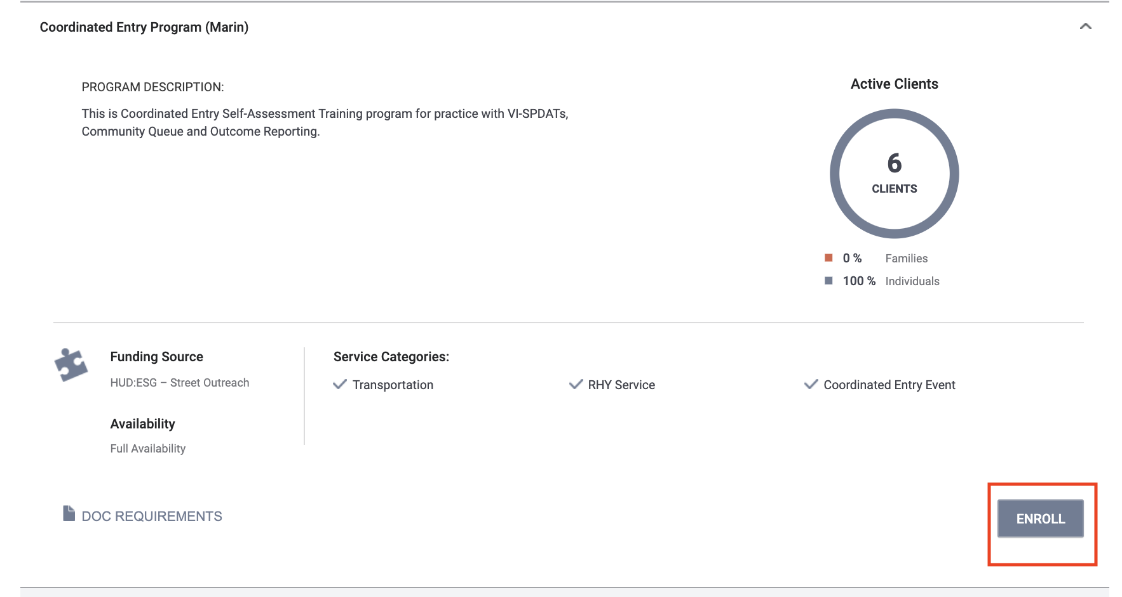
Coordinated Entry Enrollment

Slide 19
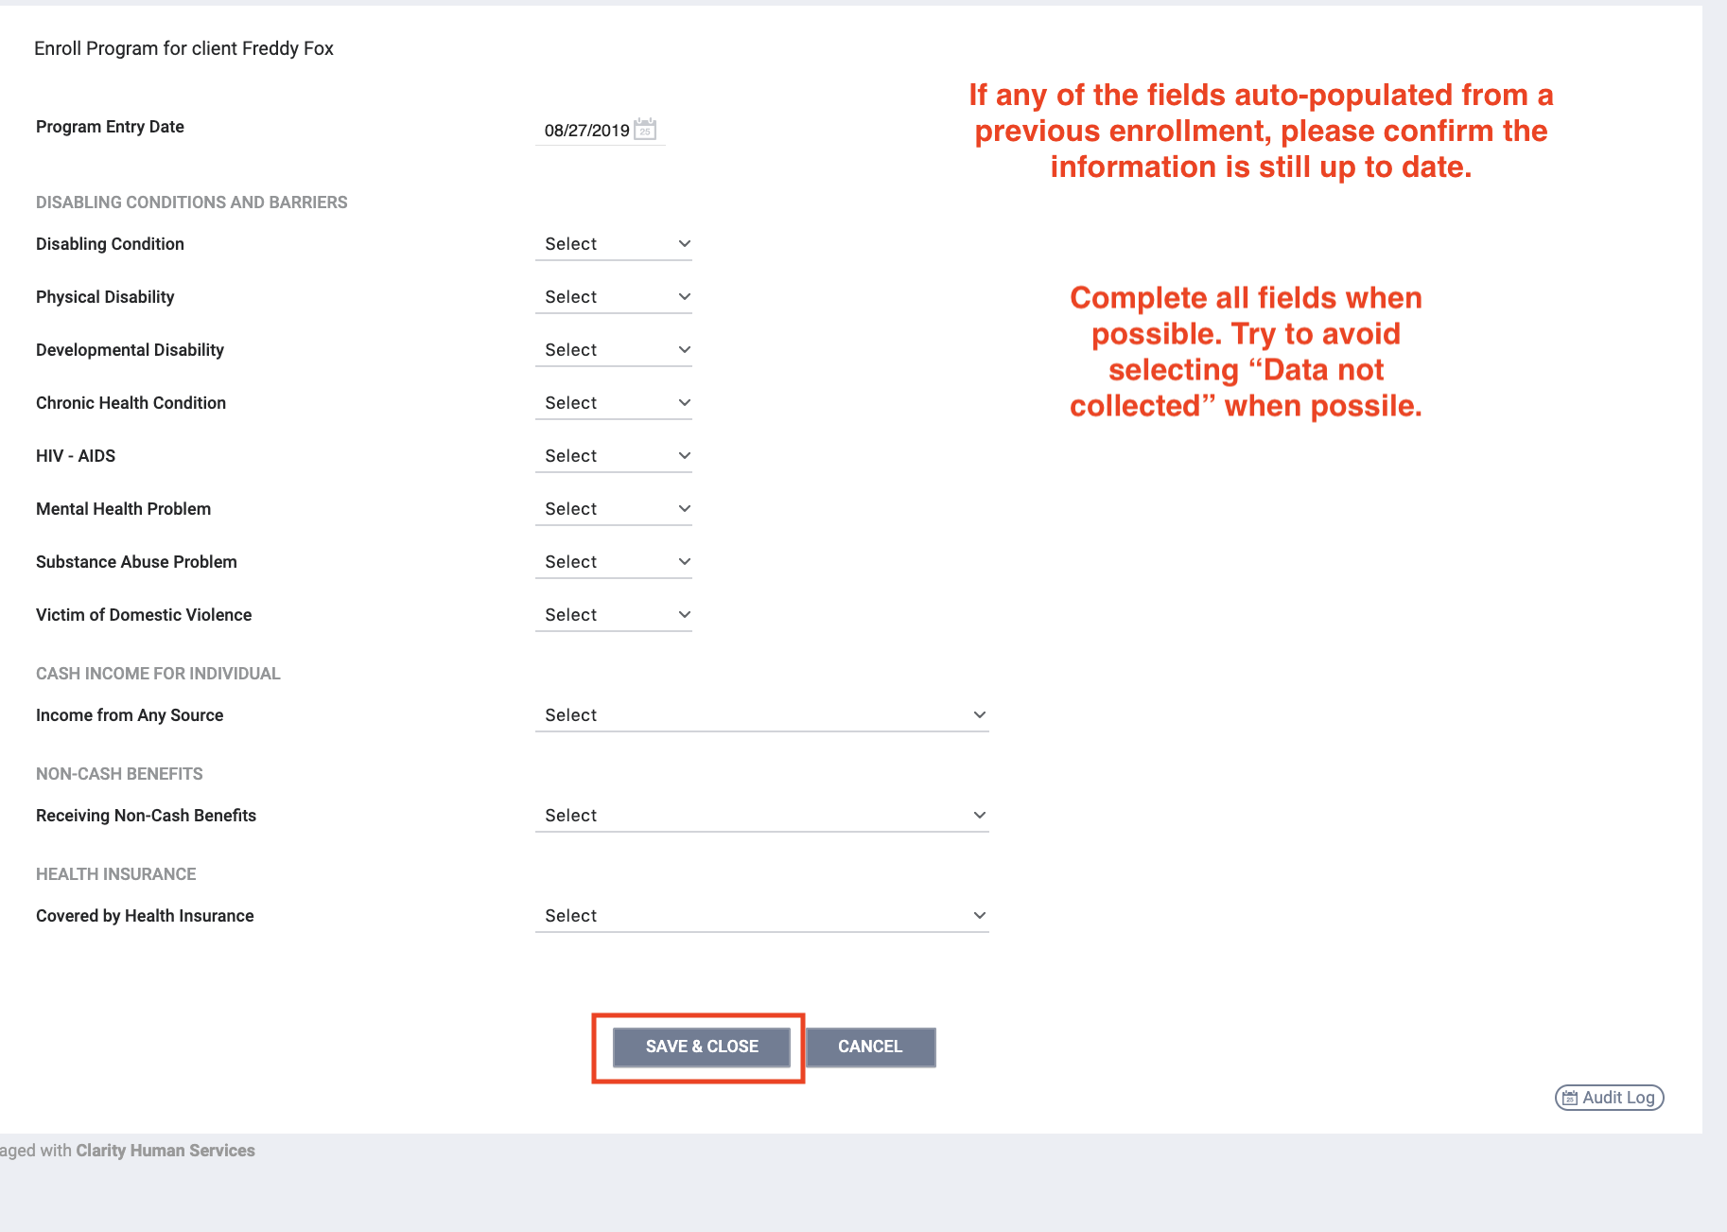
Coordinated Entry Enrollment

Slide 20
Current Living Situation

Slide 21
Current Living Situation (CLS)
*NEW* Required as part of the 2020 HUD Data Standards
Used to regularly document the following:
The current living situation of people experiencing homelessness
Homeless chronicity
When entered by shelter staff or outreach staff, it can be used as a homeless verification.

Slide 22
Current Living Situation
For Coordinated Entry, record a CLS anytime any of the following occurs:
Project Start (enrollment into CE program)
A CE Assessment or CE Event is recorded; or
The client’s living situation changes

Slide 23
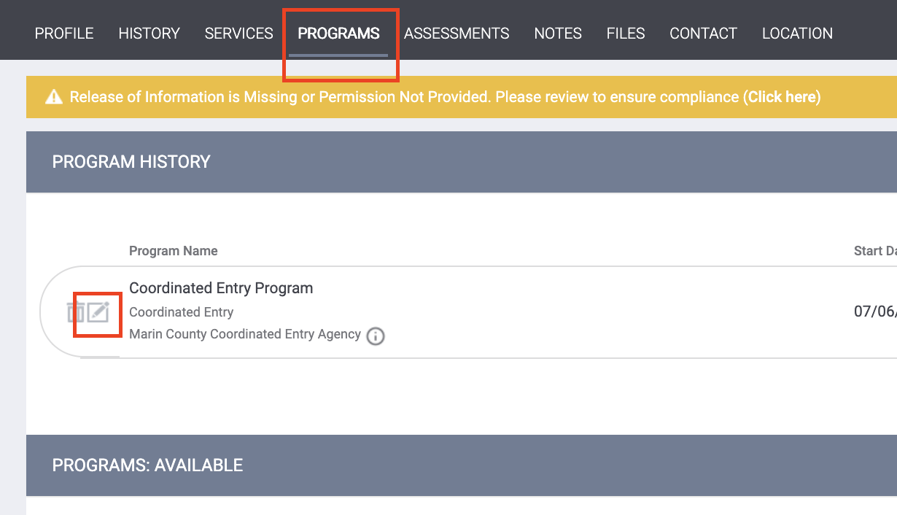
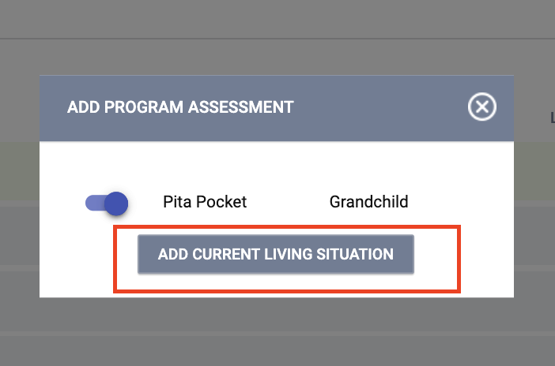
Current Living Situation Assessment

Slide 24
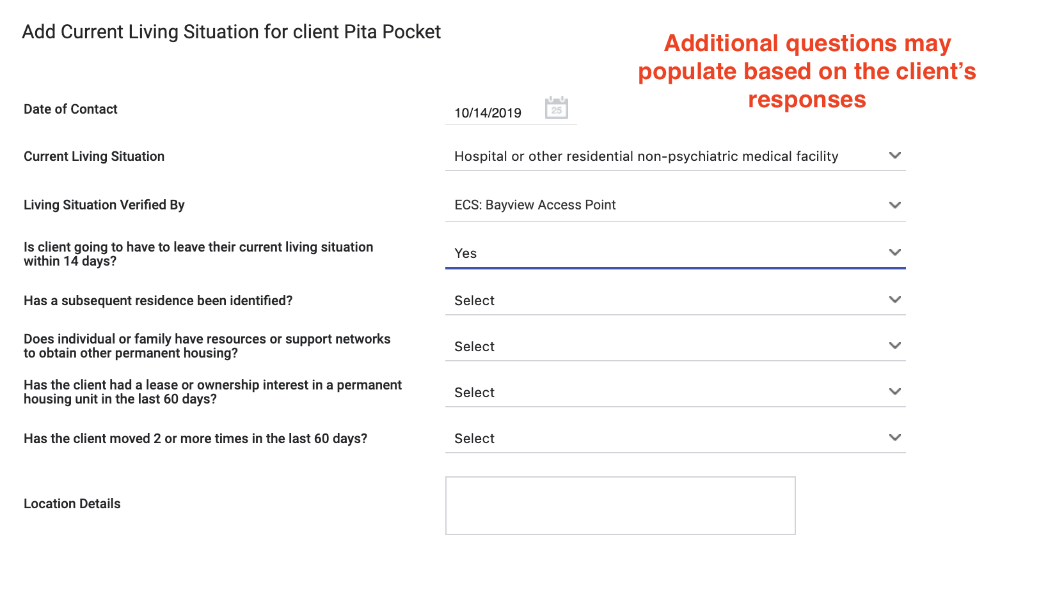
Current Living Situation Assessment

Slide 25
CE Assessment

Slide 26
CE Assessment
Evaluates a client’s possible health vulnerability, housing barriers, and homelessness chronicity
Determines prioritization for housing resources
Does NOT guarantee eligibility for a housing resource

Slide 27
CE Assessment
Prior to completing an assessment, check the client’s History or profile screen to see if they have already completed an assessment
If the client has been exited from CE, you need to re-enroll them prior to completing the assessment

Slide 28
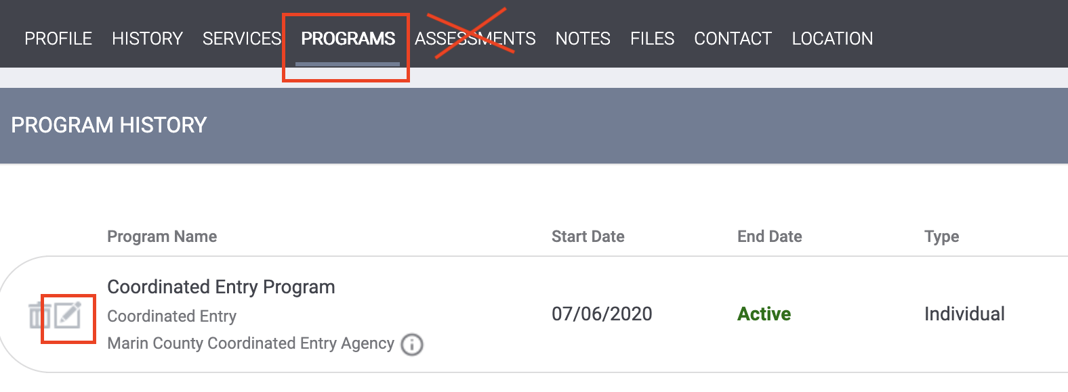
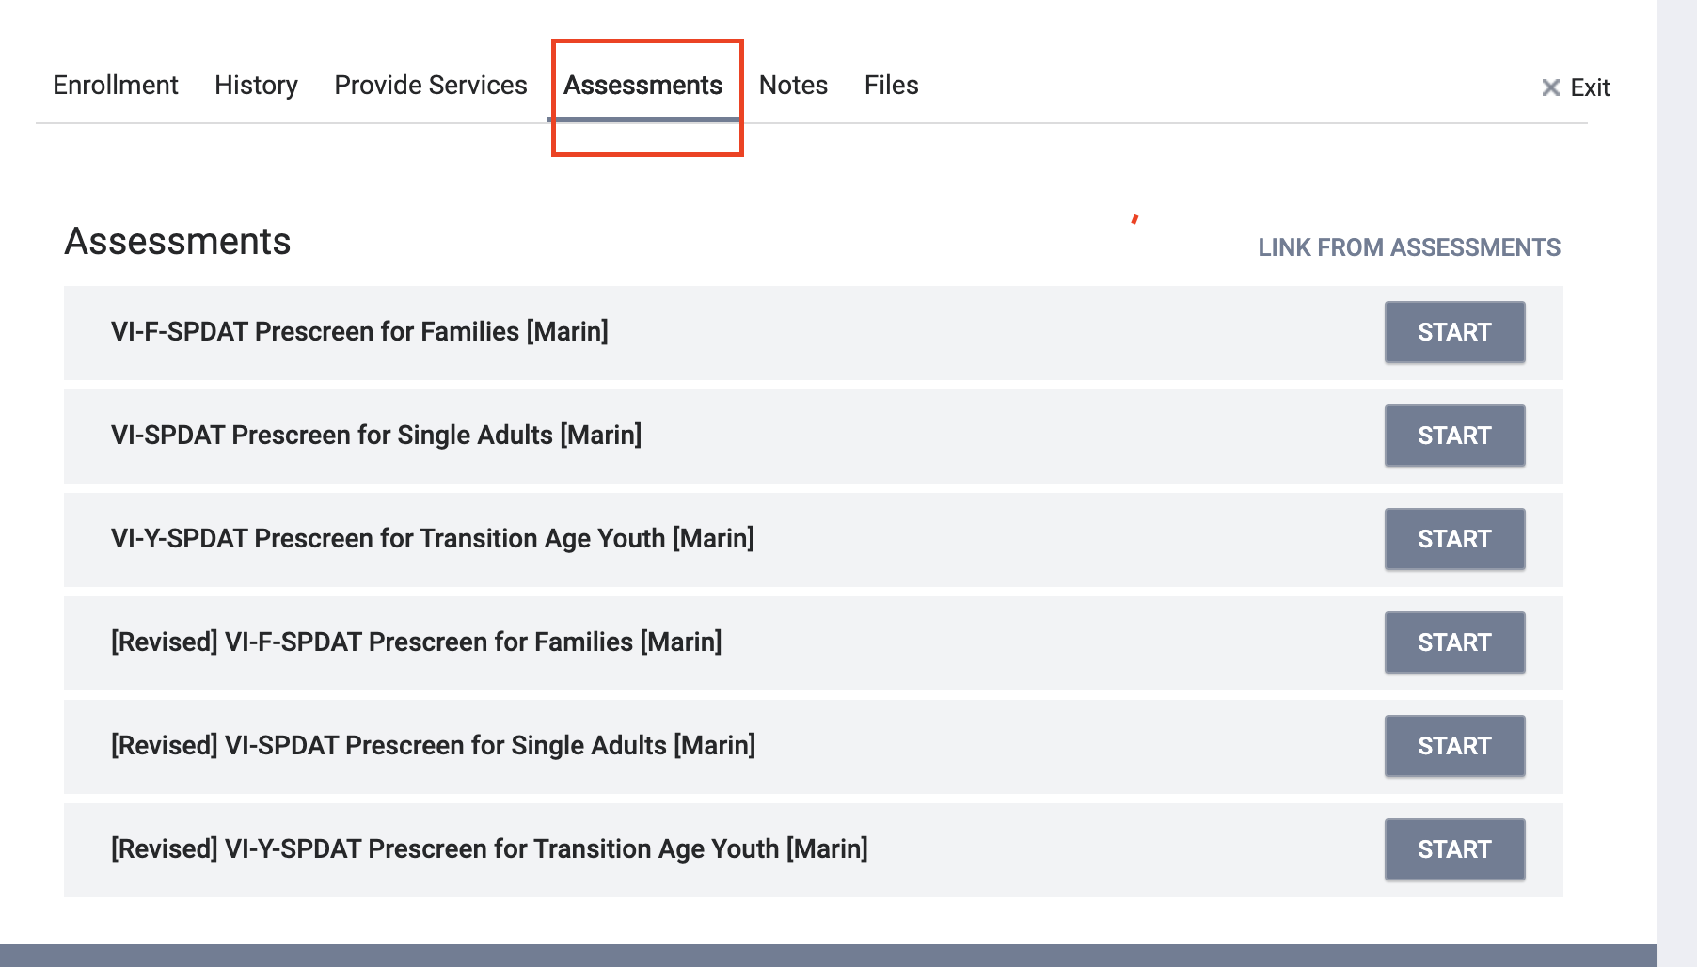
CE Assessment
*The assessment has not changed, it is just located in a new place

Slide 29
CE Assessment
*NEW* There are two new HUD 2020 Data Standards fields that will be on the CE Assessment
Location- this was updated to match the HUD standards
Assessment Type

Slide 30
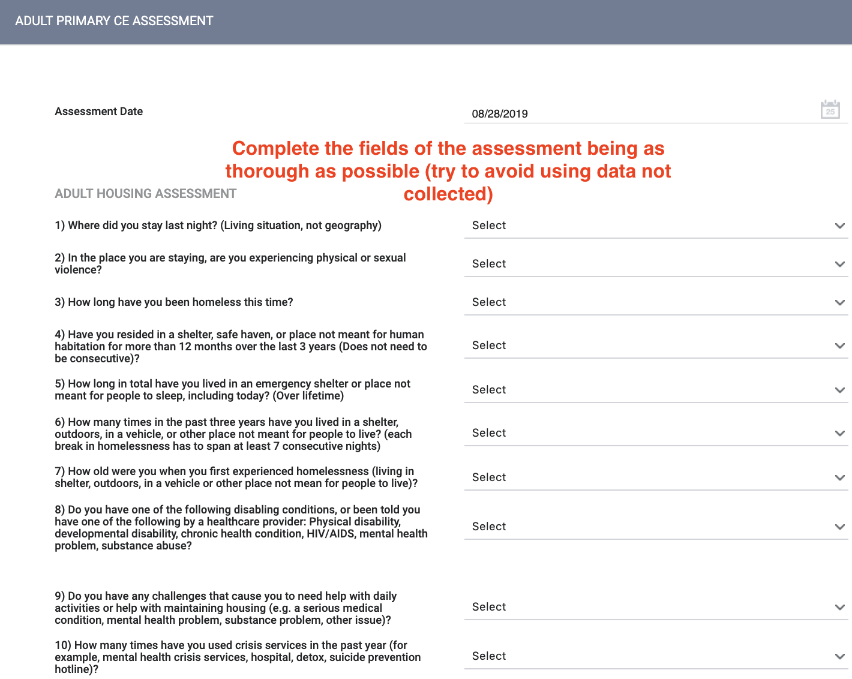
CE Assessment

Slide 31
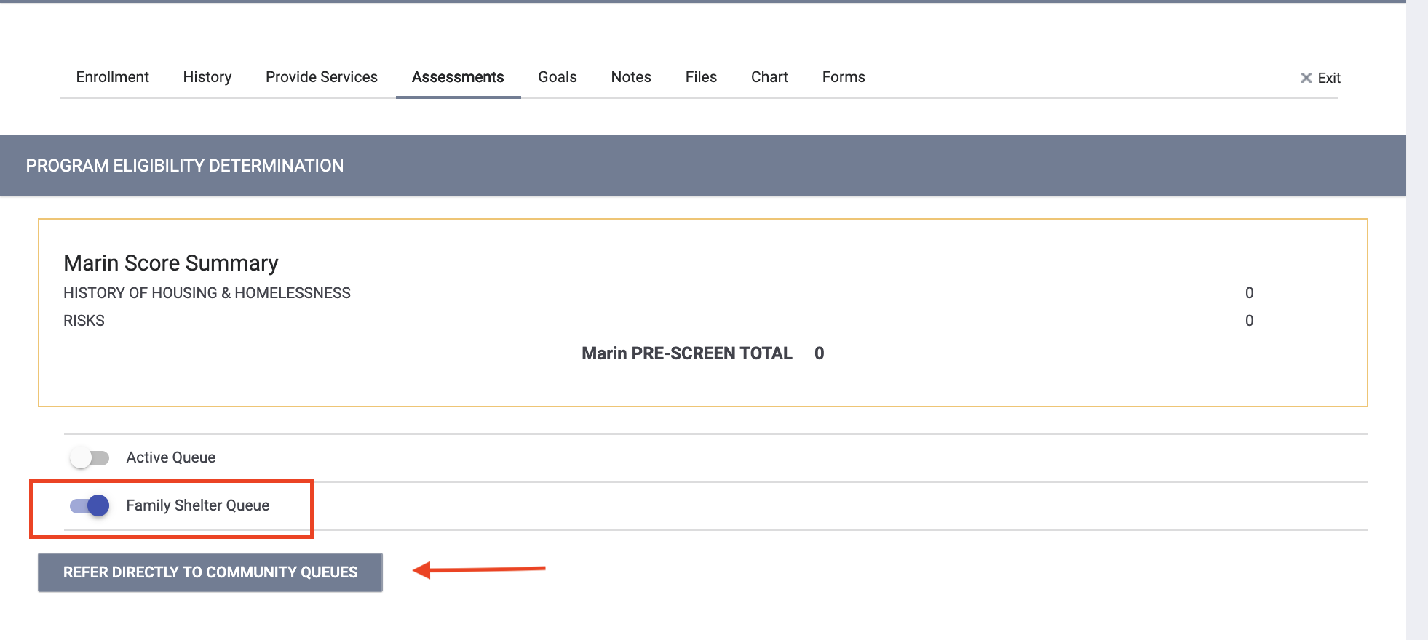
Referral to the Community Queue
Family Shelter ONLY
Families in need of shelter will be referred to the Family Housing Queue at the time of assessment
Permanent Housing/RRH
Clients will be referred to the Active List during case conferencing

Slide 32
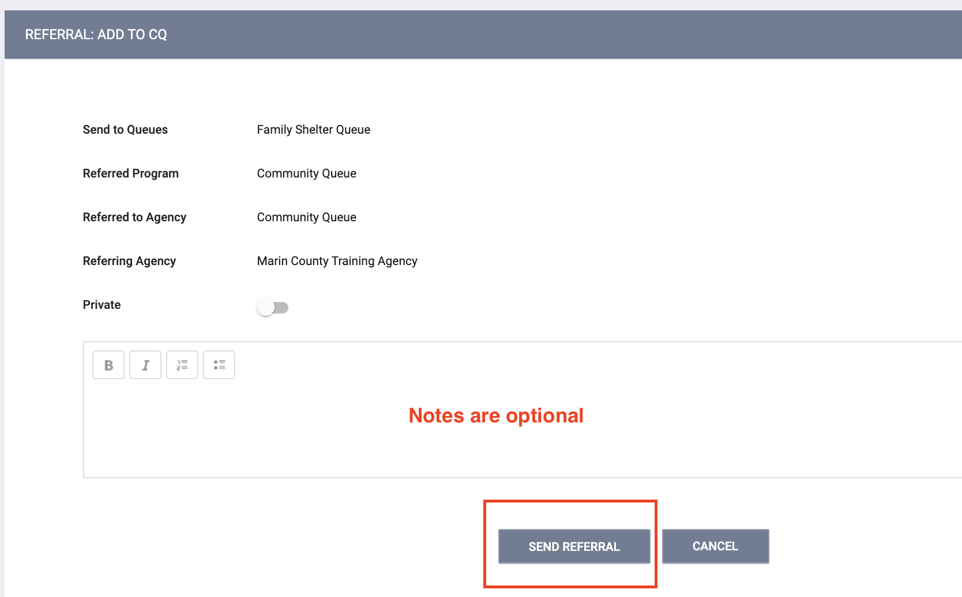
Referral to the Community Queue

Slide 33
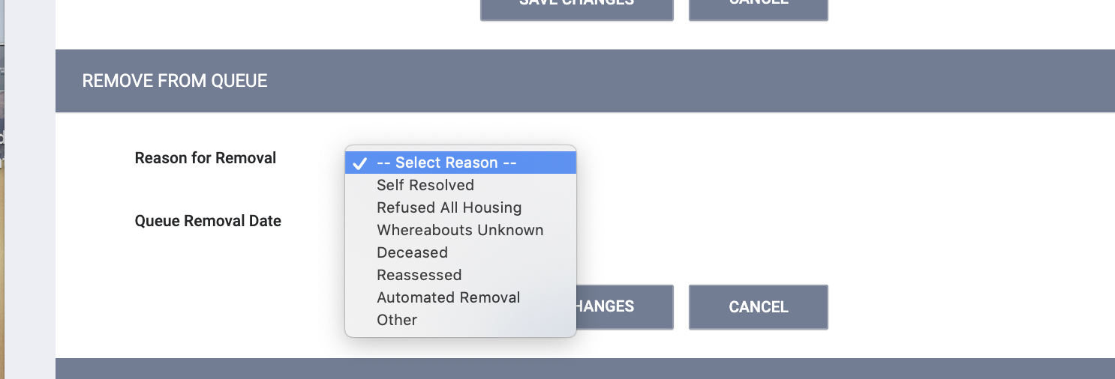
Referral to the Community Queue
Clients may removed from the queue if they self- resolve, pass away or referred by mistake

Slide 34
CE Events and Services

Slide 35
CE Event Services
*NEW* Required as part of the 2020 HUD Data Standards
Services set up under the CE agency/program are categorized as CE Events
*Remember* Every time a CE event is recorded, you must enter a Current Living Situation

Slide 36
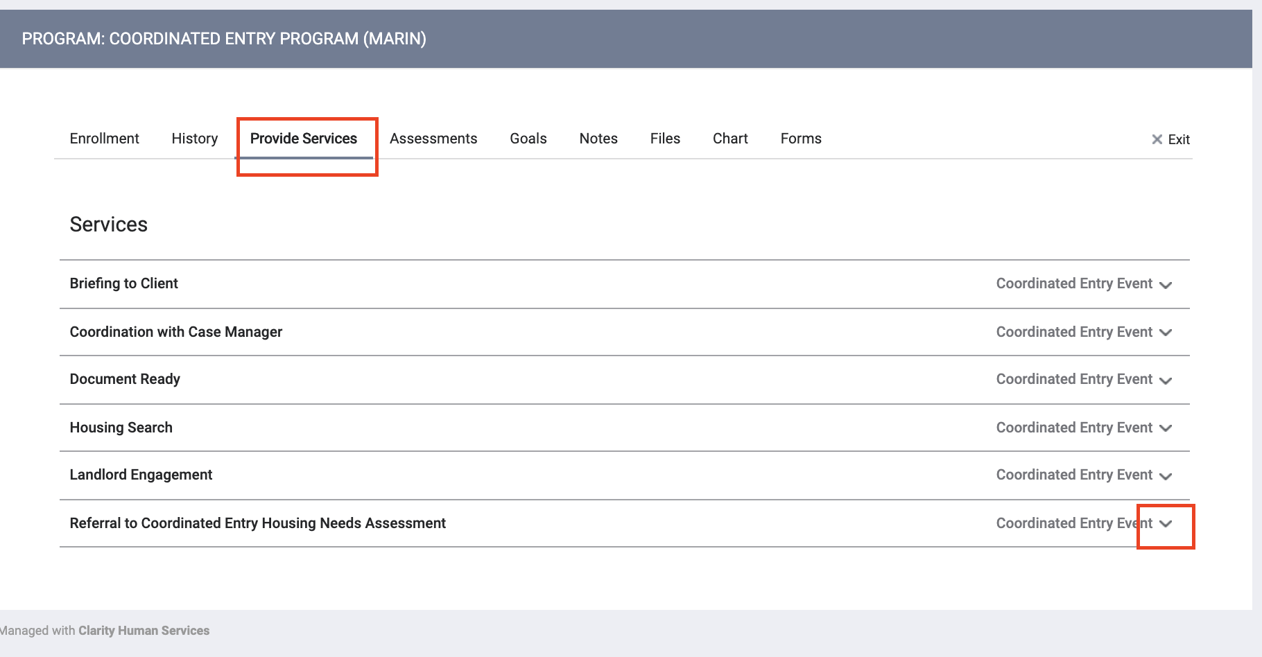
CE Event Services
“Referral to Housing Needs Assessment” service
Recorded every time you enter a CE Assessment

Slide 37
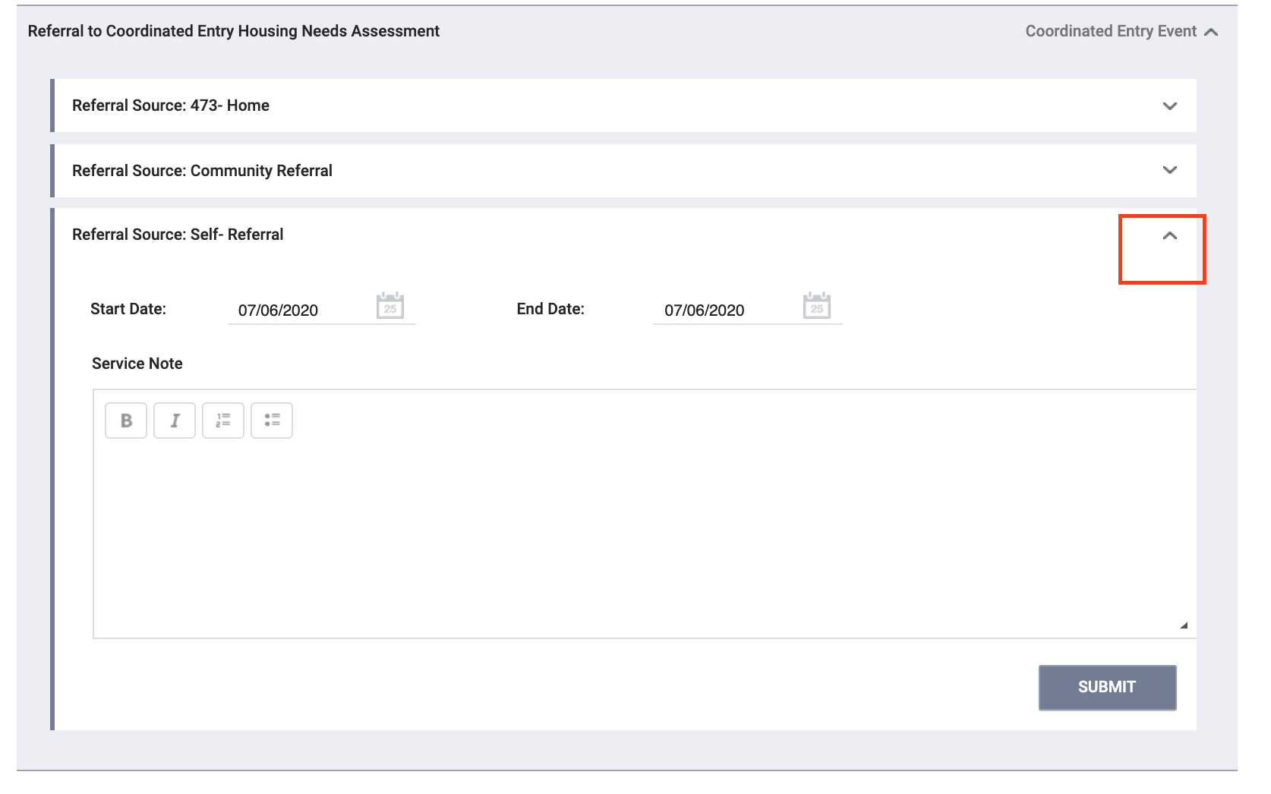
CE Event Services
Select the appropriate referral source

Slide 38
Uploading Documents

Slide 39
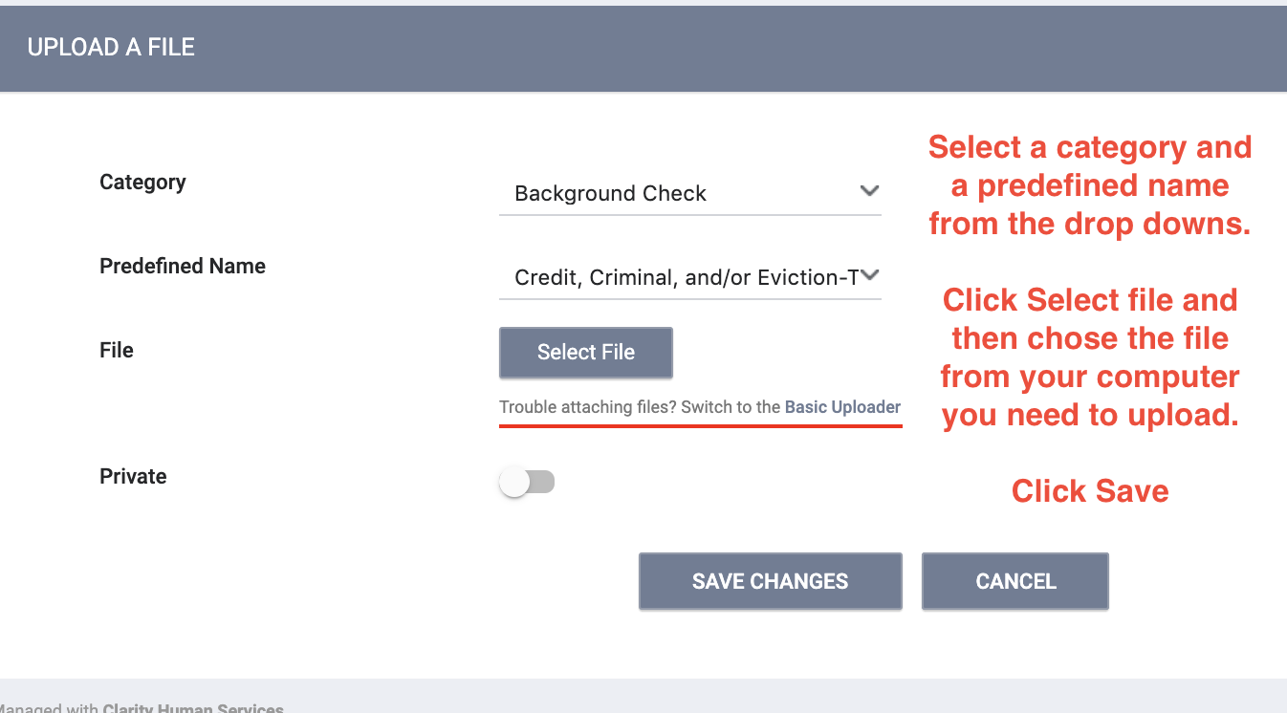
Uploading Documents

Slide 40
Exits

Slide 41
Exits
Assessor and Matchmaker staff are responsible for exiting clients from the CE program
Client should be exited from CE for the following reason:
The client has entered a permanent residential project type or is otherwise known to have found permanent housing
A client is automatically exited from CE when a client has a move-in date recorded or destination for a permanent housing destination
The client is known to have left the CoC to pursue other assistance
The client is deceased
Client has declined all services

Slide 42
Auto-Exits from CE when Housed
Auto-exits from CE happen when a client has a move-in date recorded or destination for a permanent housing destination
Example 1:
The client is referred to Fireside. The client is enrolled in the program with a move-in date of 7/30/20.
Auto-Exit from CE= YES
Example 2:
The client informs their case manager they are going to live with their aunt in Oregon.
The client needs to be manualled exited from CE.
Auto-Exit=NO

Slide 43
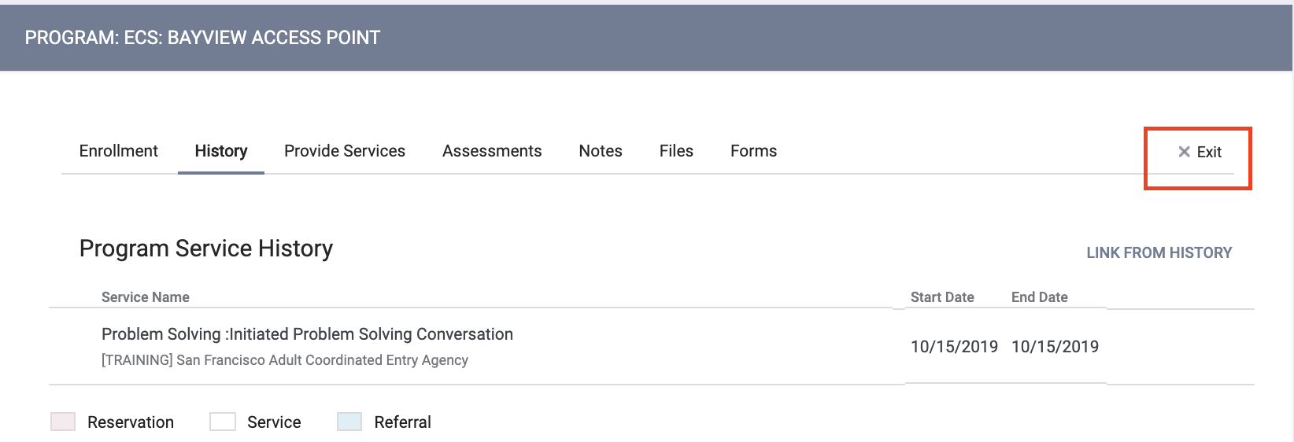
Exits

Slide 44
Recap of CE Data Standards Elements
Enrollment
Current Living Situation
CE Assessment (VI-SPDAT)
Referral to queue (Family Shelter only)
CE Event Services

Slide 45
Remember...
A Current Living Situation must be recorded when you:
Enroll the client
Enter a VI-SPDAT
Enter a Referral: Housing Needs Assessment Service

Slide 46
Referral Statistics Report
[RFRL-101] Referral Statistics (Community and Referral Reports)
Who’s been referred
Inbound vs. outbound
Number of referrals received by an agency
Status of referrals

Slide 47
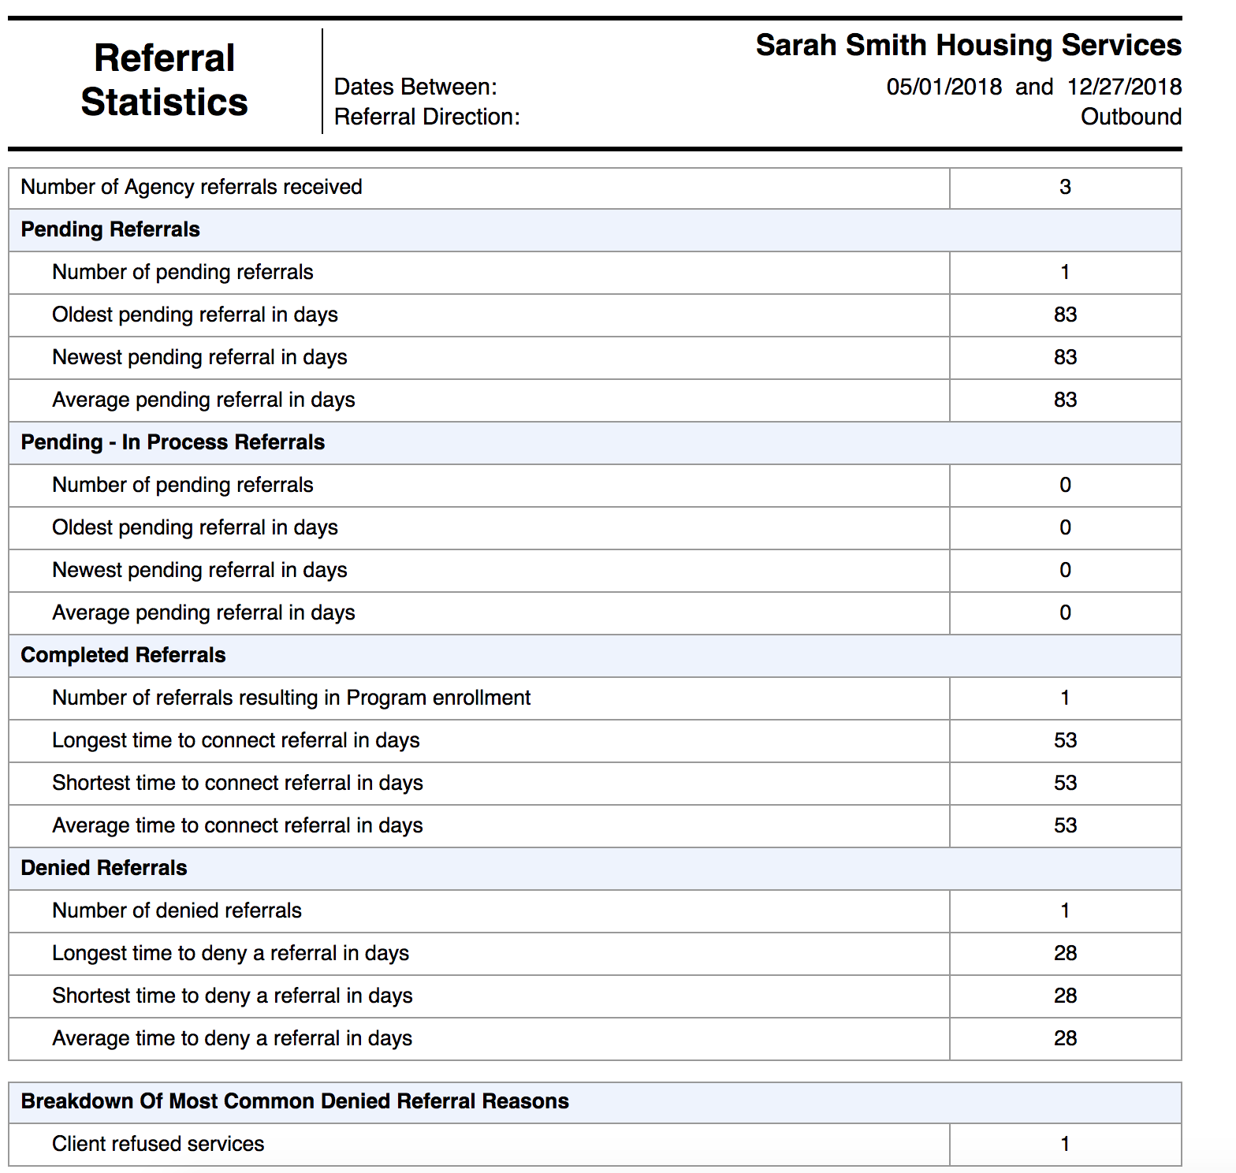
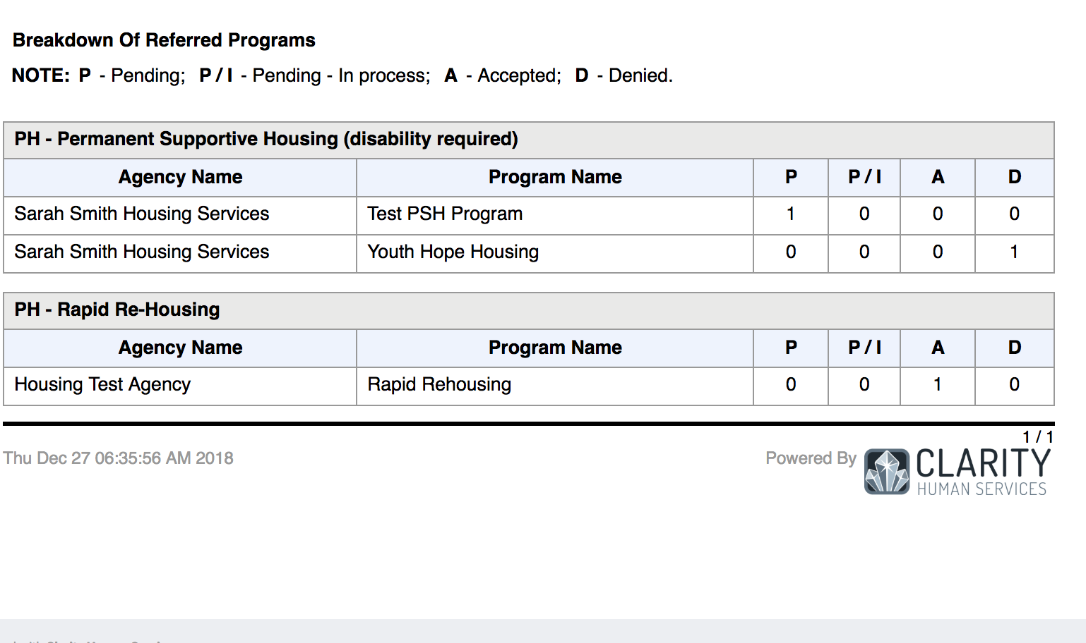
Referral Statistics Report

Slide 48
Program Roster
[GNRL-106] Program Roster (Program Based Report)
Who’s stayed in the program
Lists program stay information for clients with the selected status in the selected program

Slide 49
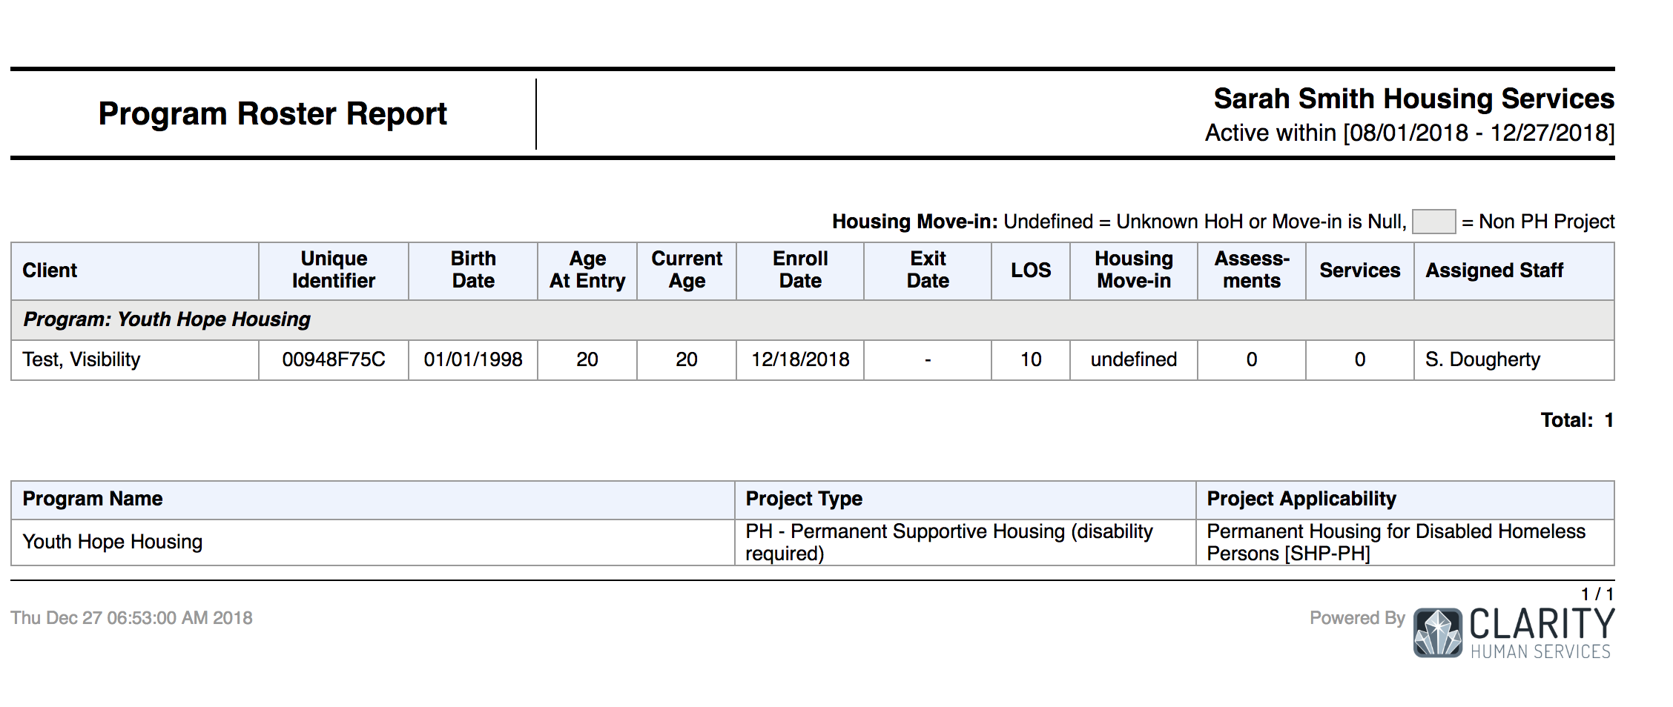
Program Roster

Slide 50
Reports
New and updated Coordinated Entry report coming soon!!!!

Slide 51
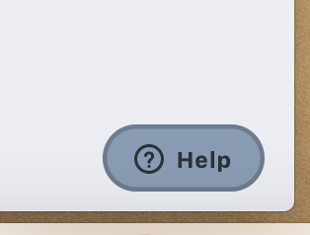
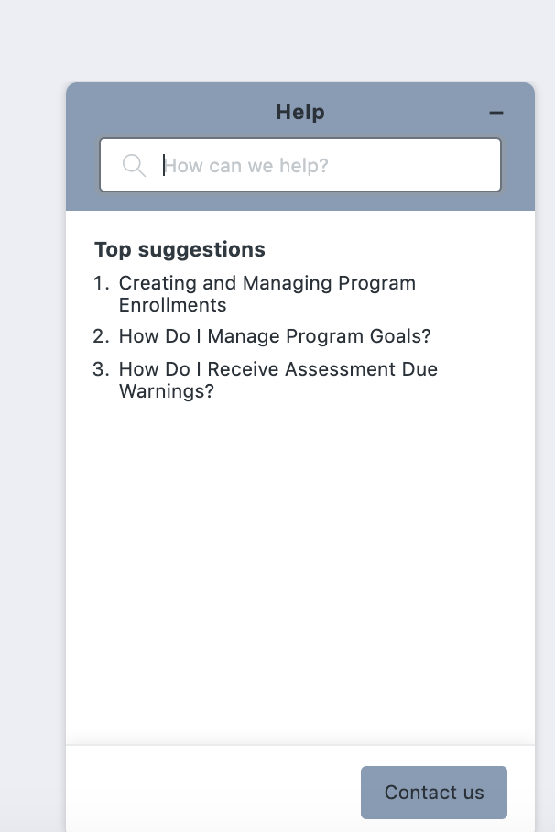
Resources
The Help Desk Widget
Bitfocus Help Desk
marin@bitfocus.com or (415) 429-4211
Marin Help Center Web Page
https://marin.clarityhs.help/hc/en-us
Coordinated Entry Training Materials
https://marin.clarityhs.help/hc/en-us/articles/360052218714

