Slide 1
Coordinated Entry: Family Shelter Training
Marin County

Slide 2
Agenda
In today’s training, you will learn how to
Complete the Family Shelter Screening
Refer a family from the Family Shelter Queue to the family shelter program
Process a referral by
Changing a referral from pending to pending in-process
Denying a referral
Accepting a referral by enrolling the client

Slide 3
How to know who is on the Shelter Queue

Slide 4
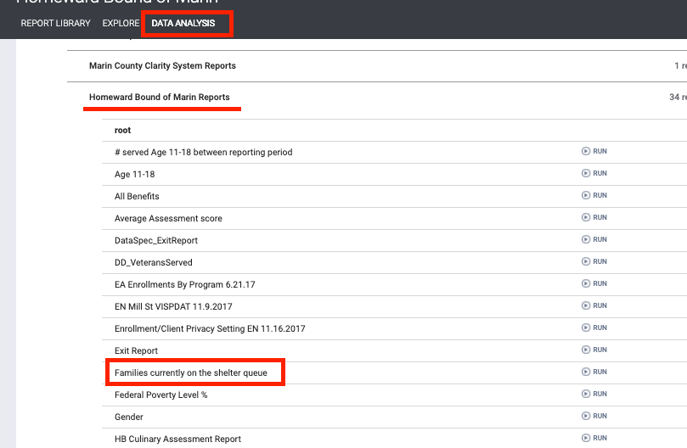
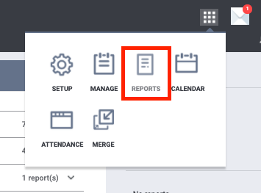
Families on the Shelter Queue Report
The Families on the Shelter Queue report will help you identify new families on the queue
The report can be accessed under the Data Analysis tab
Notes:
Note that this list has fewer clients than what you see on the queue. People have been adding adults to the family queue

Slide 5
Completing the Family Shelter Screening

Slide 6
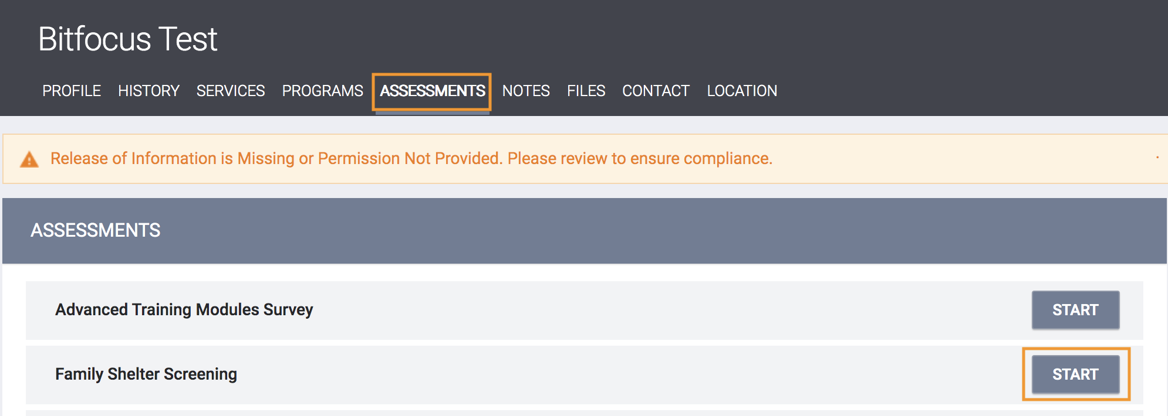
Family Shelter Screening
All families will be screened using the Family Shelter Screening
This assessment will be added as a stand alone assessment under HBOM
It is not added to the Coordinated Entry enrollment
Navigate to the head of household’s profile, click on the Assessments tab
Click Start next to the Family Shelter Screening

Slide 7
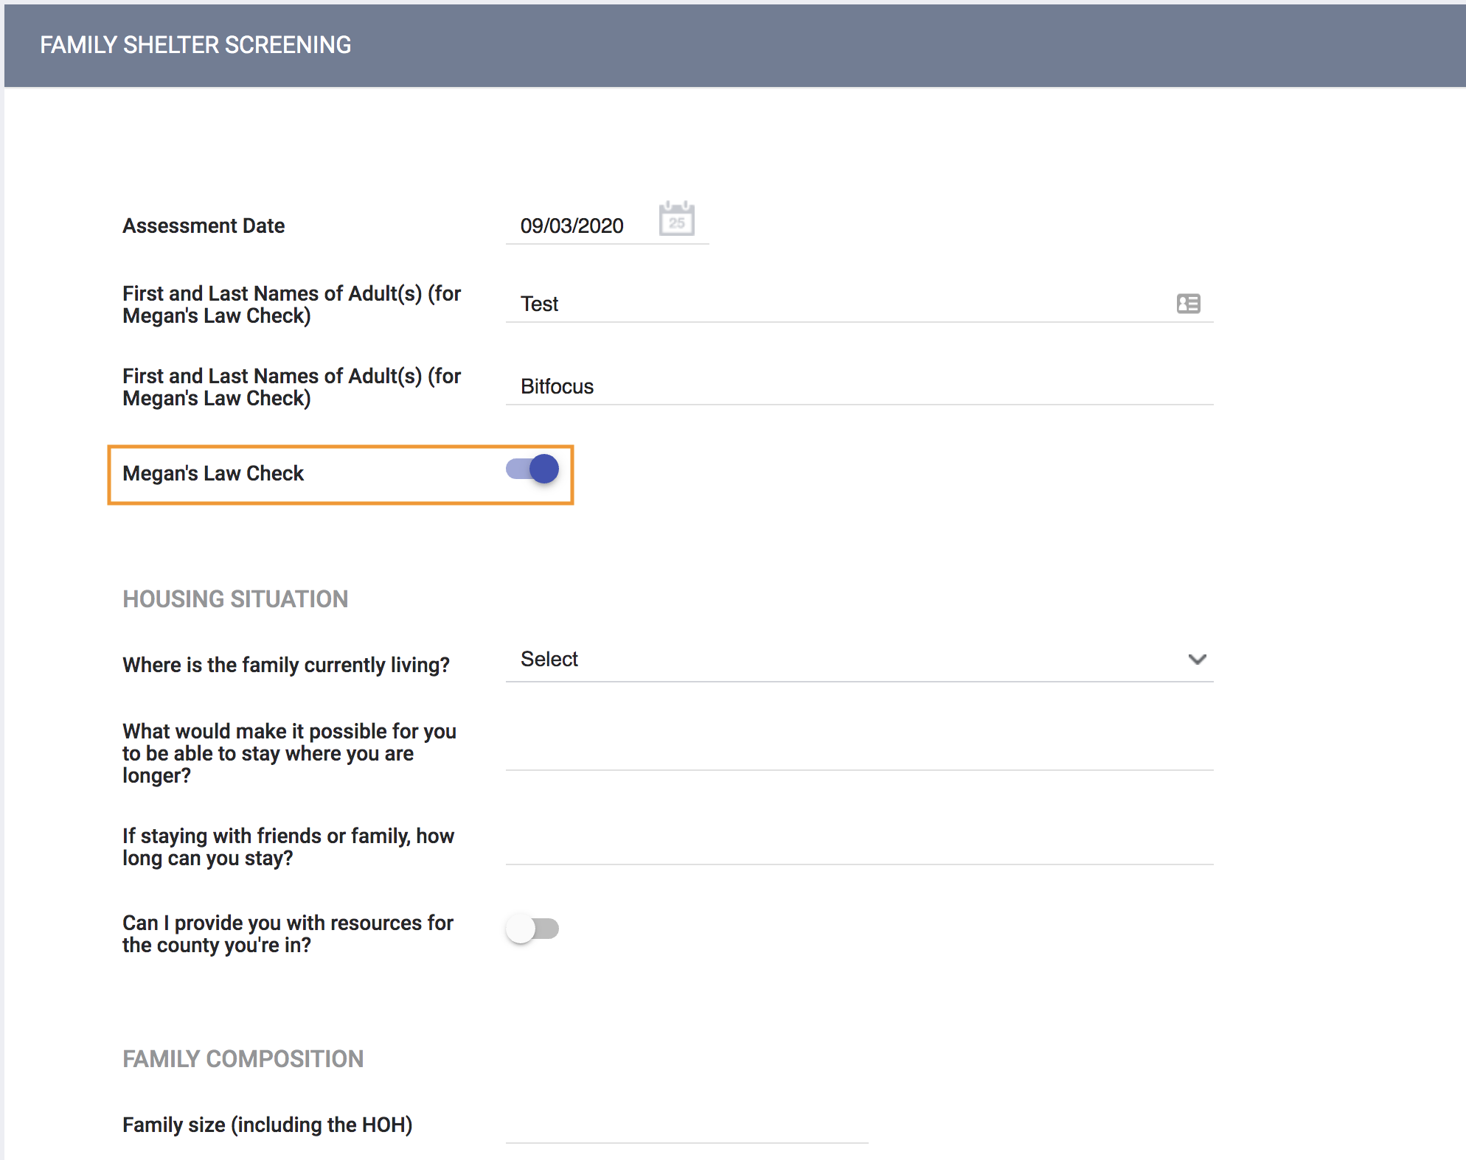
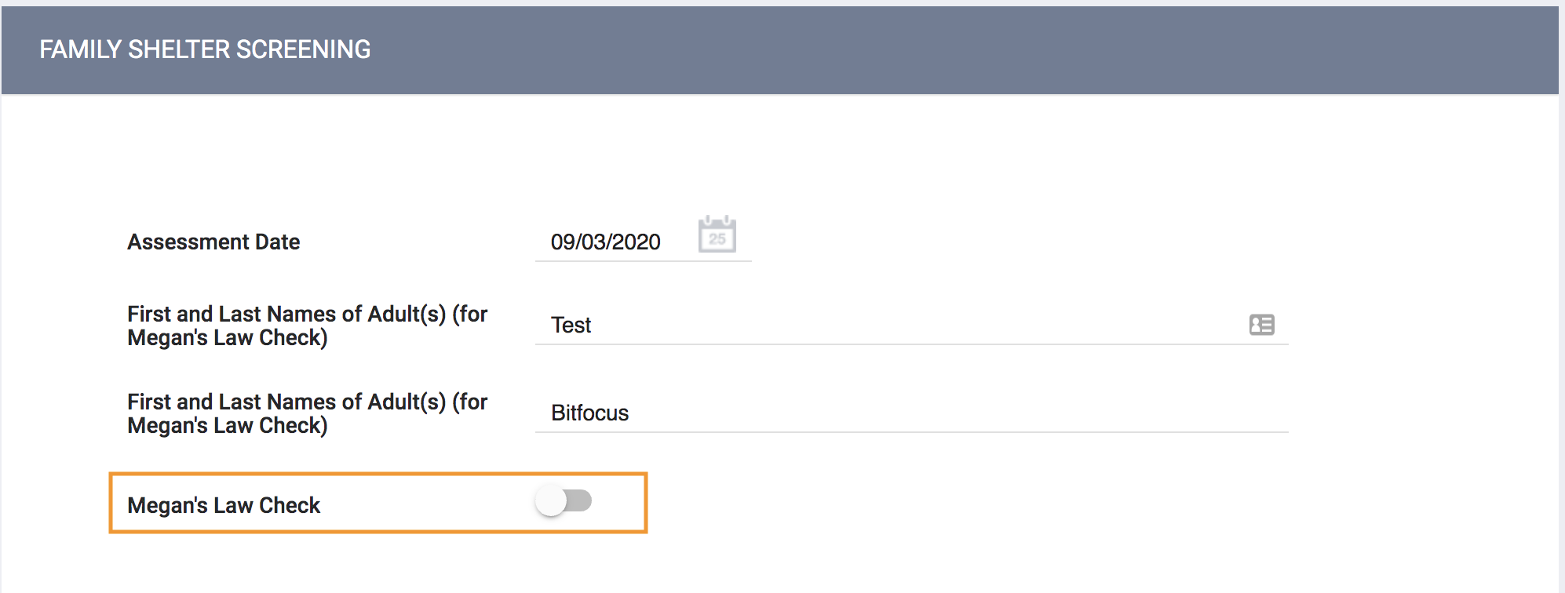
Family Shelter Screening
Complete the Family Shelter Assessment
Once the adult/s name/s have been checked against the Megan’s Law database, and the toggle is moved, the rest of the assessment will appear.
Click Save at the bottom when you are done

Slide 8
Referring a Client from the Family Shelter Queue

Slide 9
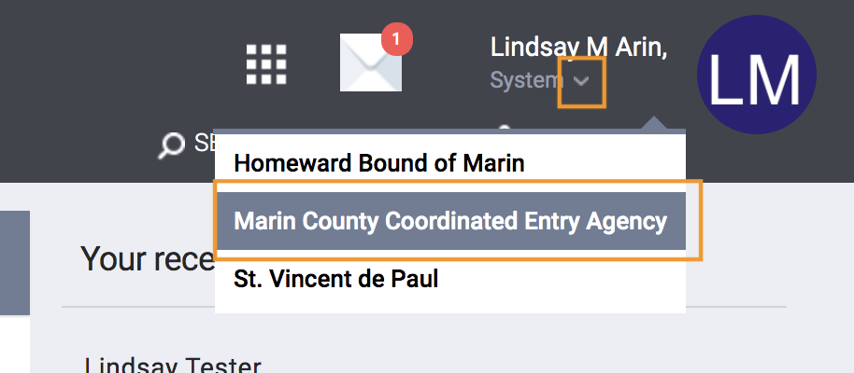
Family Shelter Queue
Before Navigating to the Family Shelter Queue, you will need to first switch under the Marin Coordinated Entry Agency
Click on the drop down arrow below your name in the top right corner
Select Marin Coordinated Entry Agency from the list
You are now ready to go to the Referrals tab
Notes:
Switch to CE agency
Go to CQ

Slide 10
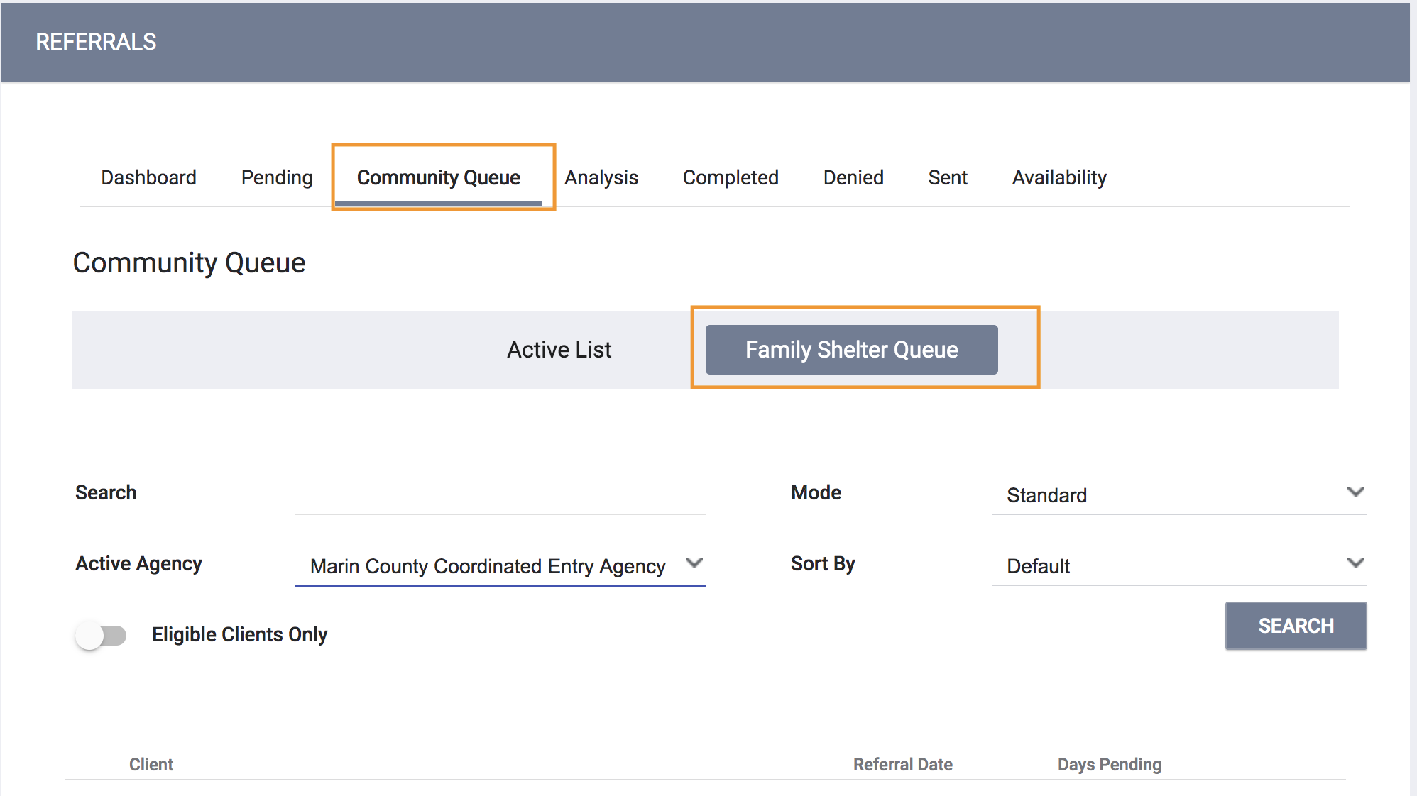
Family Shelter Queue
Click on the Referrals Tab
Click on the Community Queue tab
The name that is highlighted in blue is the queue that you are viewing. If you’re viewing the wrong list, just click on the list you want to be viewing.
Make sure Family Shelter Queue is the one that is highlighted

Slide 11
Family Shelter Queue
From the Family Shelter Queue, you can see a list of families (heads of household) who have been referred for family shelter
Search - Client Name, UI, SSN
Mode - Assessment Type (e.g. VI-SPDAT Prescreen for Families [V2])
Active Agency - the agency you want to send a referral to
Notes:
Search by mode- important to only pull in families
Enter client ID

Slide 12
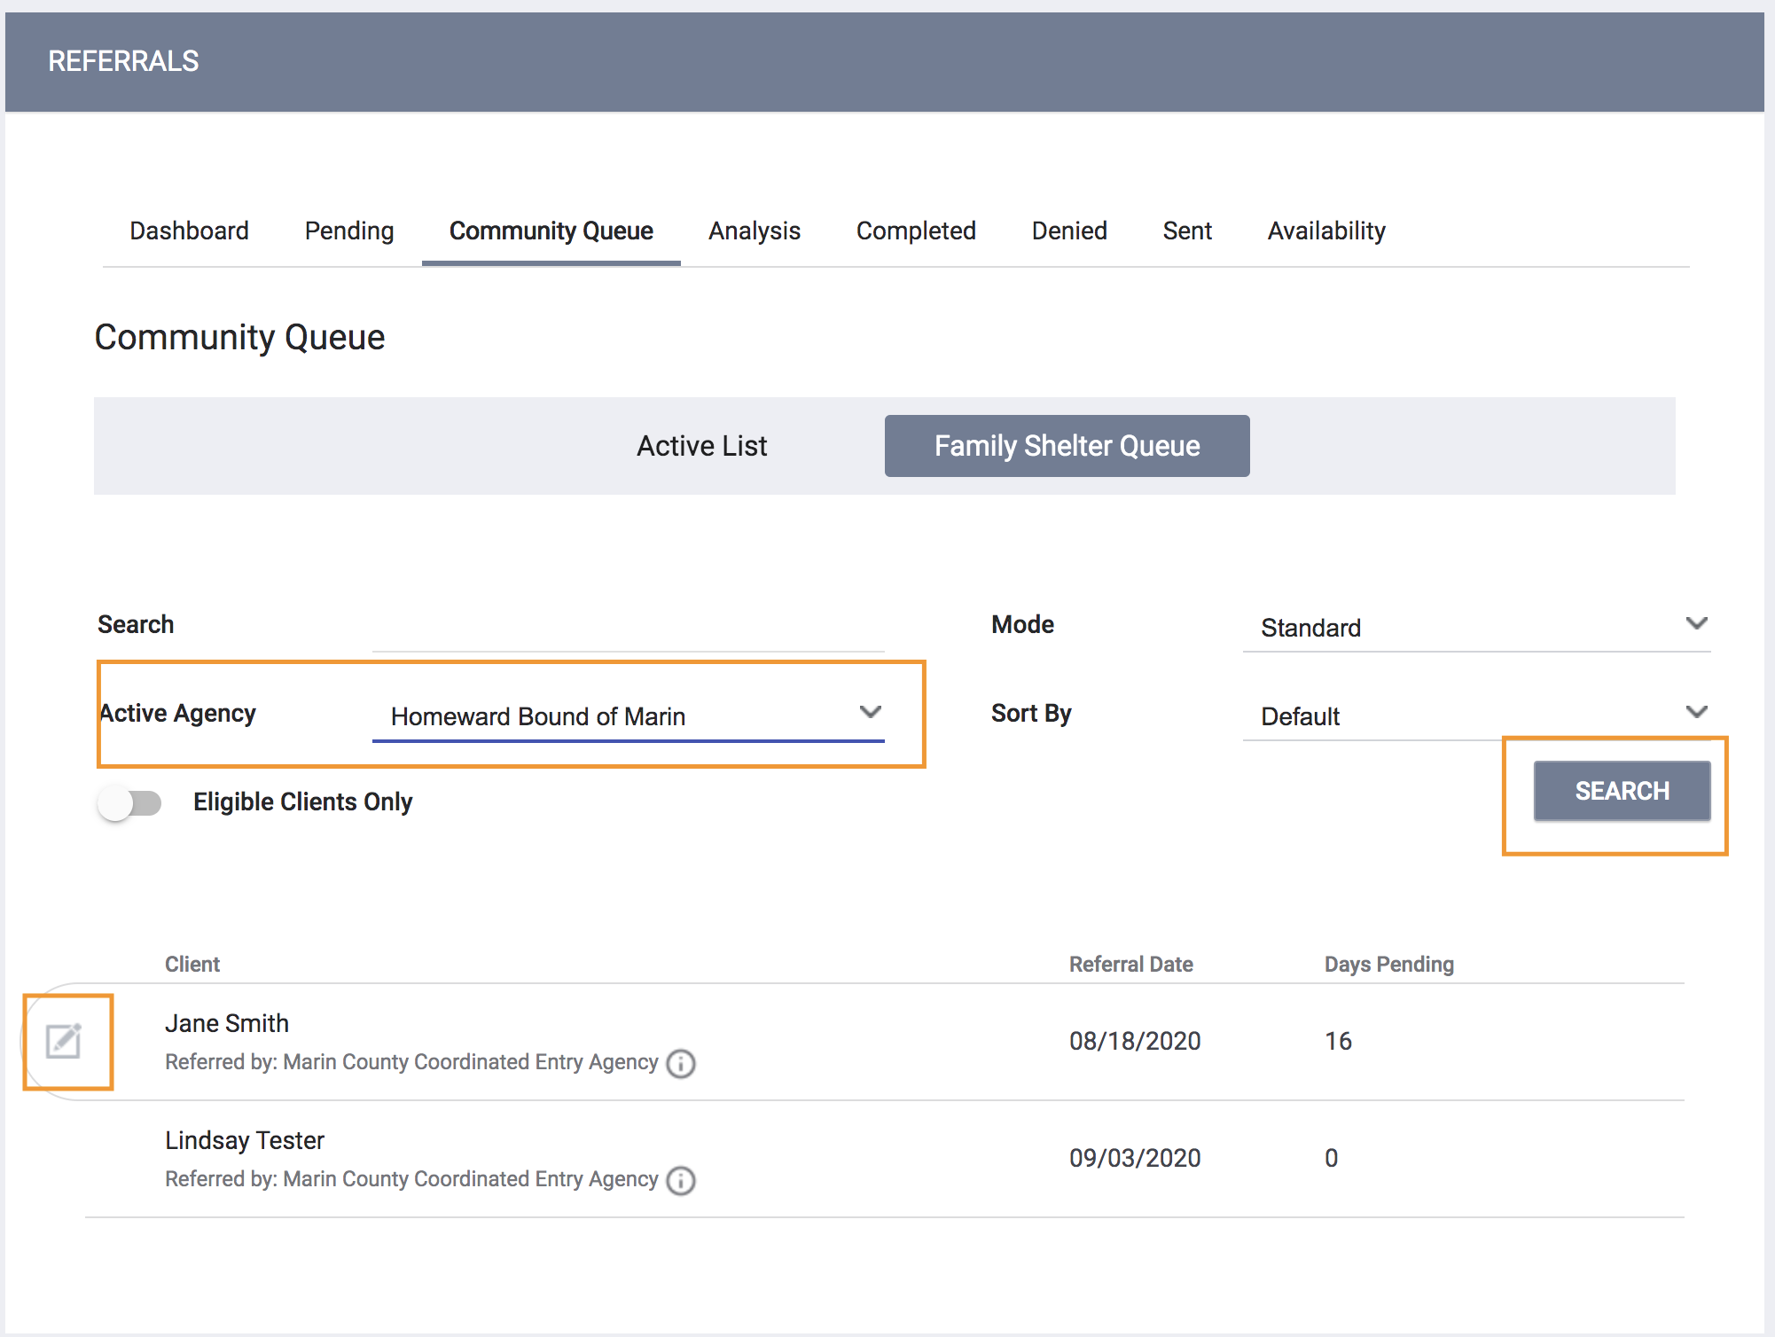
Family Shelter Queue
From this list, find the client you wish to refer
Hover your mouse to the left and click the pencil to edit the referral

Slide 13
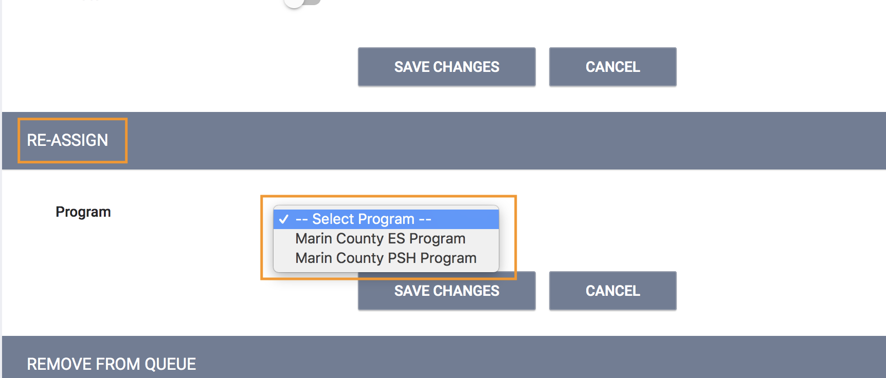
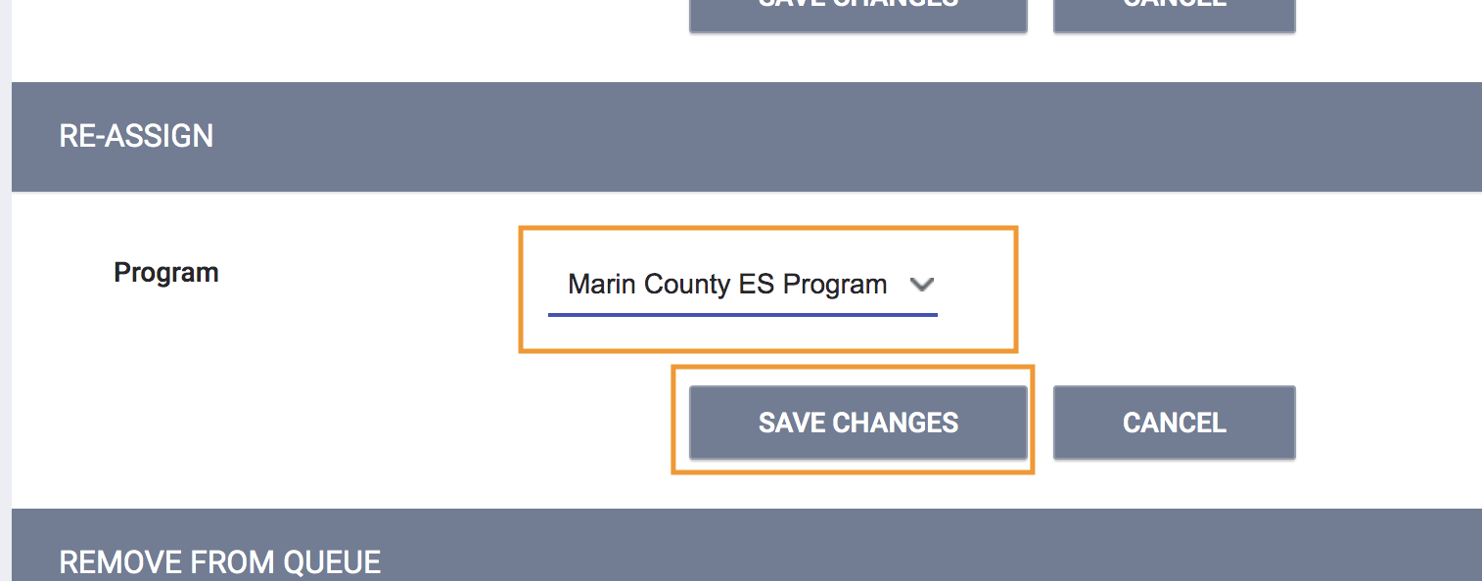
Family Shelter Queue
From the referral, scroll down to the Re-assign section
Select the program you wish to refer the client to
Click Save Changes
Notes:
No penings- just refer to the program

Slide 14
Processing a Referral

Slide 15
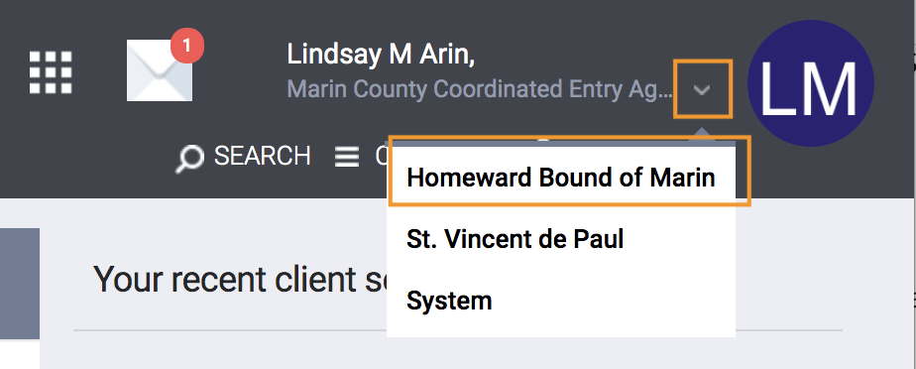
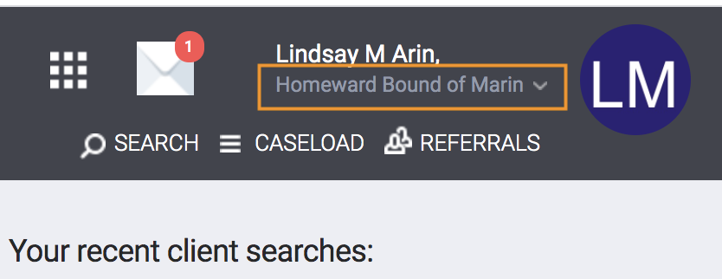
Processing a Referral
Before processing a referral, you will need to be logged in under Homeward Bound of Marin
If not already logged in under HBOM, Click on the drop down arrow below your name in the top right corner
Select Homeward Bound of Marin from the list
You are now ready to go to process the referral
Notes:
Change back to HBOM agency

Slide 16
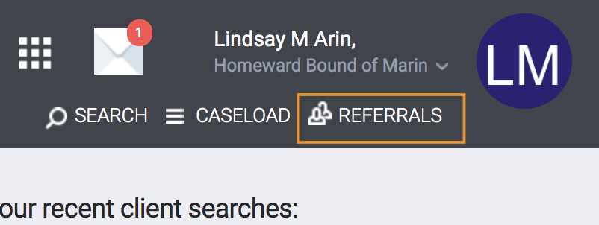
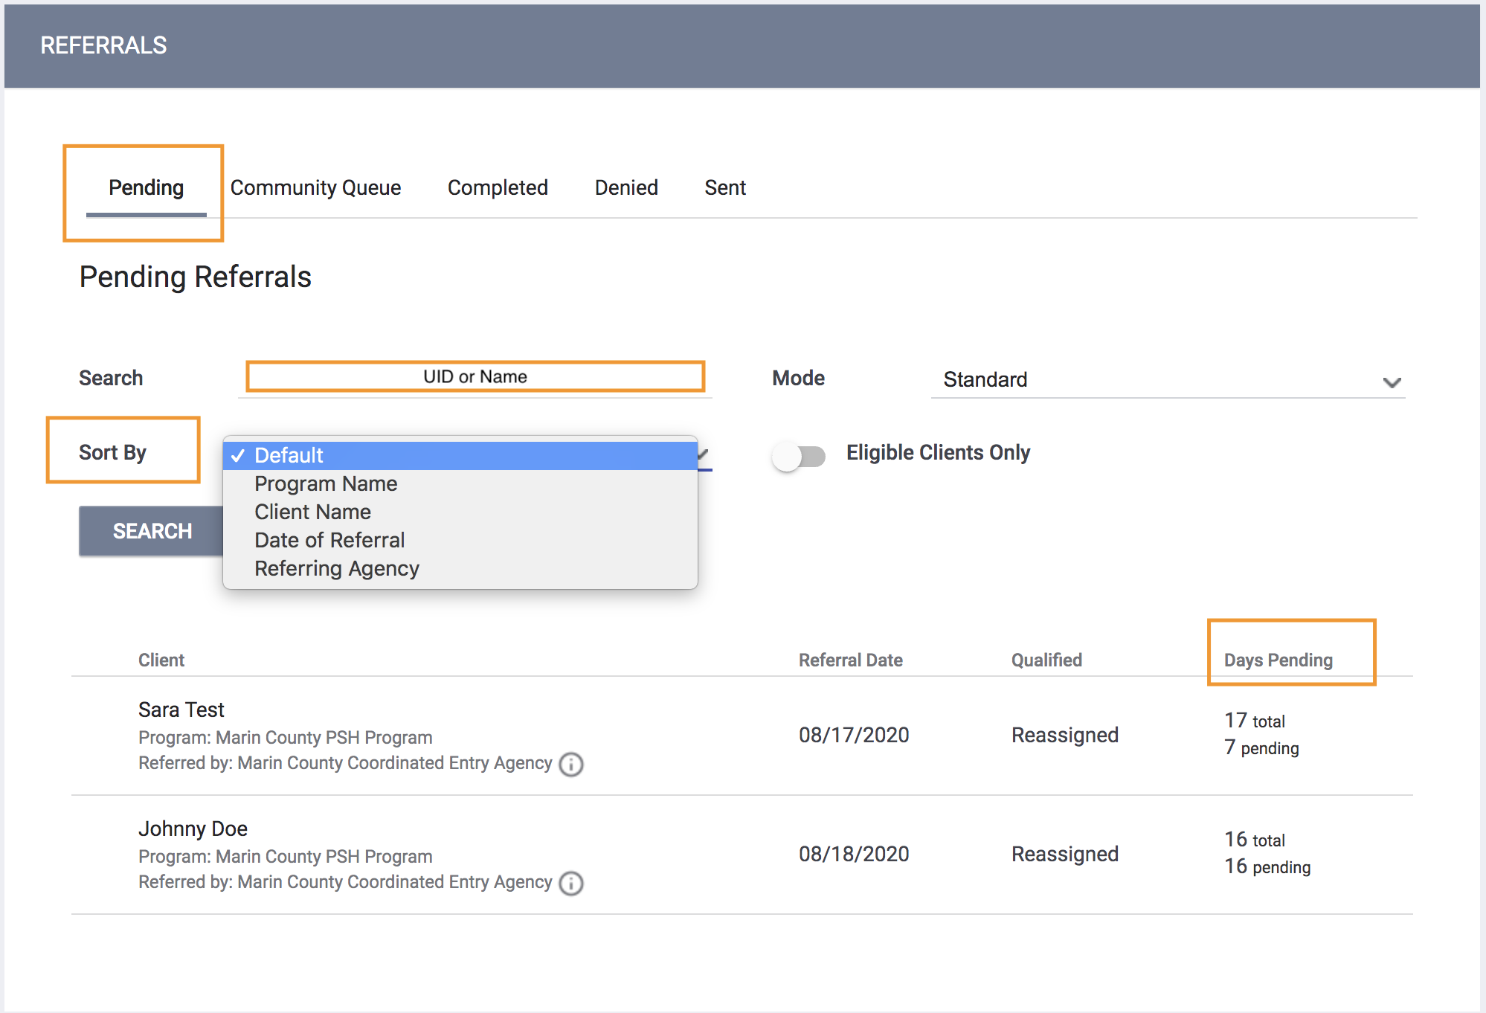
Processing a Referral
Navigate to the Pending tab by clicking the Referrals tab in the top right section under your name
It will automatically sort the clients by Days Pending
There are different sort options you can select
You can also search for clients by name or UID
White= status hasn’t’ been changed
Green= status in pending I/P

Slide 17
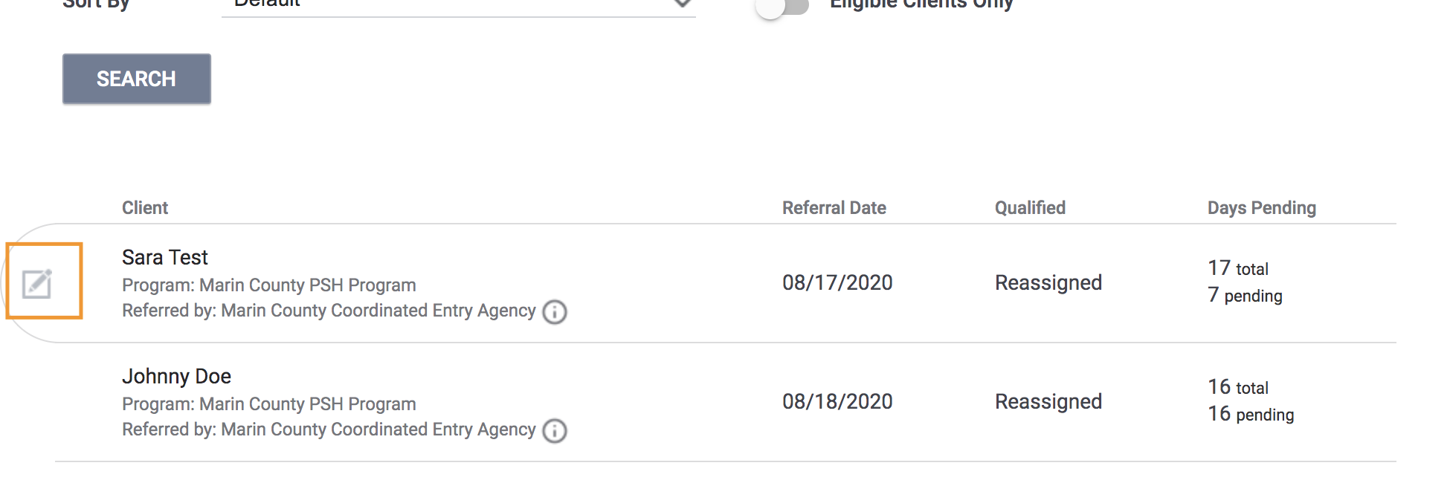
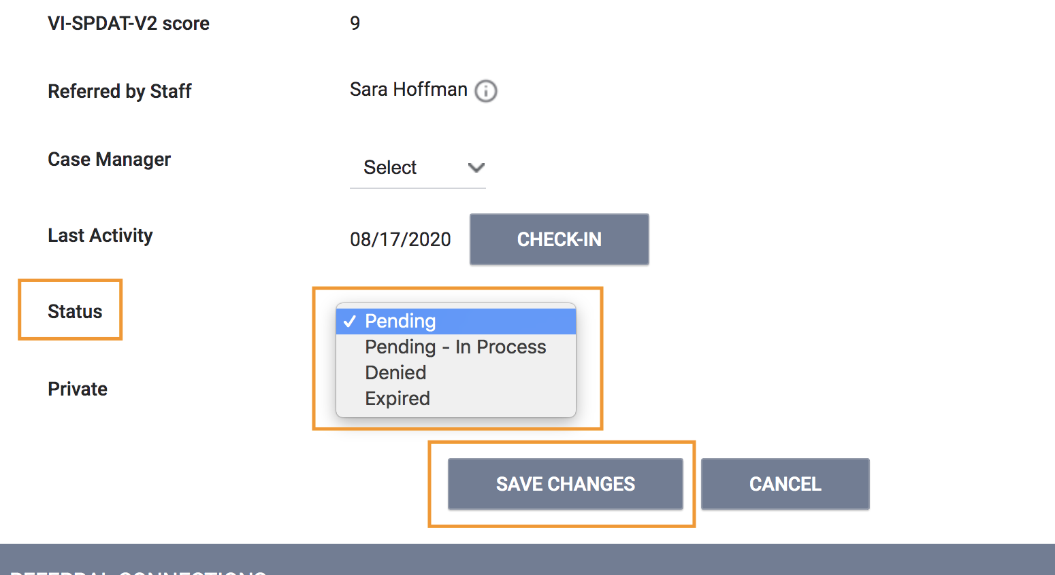
Processing a Referral
From this list, find the referral you wish to process
Hover your mouse to the left and click the pencil to edit the referral
Once inside the referral, scroll down until you see Status
Pending In-Process - these are referrals HBOM is processing
Denied - referrals HBOM is not accepting

Slide 18
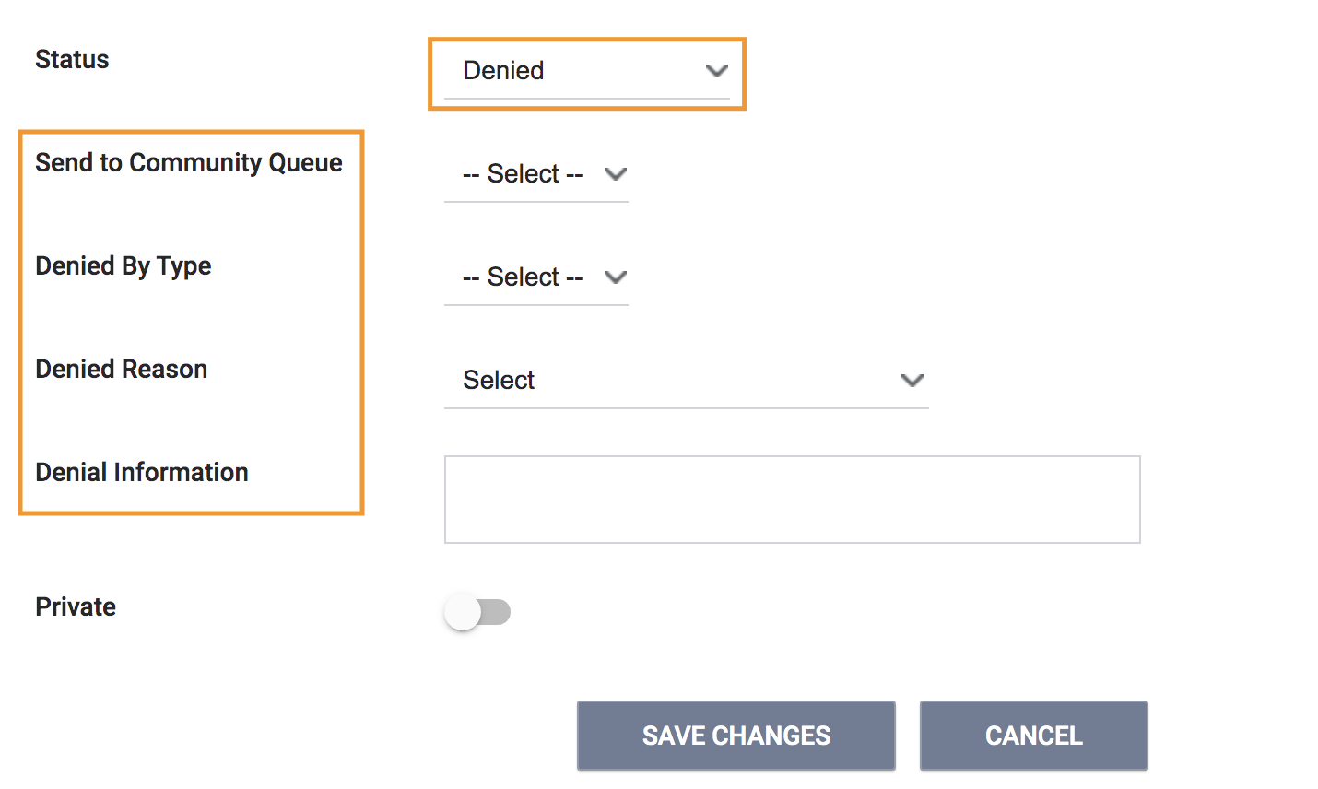
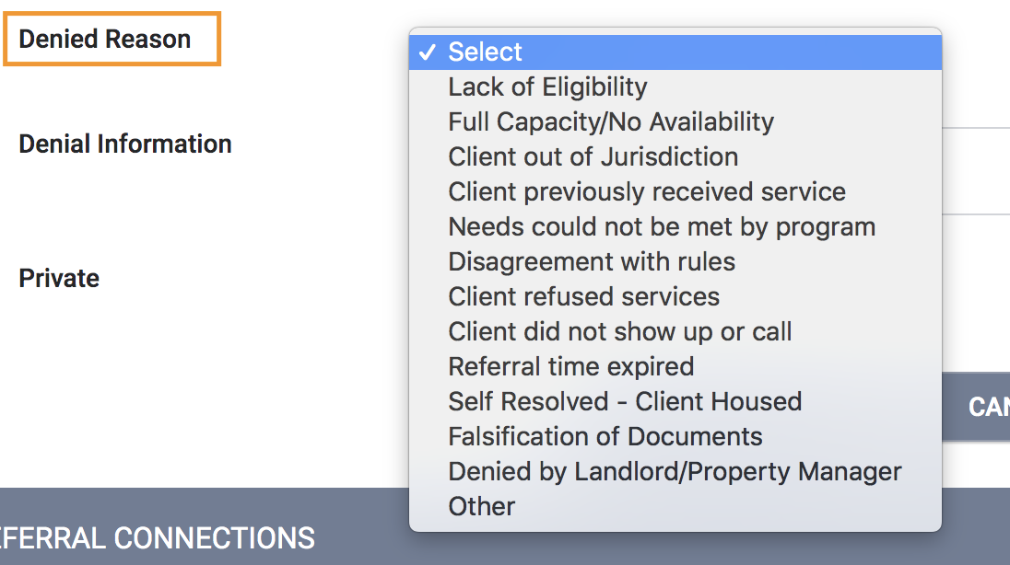
Processing a Referral
Denials - if HBOM is denying a referral, four additional field will appear
Send to Community Queue - sends the referral back to the Family Shelter Queue
Denied by Type - Client or Provider
Denial Reason - List of reasons the referral was denied
Denial Information - Add additional details regarding the denial

Slide 19
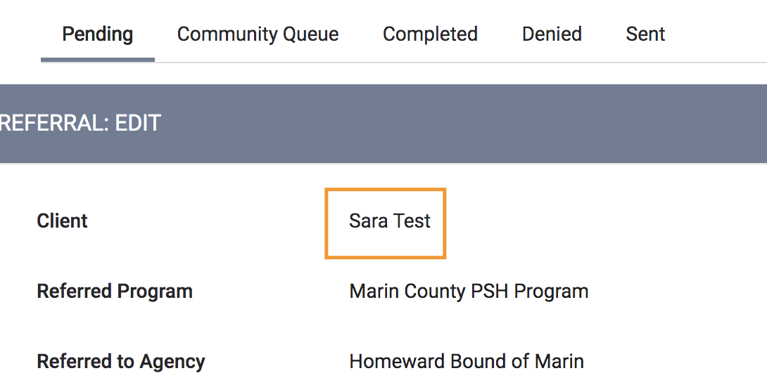
Accepting a Referral
To accept a referral, client and household will then be enrolled in the family shelter program
Click on the client’s name to be taken directly to their profile, where you can then enrolled the client and household into the family shelter program

Slide 20
Processing a Referral
Once at the Head of Household’s profile, click the Programs tab
Click on the family shelter program
IMPORTANT: Before clicking Enroll make sure Program Placement a result of Referral provided by Marin County Coordinated Entry Agency is toggled on - this is what will mark the referral as complete and accepted
Toggle the slider next to each Program Group Member that is enrolling with the head of household

Slide 21
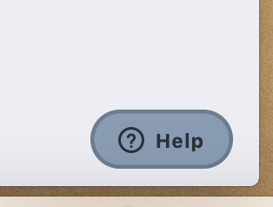
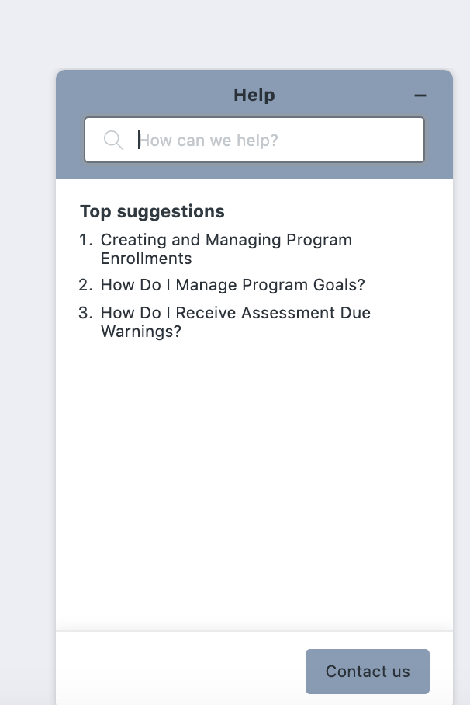
Resources
The Help Desk Widget
Bitfocus Help Desk
marin@bitfocus.com or (415) 429-4211
Marin Help Center Web Page
https://marin.clarityhs.help/hc/en-us
Coordinated Entry Training Materials
https://marin.clarityhs.help/hc/en-us/articles/360052218714

