Slide 1
Coordinated Entry: Matchmaker Training
Marin County

Slide 2
Agenda
What happened before?
Referral to the CQ
Orientation to the queue
Agency
Mode
Prioritization of queue/ Display scores
Referrals to shelter or housing
Removal from CQ
Referral Notifications
Reports
Resources

Slide 3
What Happens Before...

Slide 4
Definitions
Community Queue (CQ): a list of clients who have been prioritized for shelter or housing.
“Active List”
Family Housing Queue
Matchmaking: the process of determining what resources clients are eligible for and making a referral to the resource
Matchmaker: the staff responsible for making the referral

Slide 5
Referral to the Community Queue

Slide 6
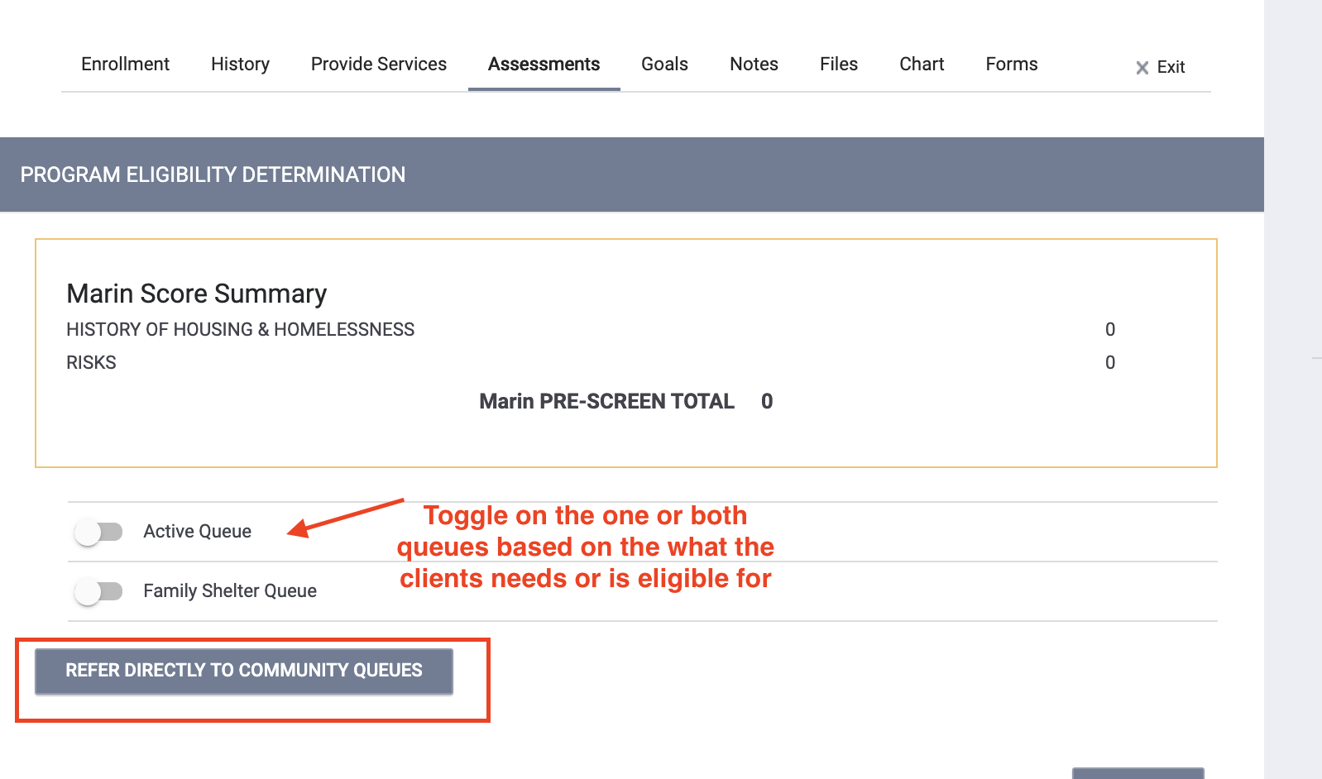
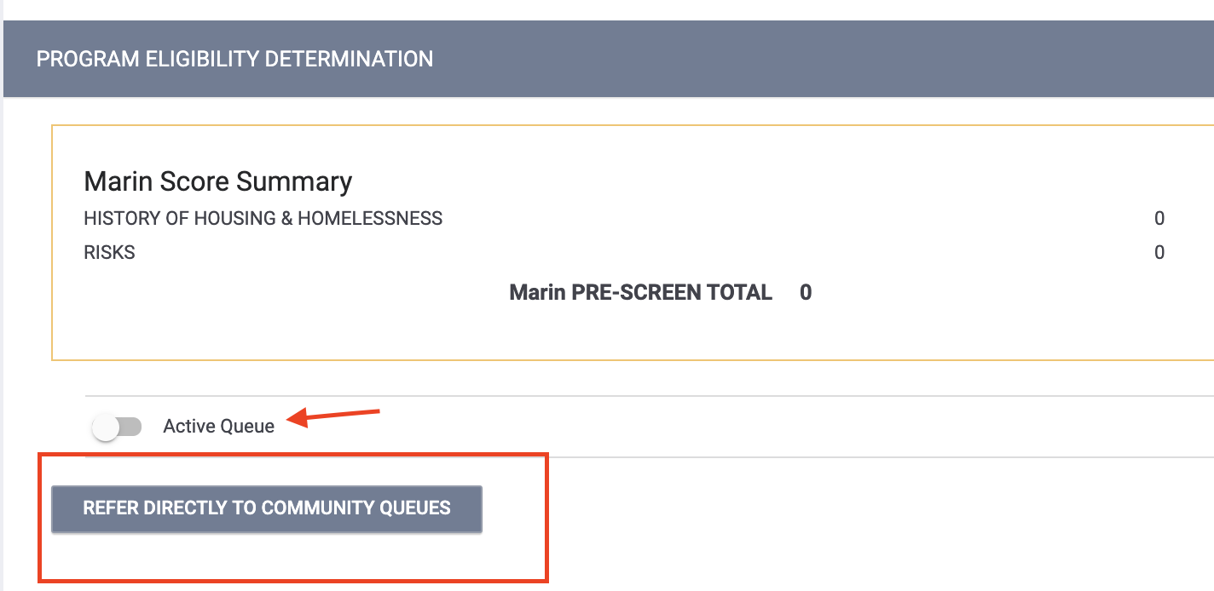
Referring to the CQ
Marin has two community queues
Active List
Family Shelter
From the Family Assessment From the Adult or TAY Assessment Assessment

Slide 7
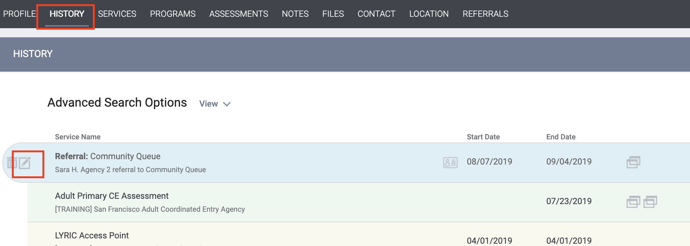
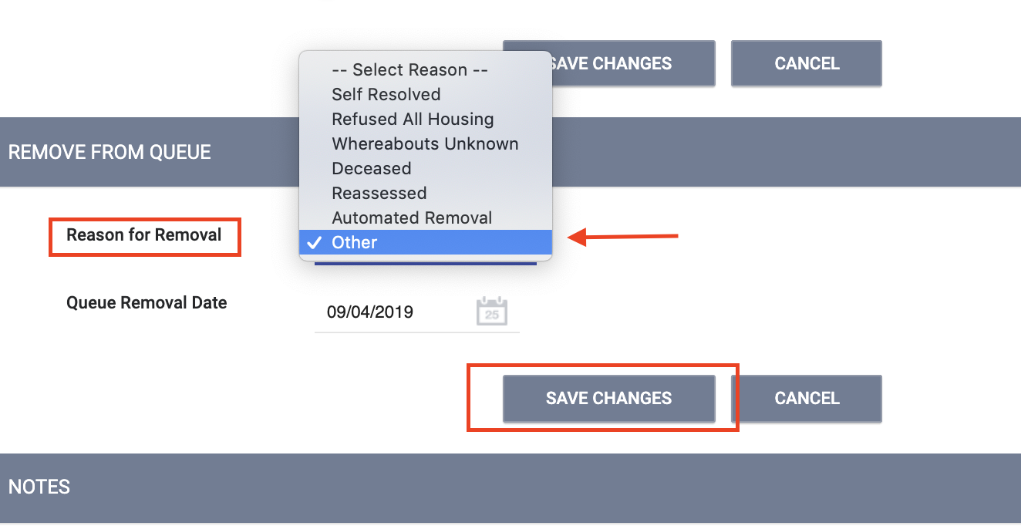
Referrals to the CQ
If the client gets a VI-SPDAT Revision, the original assessment needs to be removed from the CQ and the new assessment will need to be referred

Slide 8
Matchmaking

Slide 9
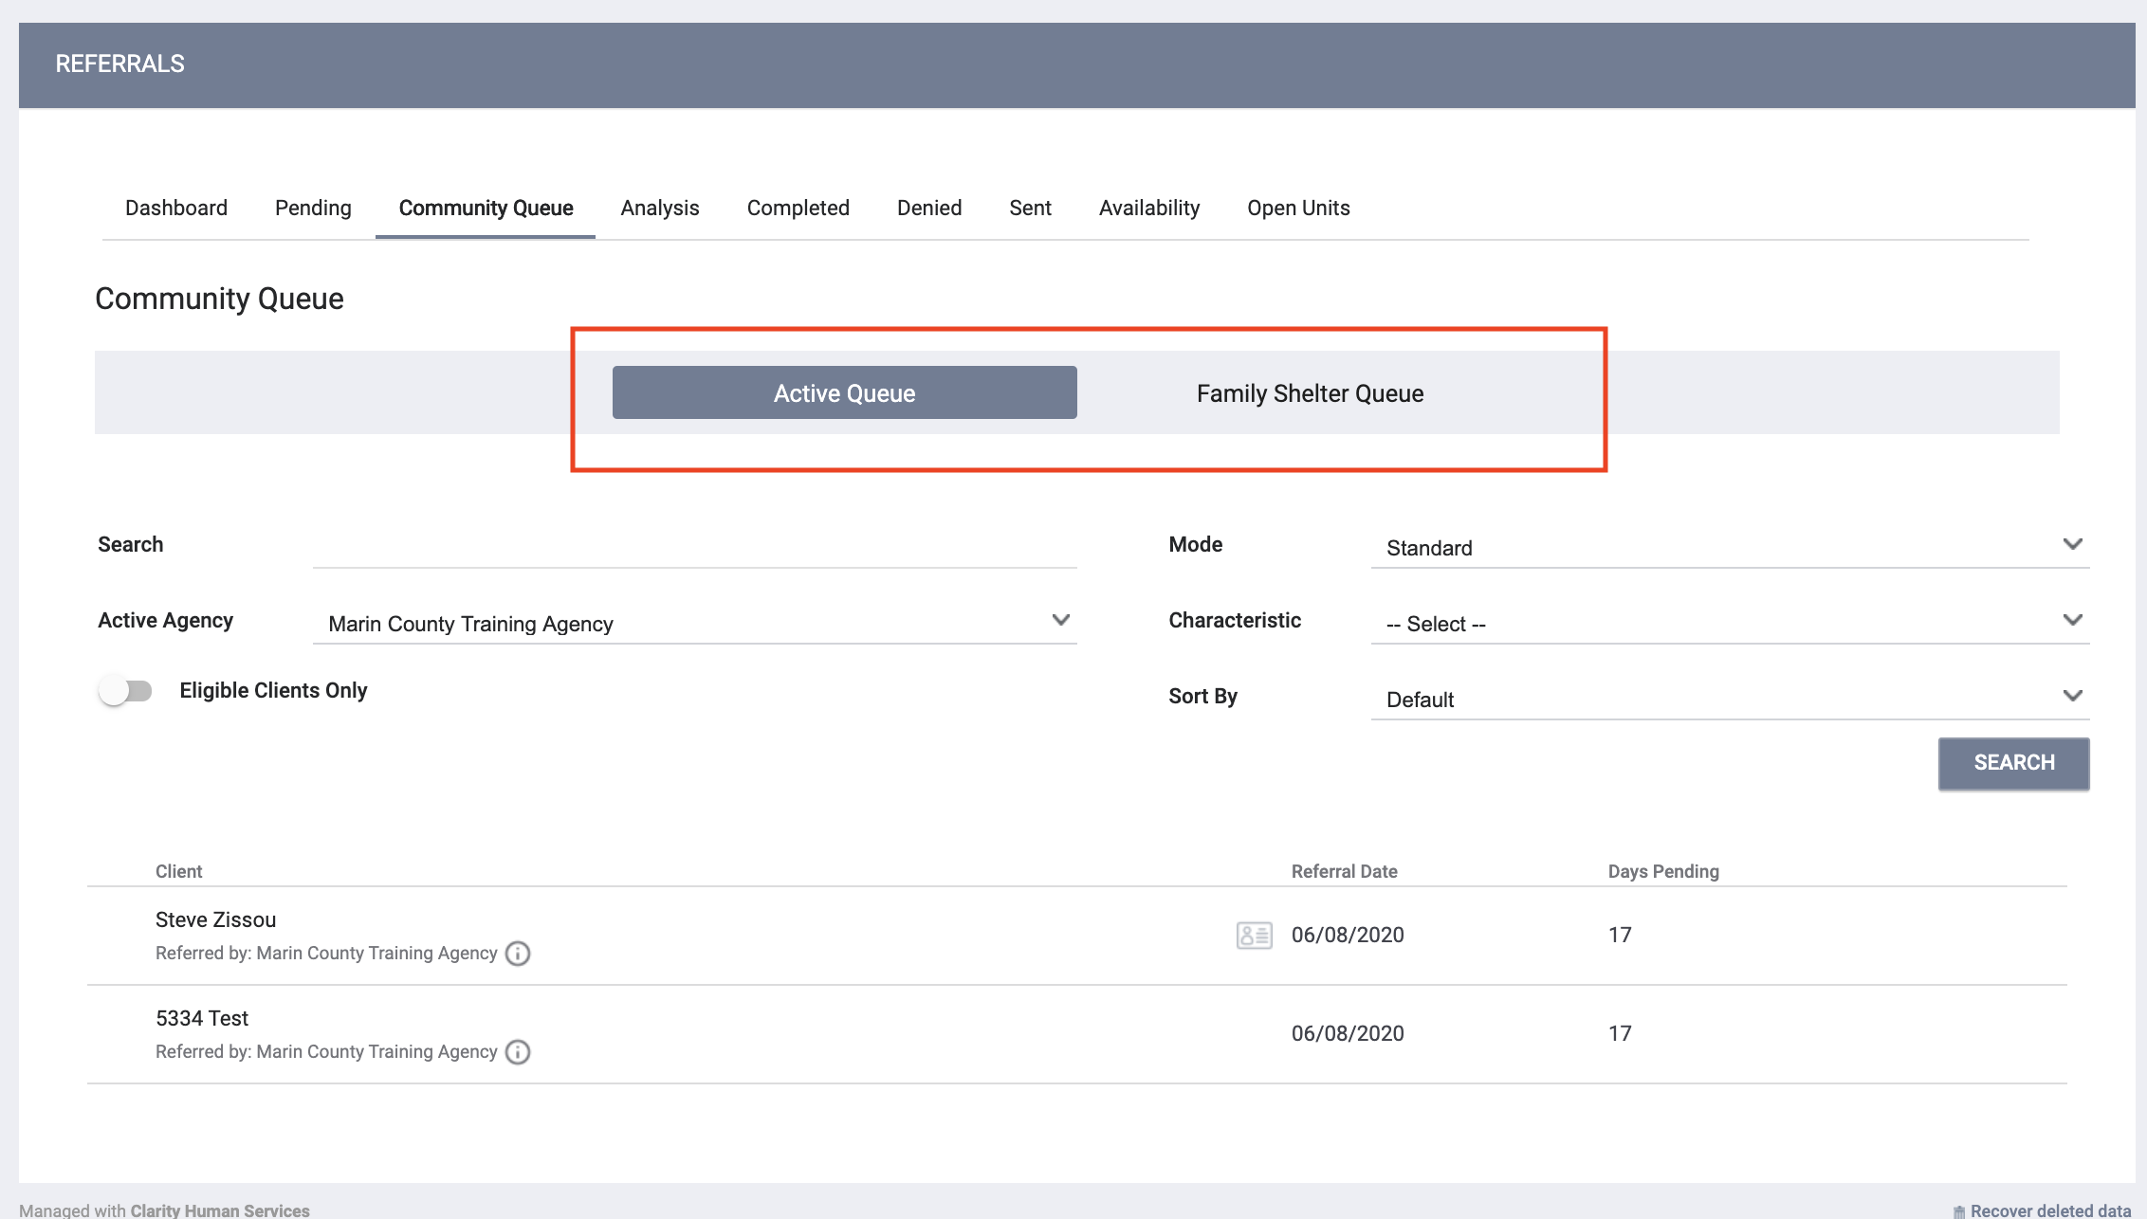
Matchmaking
Two Community Queues
Active List
Family Shelter
Click on the CQ (blue indicates the CQ you are on)
Queues are independent of each other
If a client is on both queues and referred from one, they still remain on the other queue.

Slide 10
Matchmaking
The Community Queue is equipped with multiple filters. The unified search box allows for different types of criteria to be entered, either on its own, or in a combination with other terms.
Select search parameters and click Search:
Search - Client Name, UI, SSN
Mode - Assessment Type (e.g. VI-SPDAT Prescreen for Families [V1])
Active Agency - the agency you want to send a referral to

Slide 11
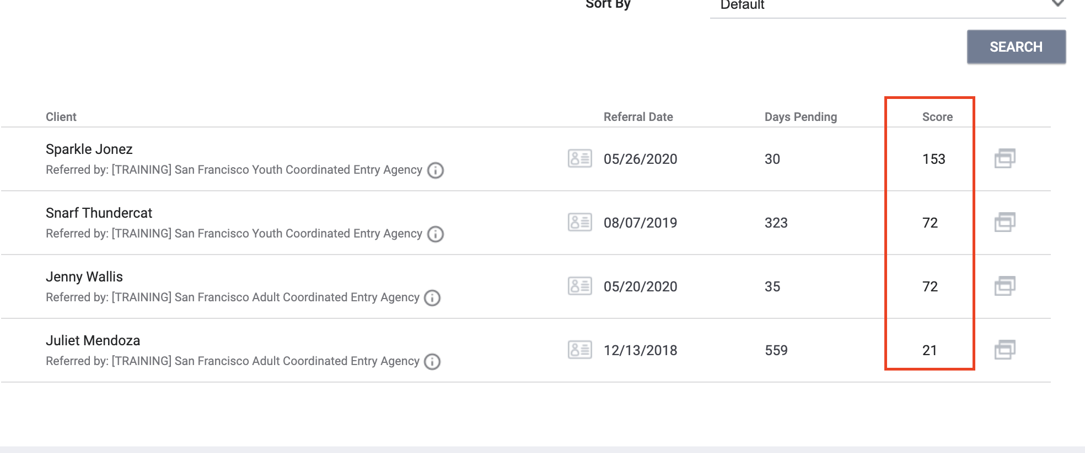
Searching by Mode
Searching by Mode will show client score and prioritize clients on the CQ with the highest score

Slide 12
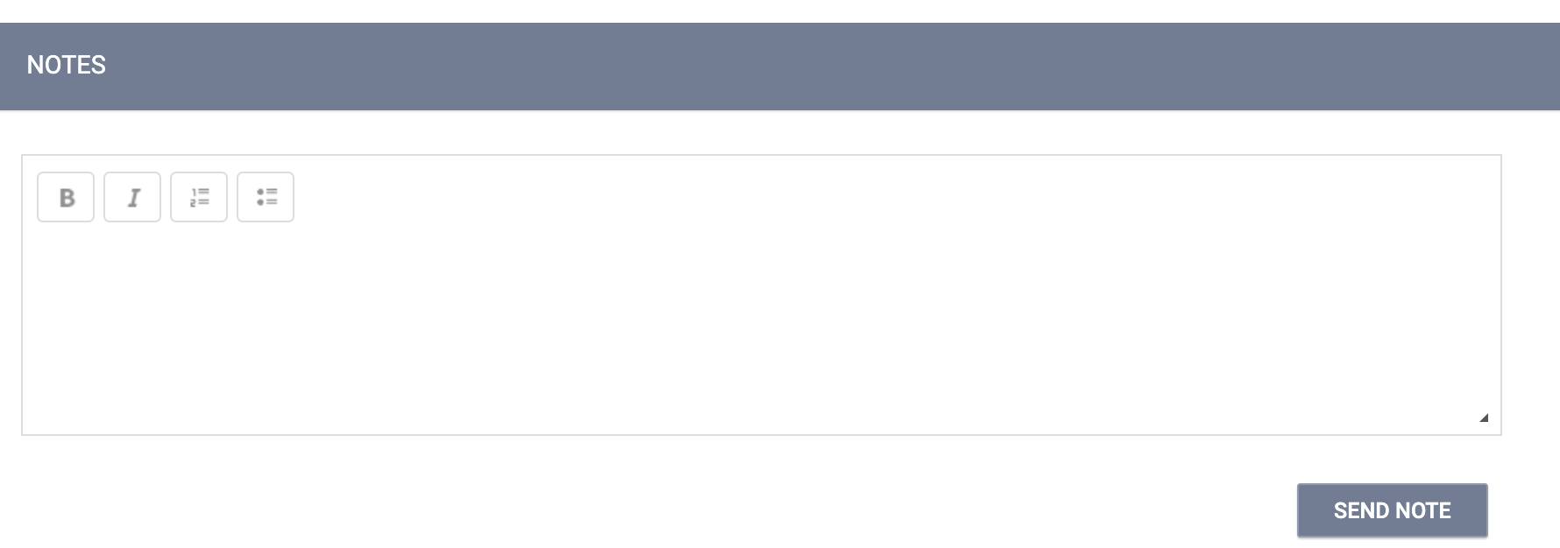
Making a Referral
Select the correct program and click Save
Scroll down to the notes, section to enter a note if needed

Slide 13
Referral Notifications
The provider will receive a notification once the referral is sent
The person who sends the referral will receive a notification once the provider changes the status of the referral

Slide 14
Referral Notifications
Notification | Time | Action
Pending Notification | 7 days | If the status of the referral stays in pending status for 7 days or more, the provider will receive weekly notifications until the status is changed
Pending-in Process Notification | 14 days | If the status of the referral stays in pending-in process status for 14 days or more, the provider will receive weekly notifications until the status is changed

Slide 15
History of the Referral
You can see the activity for a particular referral in the history of that referral

Slide 16
Exits

Slide 17
Exits
Assessor and Matchmaker staff are responsible for existing clients from the CE program
Client should be exited from CE for the following reason:
The client has entered a permanent residential project type or is otherwise known to have found permanent housing
The client is known to have left the CoC to pursue other assistance
The client is deceased
Client has declined all services

Slide 18
Auto-Exits from CE
Auto-exits from CE happen when a client has a move-in date recorded or destination for a permanent housing destination
Example 1:
The client is referred to Fireside. The client is enrolled in the program with a move-in date of 7/30/20.
Auto-Exit from CE= YES
Example 2:
The client informs their CE staff they are going to live with their aunt in Oregon.
The client needs to be manualled exited from CE.
Auto-Exit=NO

Slide 19
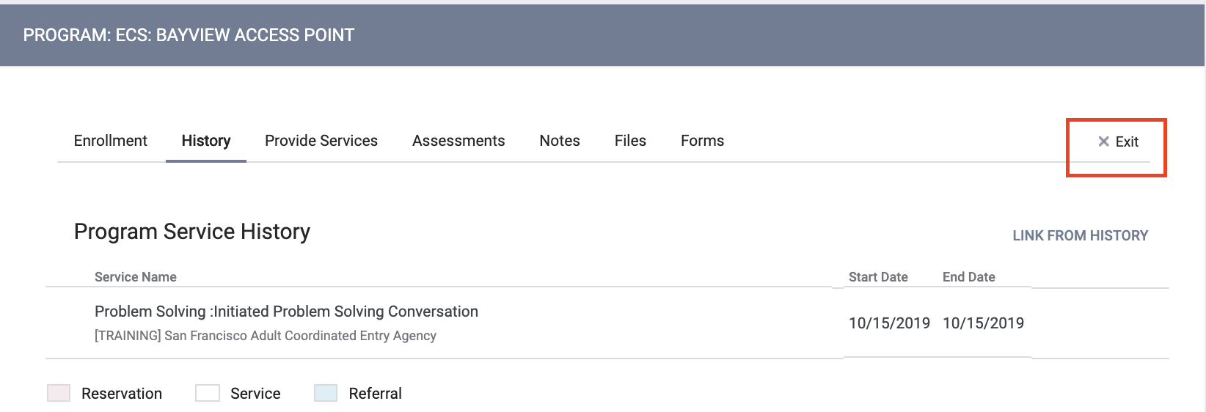
Exits

Slide 20
Let’s Talk Reports

Slide 21
Referral Statistics Report
[RFRL-101] Referral Statistics (Community and Referral Reports)
Who’s been referred
Inbound vs. outbound
Number of referrals received by an agency
Status of referrals

Slide 22
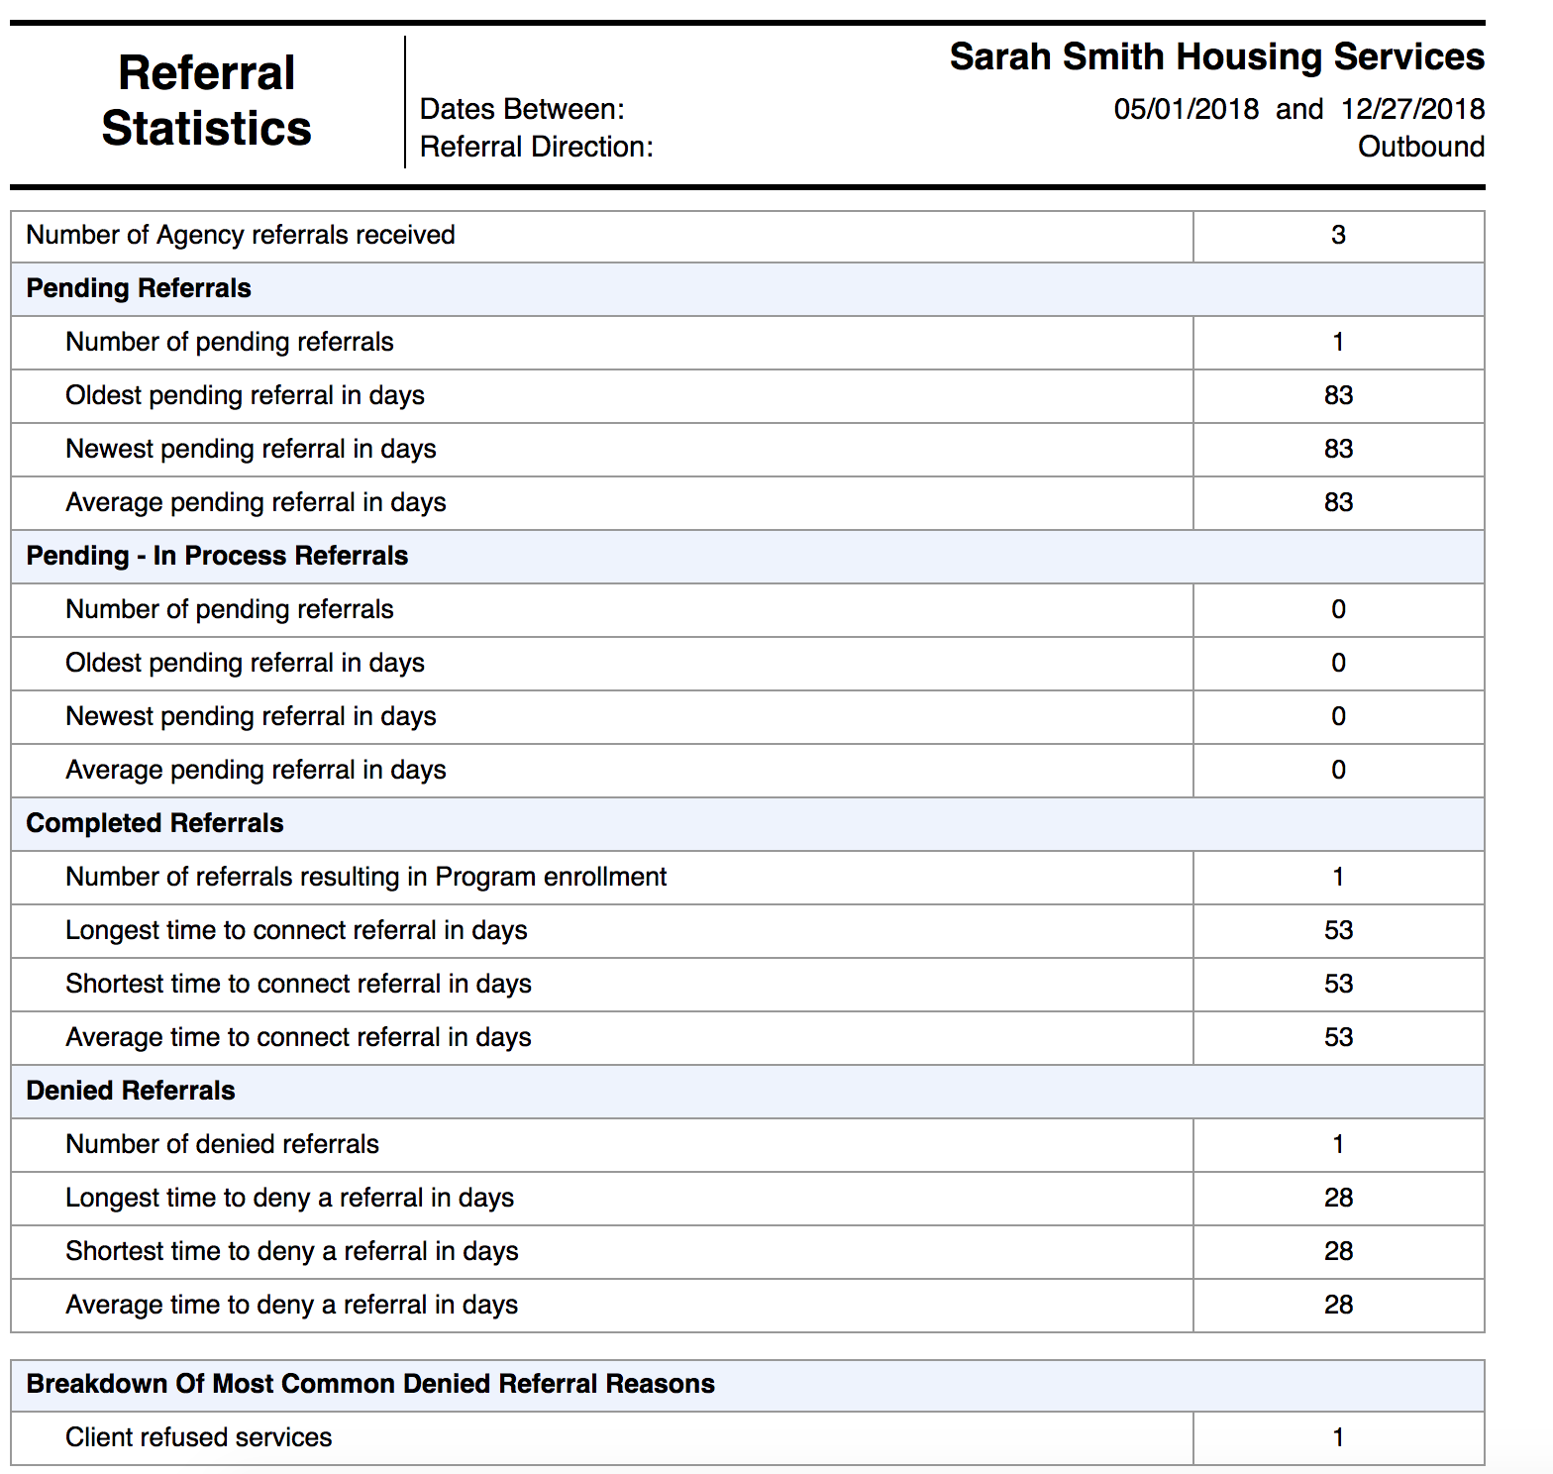
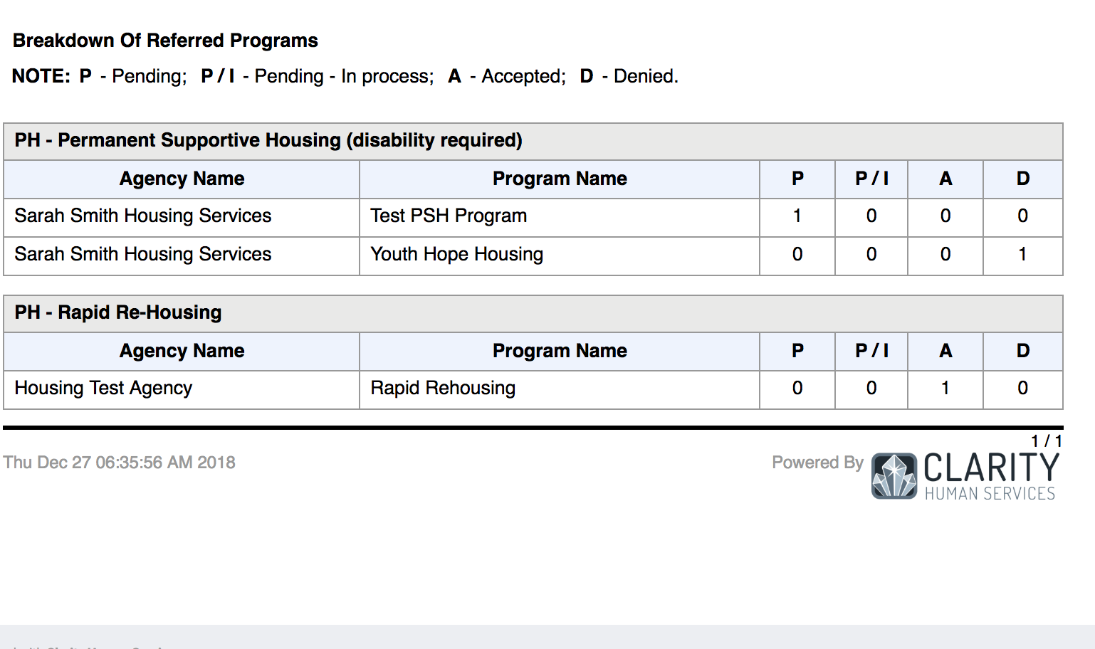
Referral Statistics Report

Slide 23
Community Queue Details Report
[RFRL-120] Community Queue Detail (Community and Referral Reports)
Clients currently on the queue
Specific demographic information about clients on the queue

Slide 24
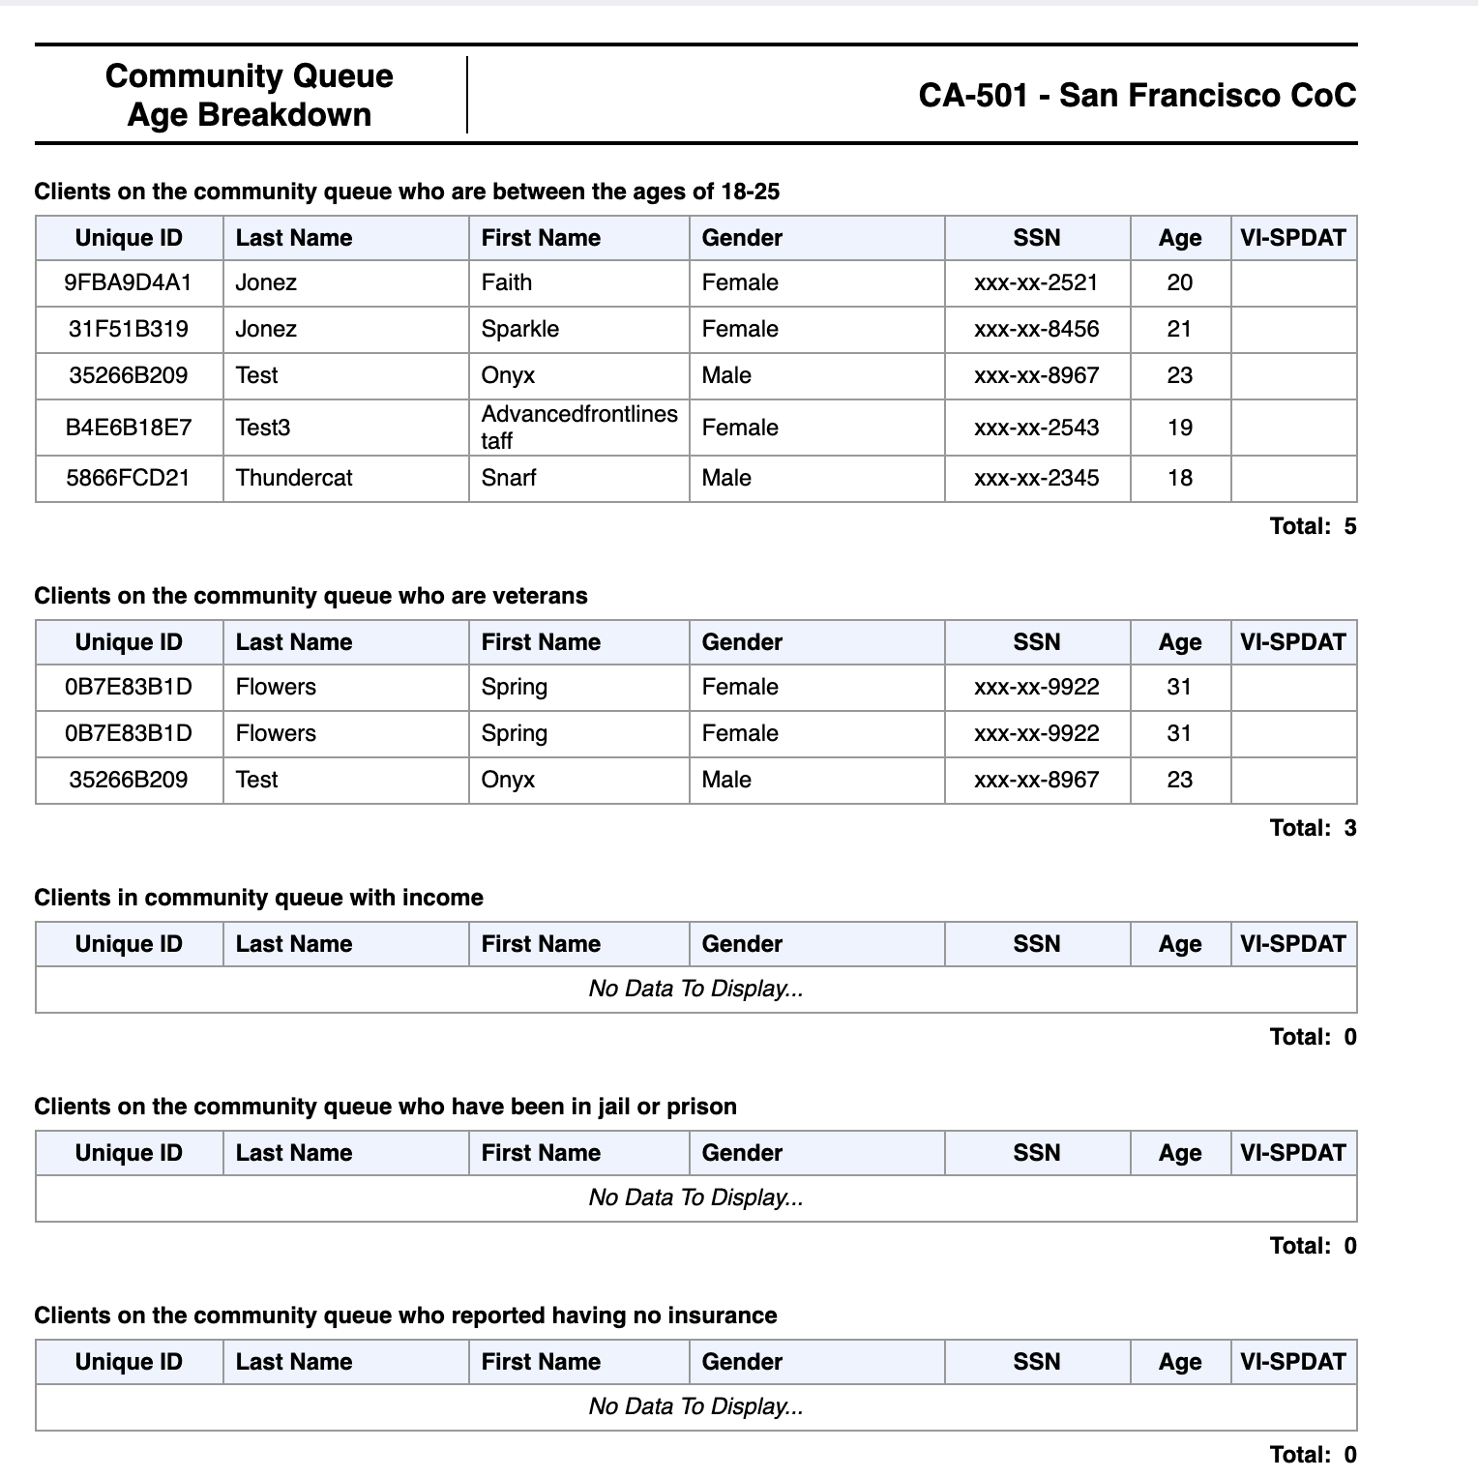
Community Queue Details Report

Slide 25
Program Roster
[GNRL-106] Program Roster (Program Based Report)
Who’s stayed in the program
Lists program stay information for clients with the selected status in the selected program

Slide 26
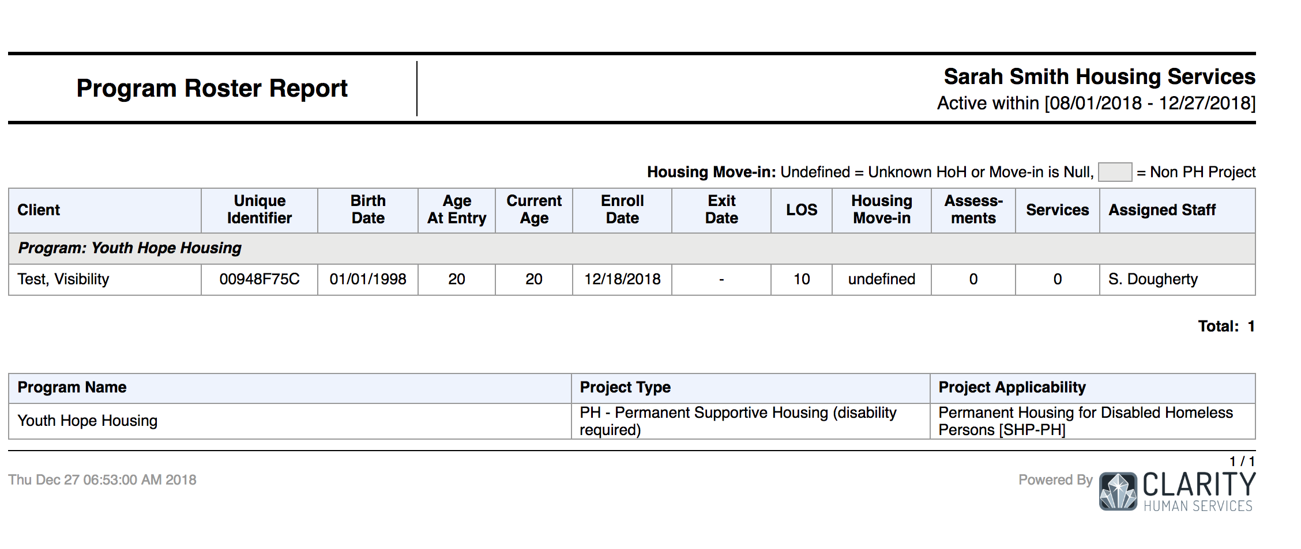
Program Roster

Slide 27
Reports
New and updated Coordinated Entry report coming soon!!!!

Slide 28
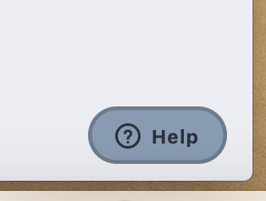
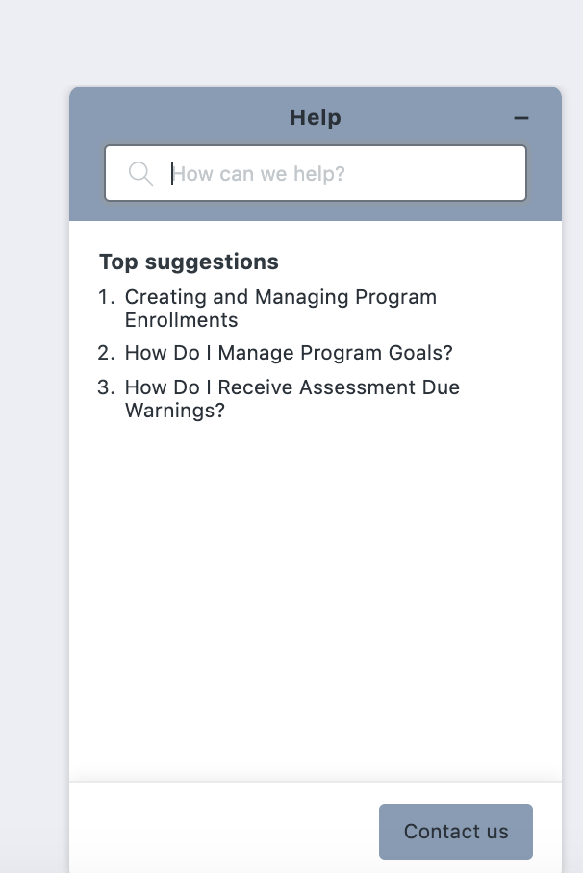
Resources
The Help Desk Widget
Bitfocus Help Desk
marin@bitfocus.com or (415) 429-4211
Marin Help Center Web Page
https://marin.clarityhs.help/hc/en-us
Coordinated Entry Training Materials
https://marin.clarityhs.help/hc/en-us/articles/360052218714

