Slide 1
Coordinated Entry: Provider Training
Marin County

Slide 2
Agenda
Pending Referrals Tab
Changing the status of referrals
Referral Notifications
Denying a referral
Accepting a referral
Reports
Resources

Slide 3
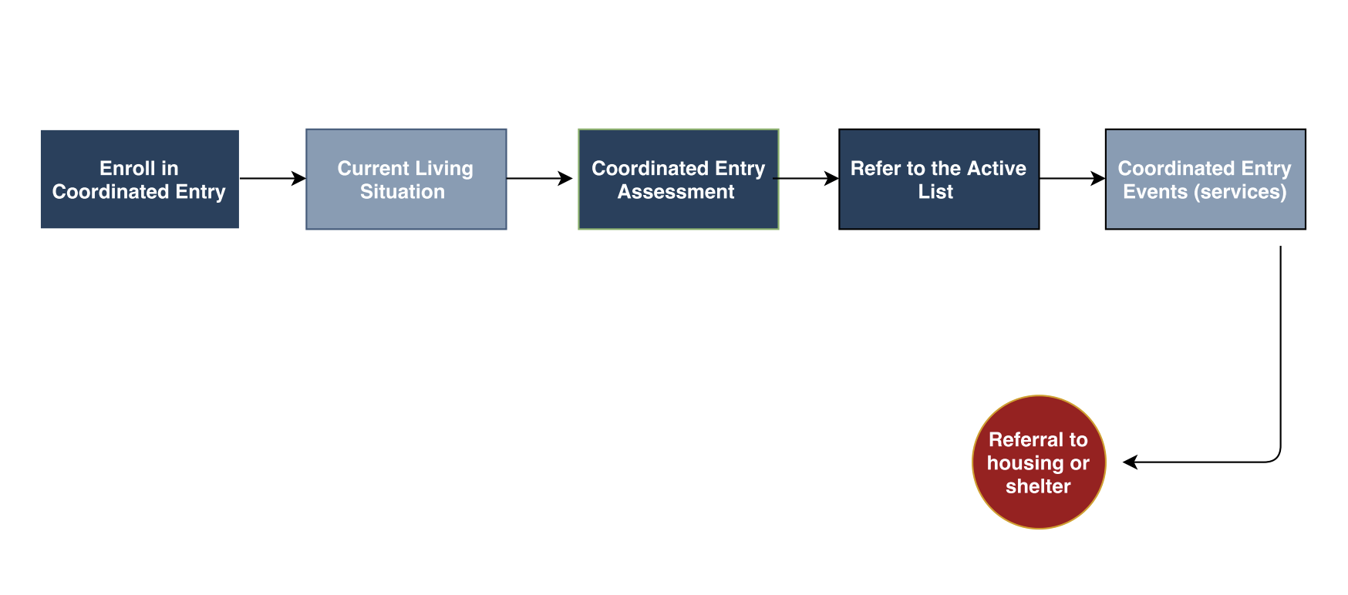
What Happens Before
Notes:
Enrolled in Coordinated Entry (CE)
Current Living Situation
Client completes a CE Assessment
Referred to the Community Queue (“Active List”)
Navigation support and other services are provided
Referred to a housing or shelter program

Slide 4
Managing Referrals

Slide 5
Referral Notifications
Providers will receive a notification via email/ Clarity Inbox when a referral has been sent to their program
Providers need to make sure the appropriate staff are set-up to receive notifications
Agency Leads should contact the Bitfocus Helpdesk at marin@bitfocus.com or 415.429.4211 to make any changes

Slide 6
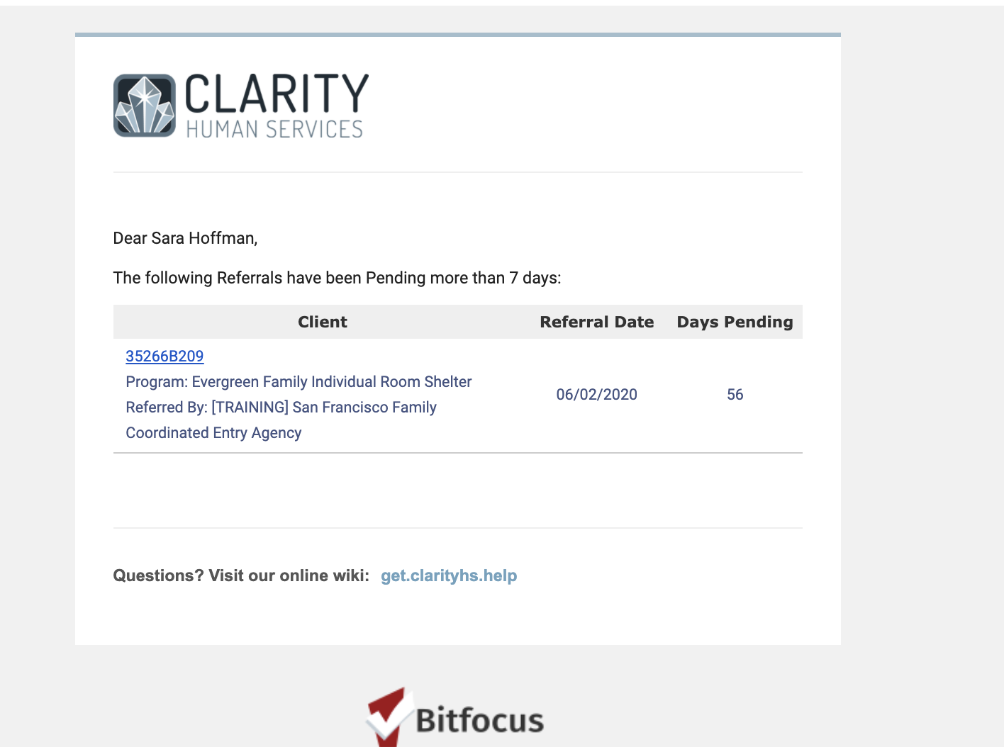
Referral Notifications

Slide 7
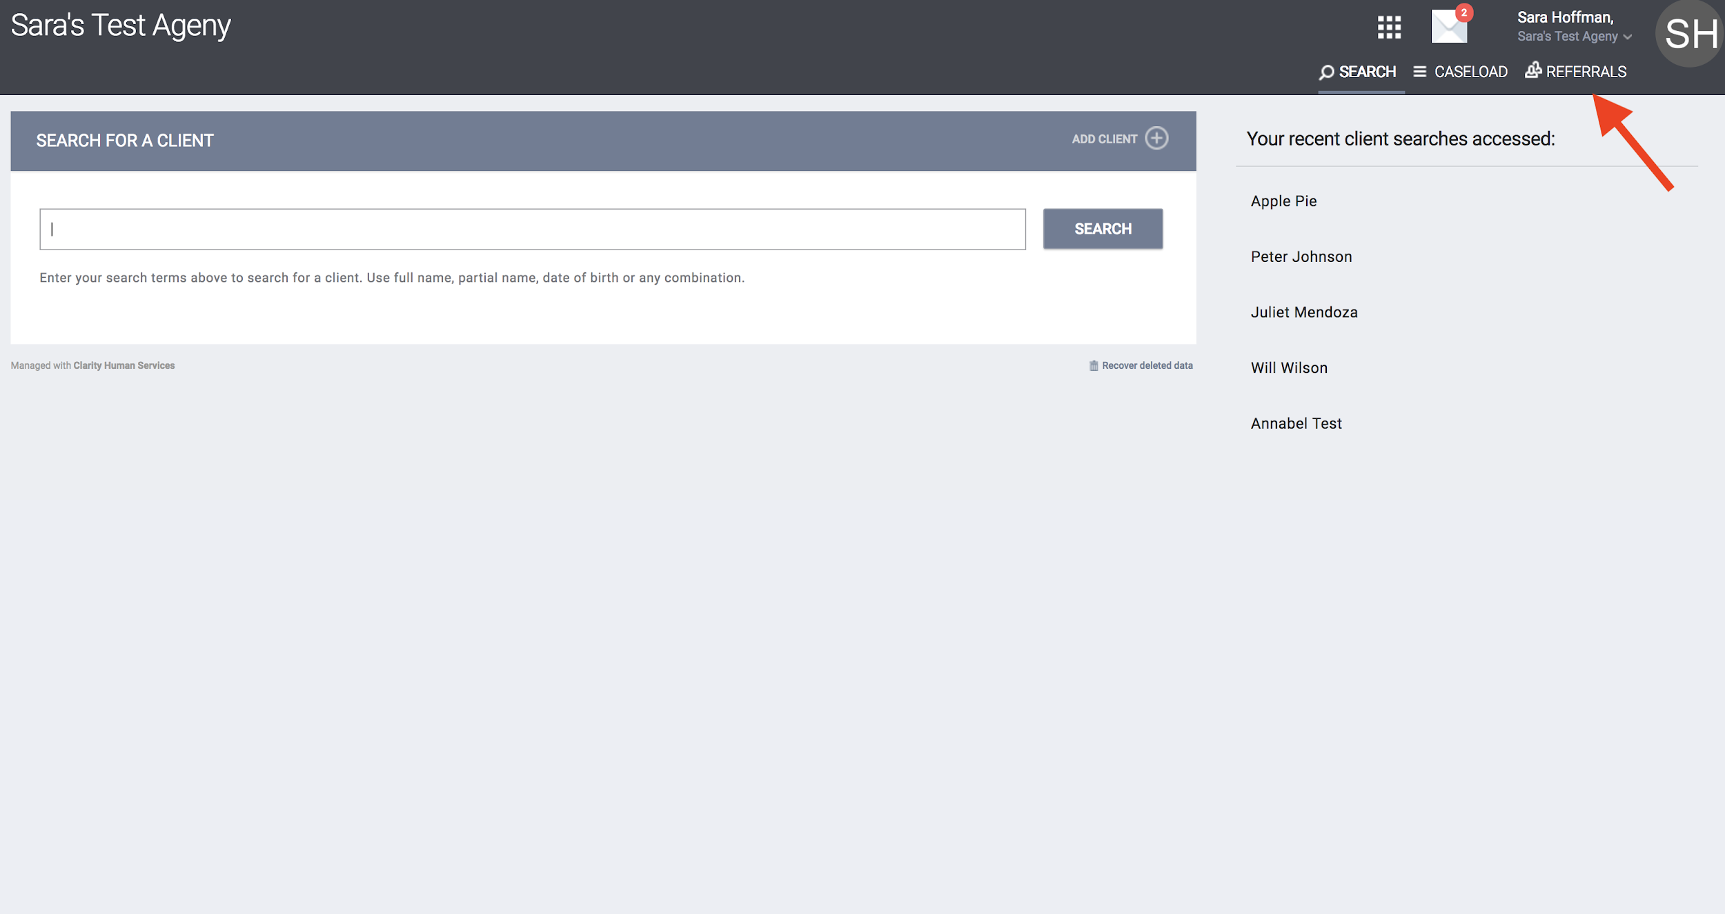
Referrals Tab
Click the Referrals Button at the top right of the screen.

Slide 8
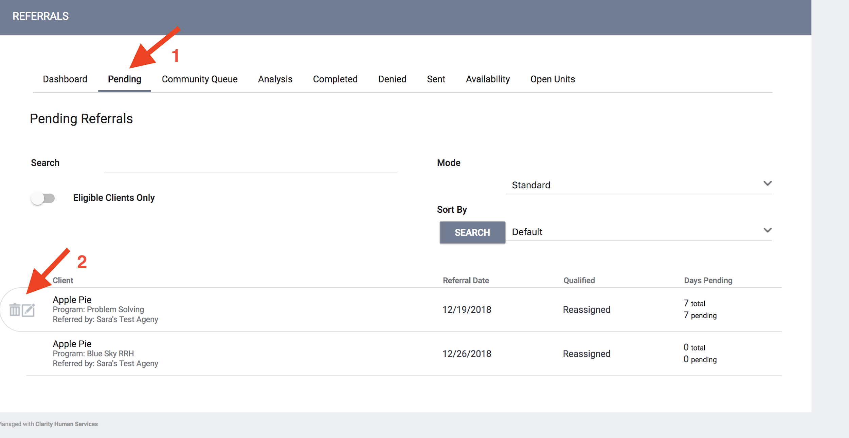
The Pending Referrals Tab
Click the Pending Tab
Select the client by clicking the edit box to the left of the client’s name

Slide 9
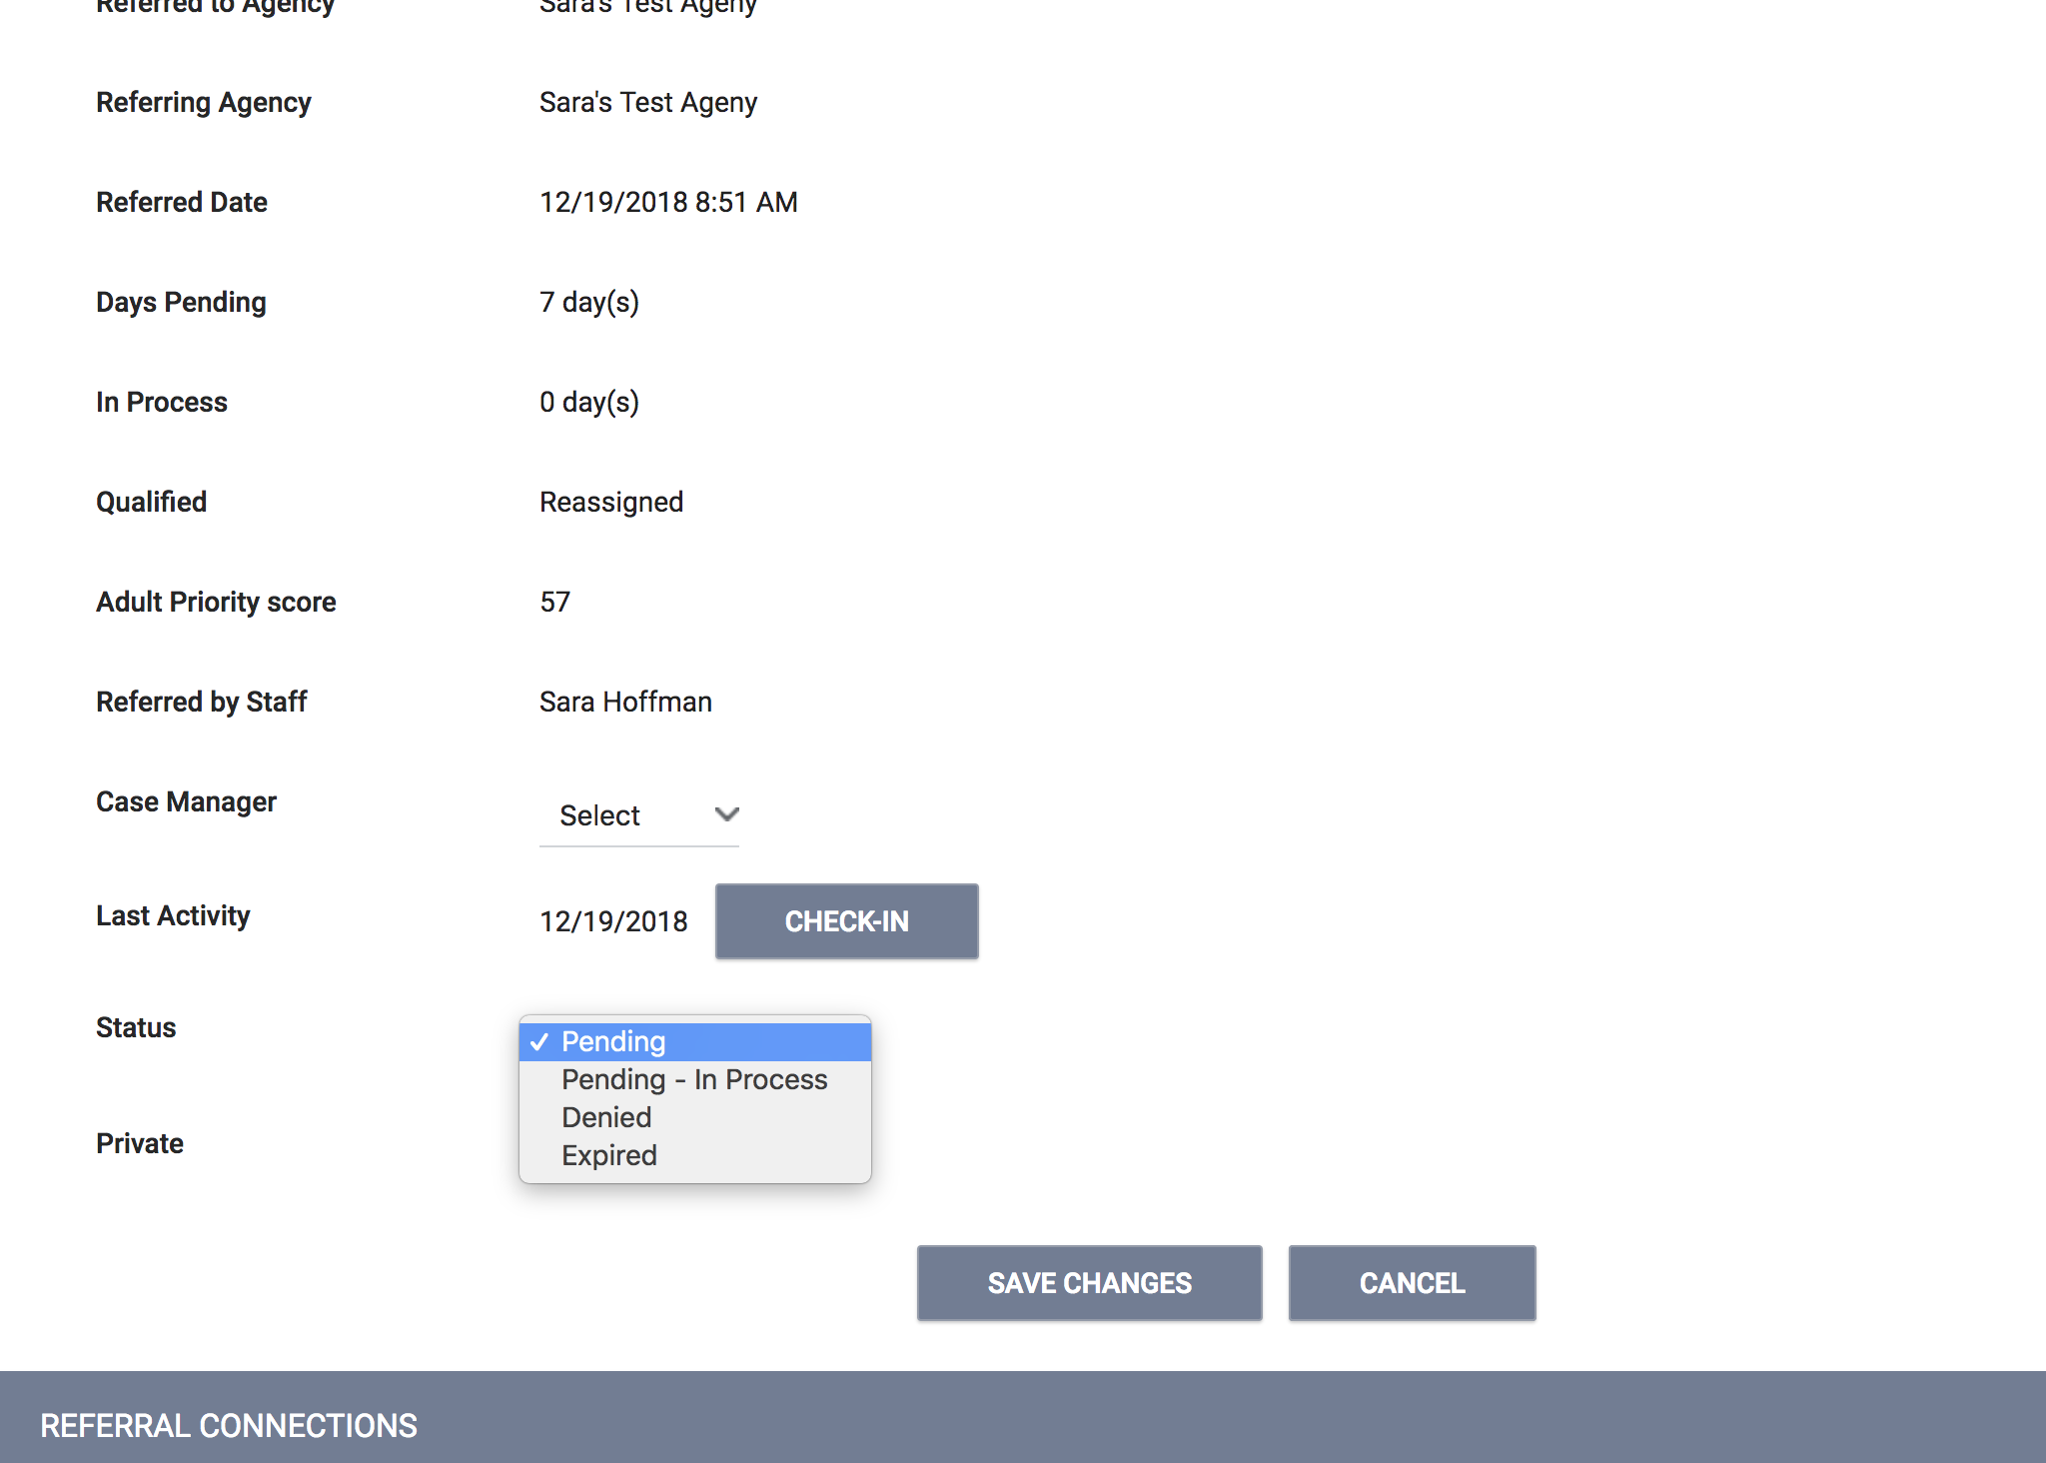
Managing Referrals: Changing the Status
Click the Status drop down and make the appropriate selection
Change from pending to pending-in process within 48 hours
Referrals will turn green once the status has been changed

Slide 10
Referral Notifications
Notification | Time | Action
Pending Notification | 7 days | If the status of the referral stays in pending status for 7 days or more, the provider will receive weekly notifications until the status is changed
Pending-in Process Notification | 14 days | If the status of the referral stays in pending-in process status for 14 days or more, the provider will receive weekly notifications until the status is changed

Slide 11
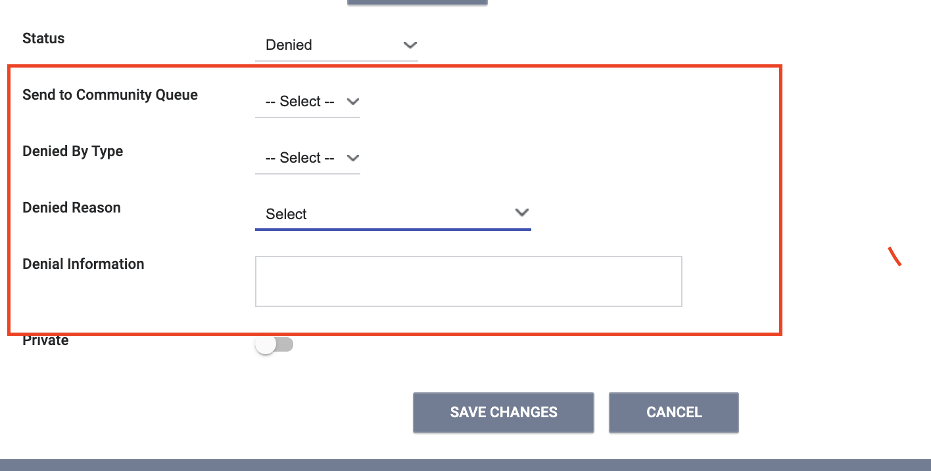
Denying a Referral
Change the status of the referral to denied
Four additional fields will populate that need to be answered
Send to Community Queue: Answer yes if client is still experiencing homelessness
Denied by type: Provider/client
Denied Reason: Reason for the denial
Denial Information: Provide additional details explaining the reason for the denial

Slide 12
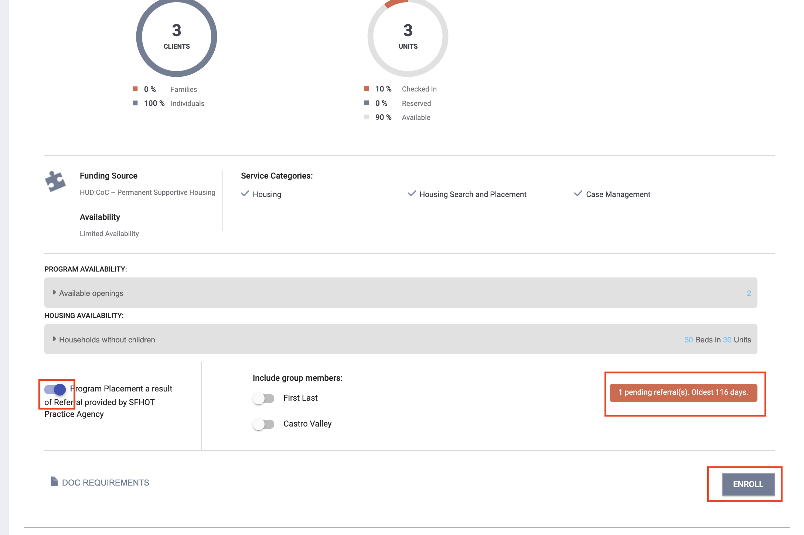
Accepting Referrals
Accepting the referral enrolls the client and closes the referral simultaneously
The “Program placement a result of…” toggle must be on to close the referral
The orange pending referral box is a visual to let you know your are enrolling in the right program

Slide 13
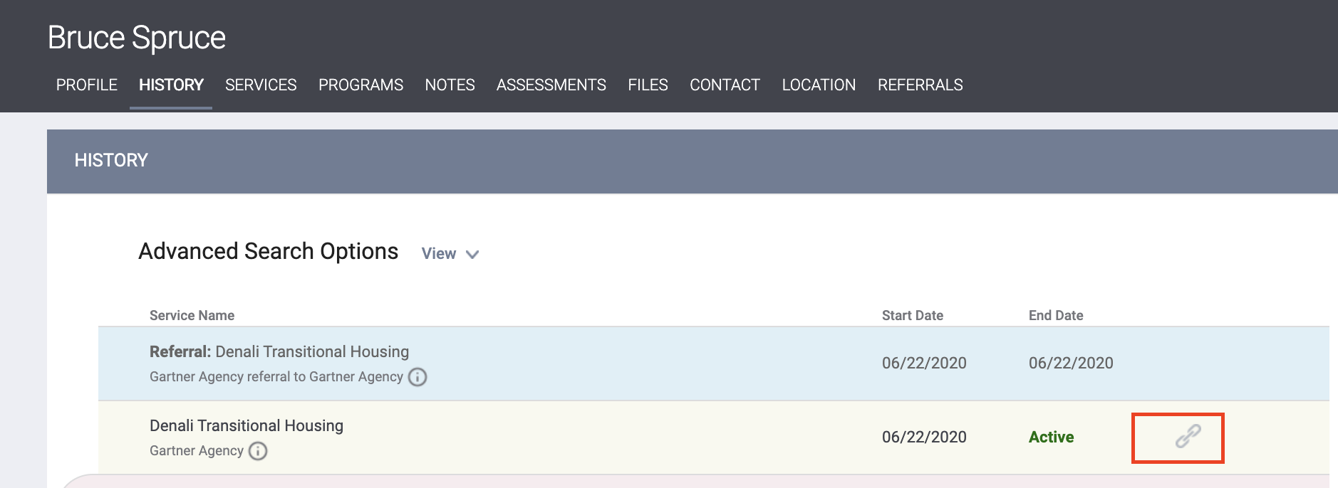
Accepting Referrals
The chain link icon indicated that the enrollment is linked to a referral and was completed properly
Indicates the enrollment was completed properly

Slide 14
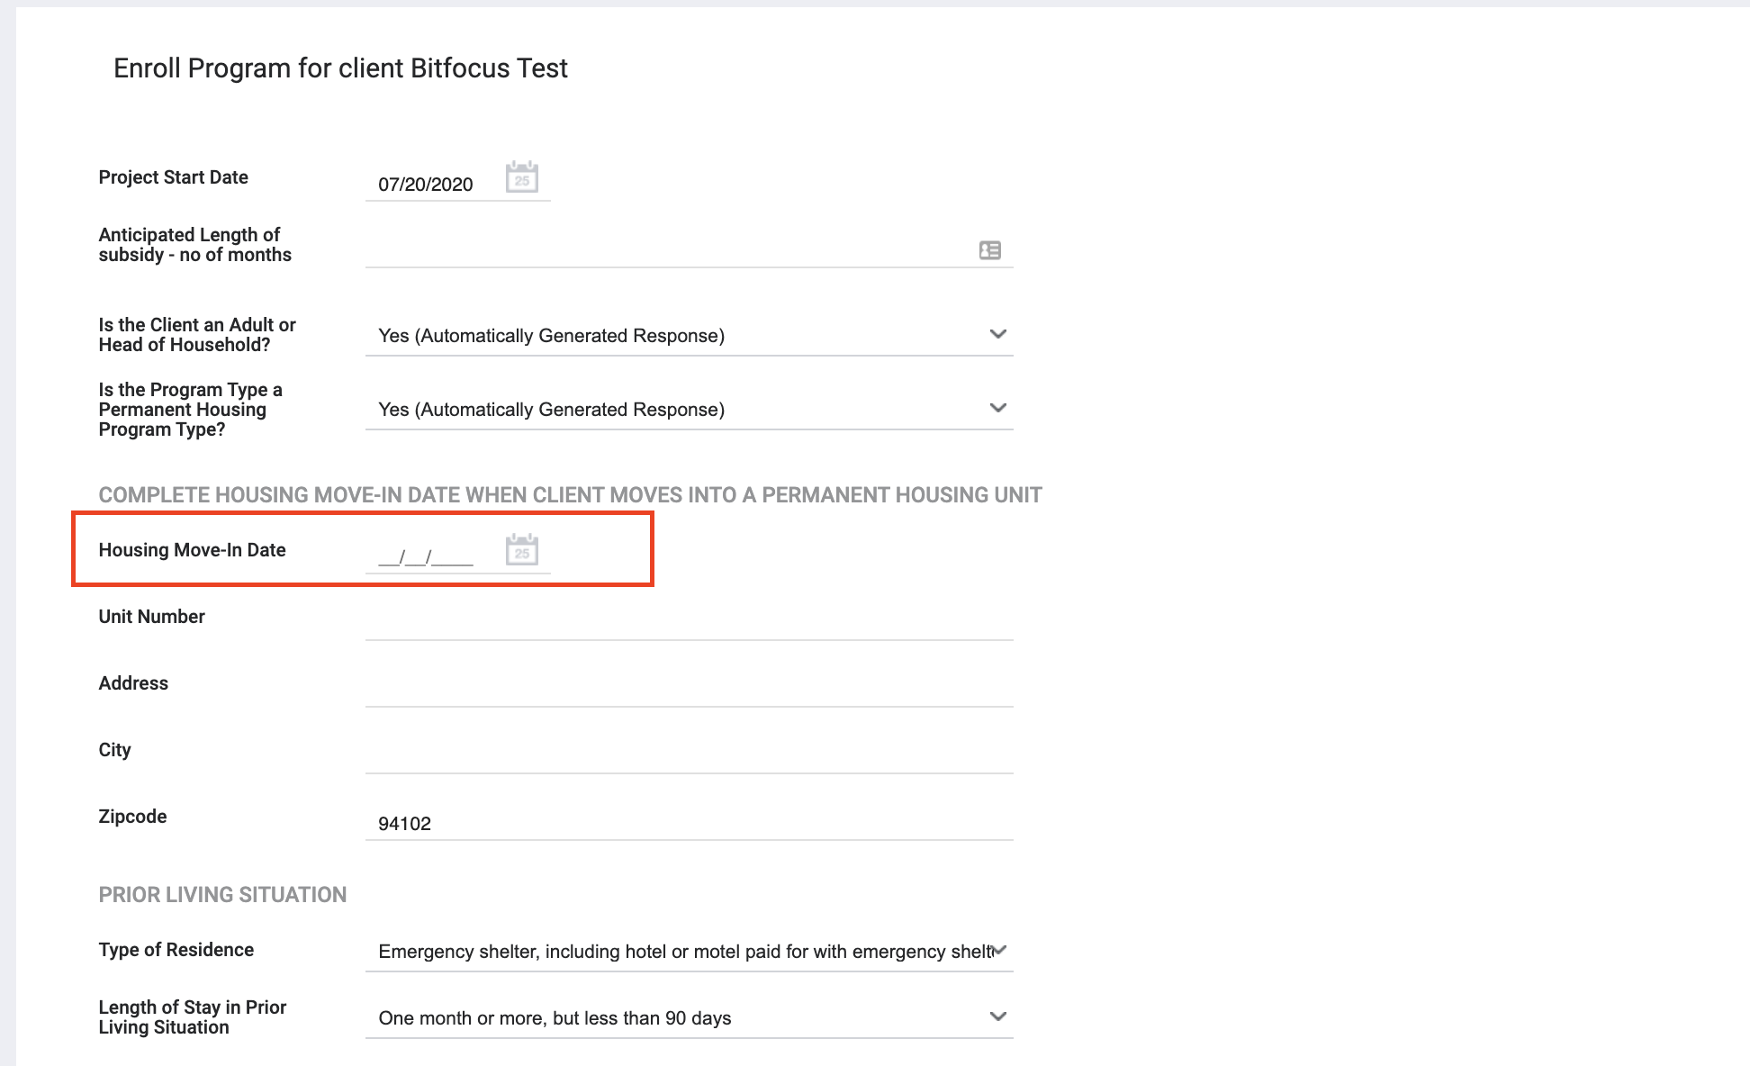
Move-In Dates
Move-in dates should be entered on the enrollment screen
For PSH programs, the move-in date typically matched the enrollment date
For RRH, the enrollment should happen during program intake. The move-in date should be entered later, when the client moves into their unit.

Slide 15
Uploading Documents

Slide 16
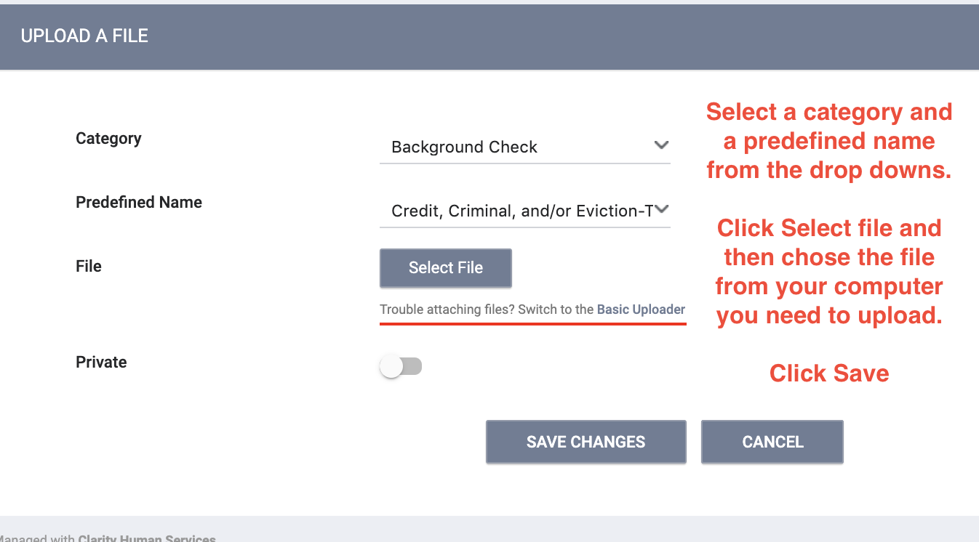
Uploading Documents

Slide 17
Let’s Talk Reports

Slide 18
Referral Statistics Report
[RFRL-101] Referral Statistics (Community and Referral Reports)
Who’s been referred
Inbound vs. outbound
Number of referrals received by an agency
Status of referrals

Slide 19
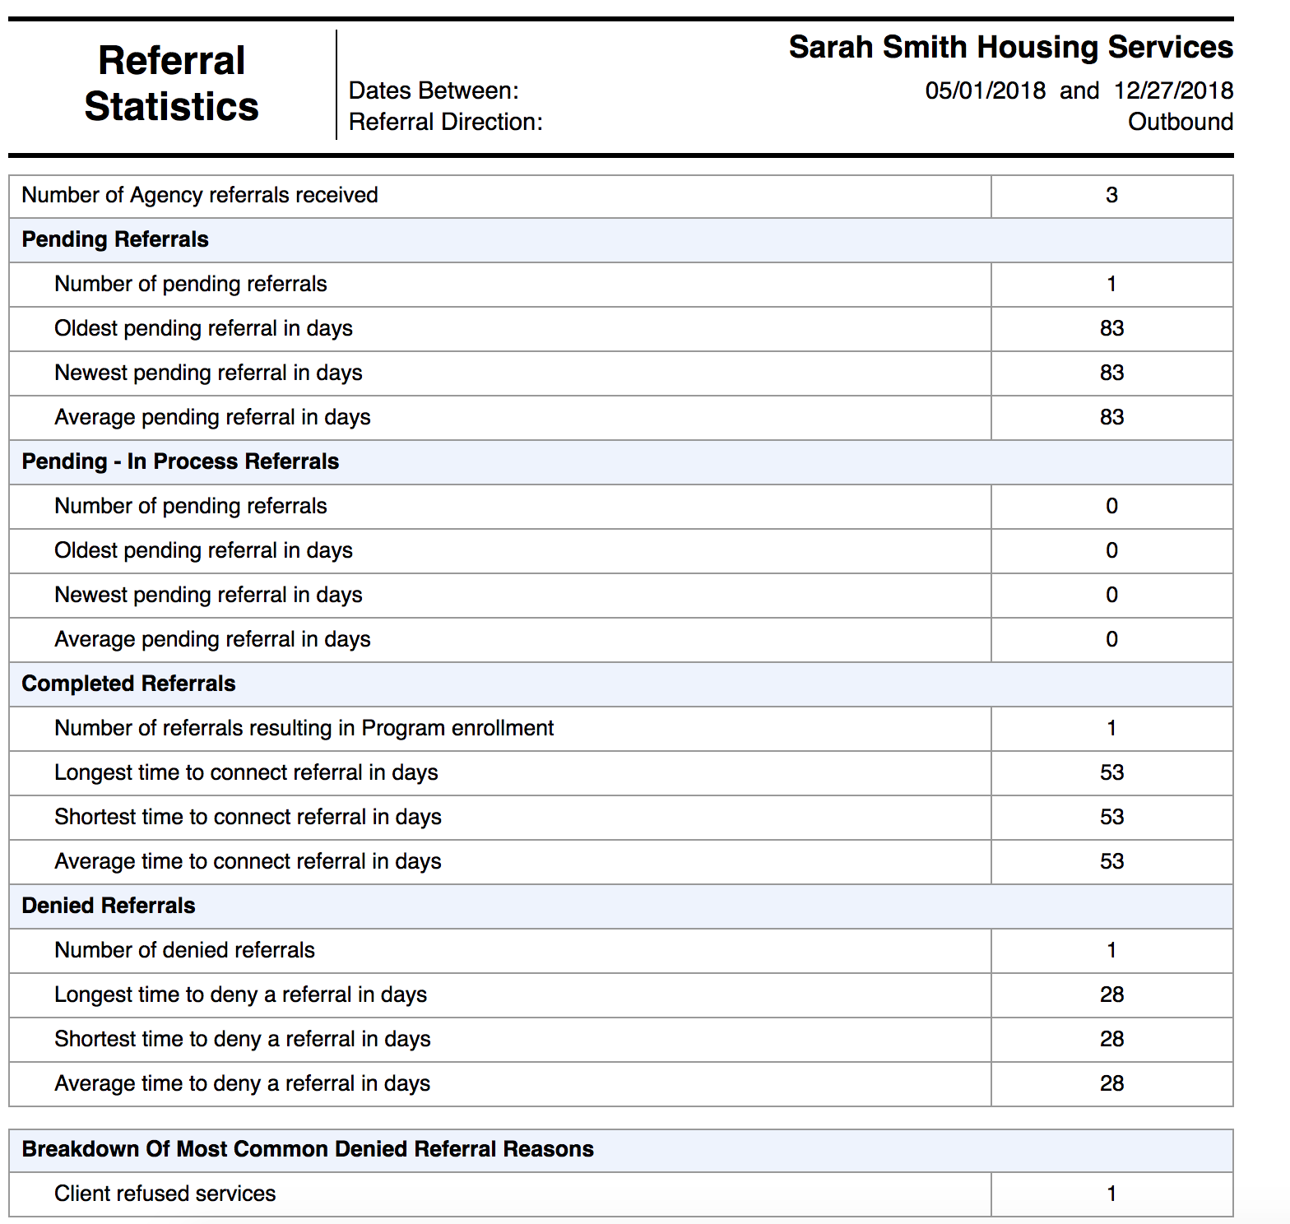
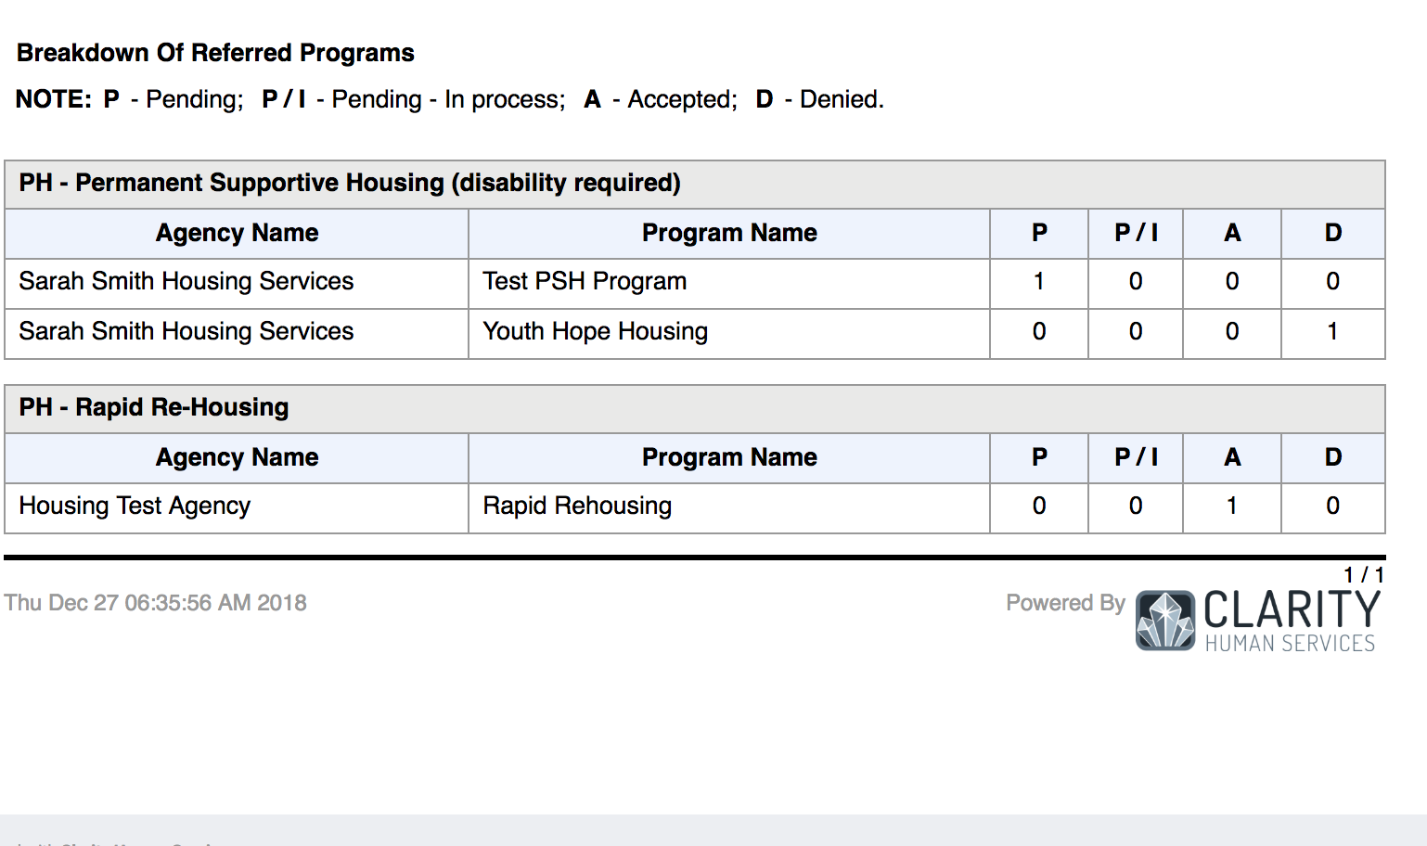
Referral Statistics Report

Slide 20
Program Roster
[GNRL-106] Program Roster (Program Based Report)
Who’s stayed in the program
Lists program stay information for clients with the selected status in the selected program

Slide 21
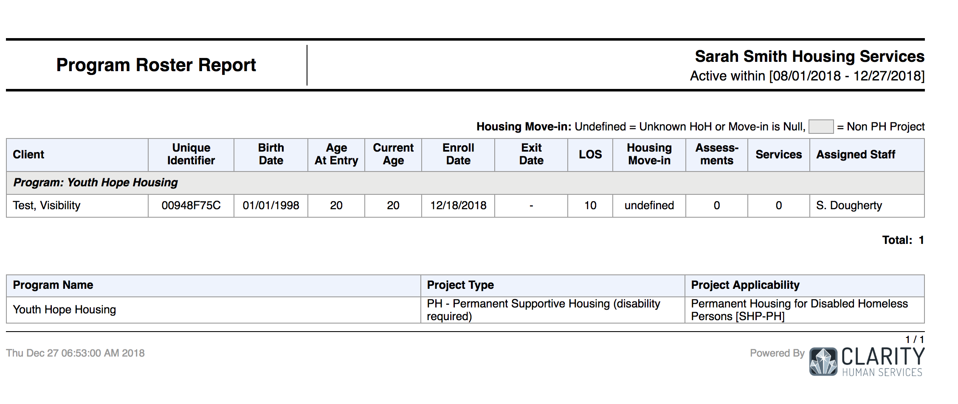
Program Roster

Slide 22
HMIS Data Quality Report
[HUDX-225] HMIS Data Quality Report (HUD Reports)
Who needs support around data entry?
Part of HUD’s Data Quality Framework
Comprehensive data review

Slide 23
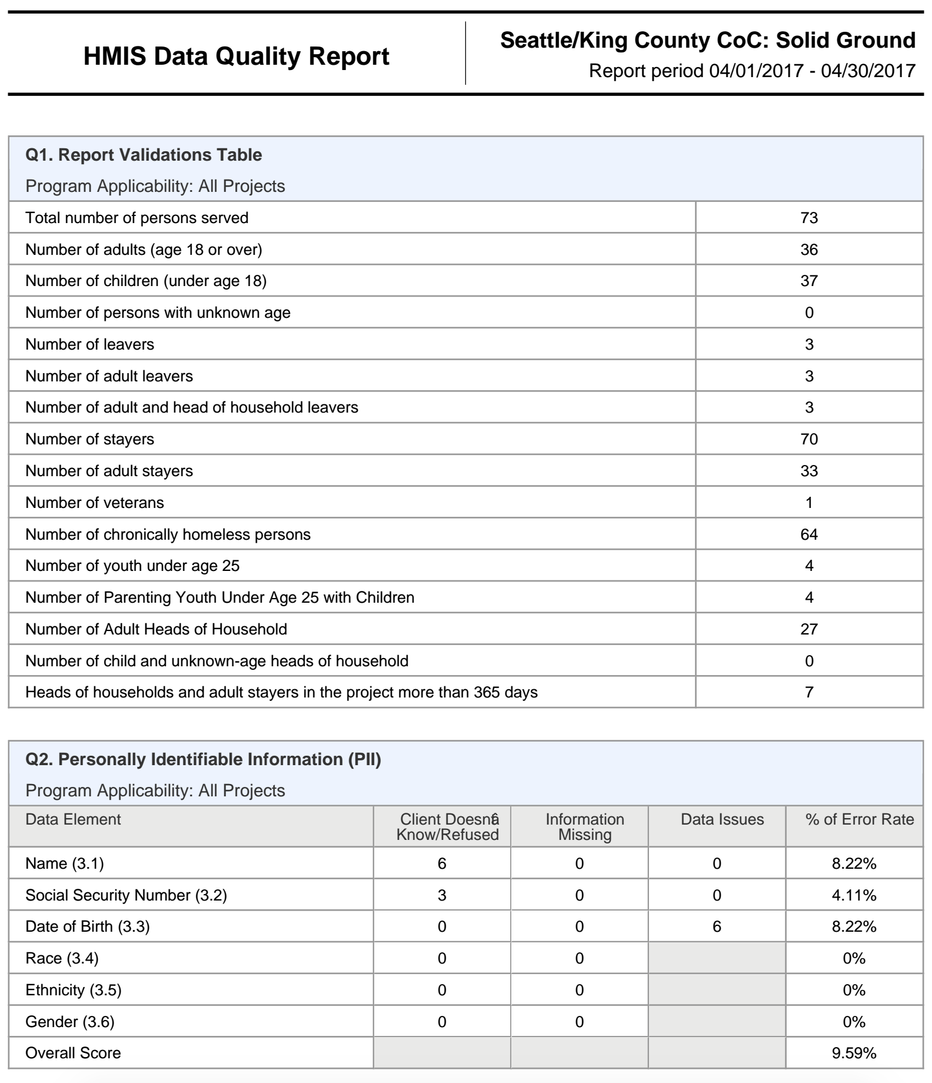
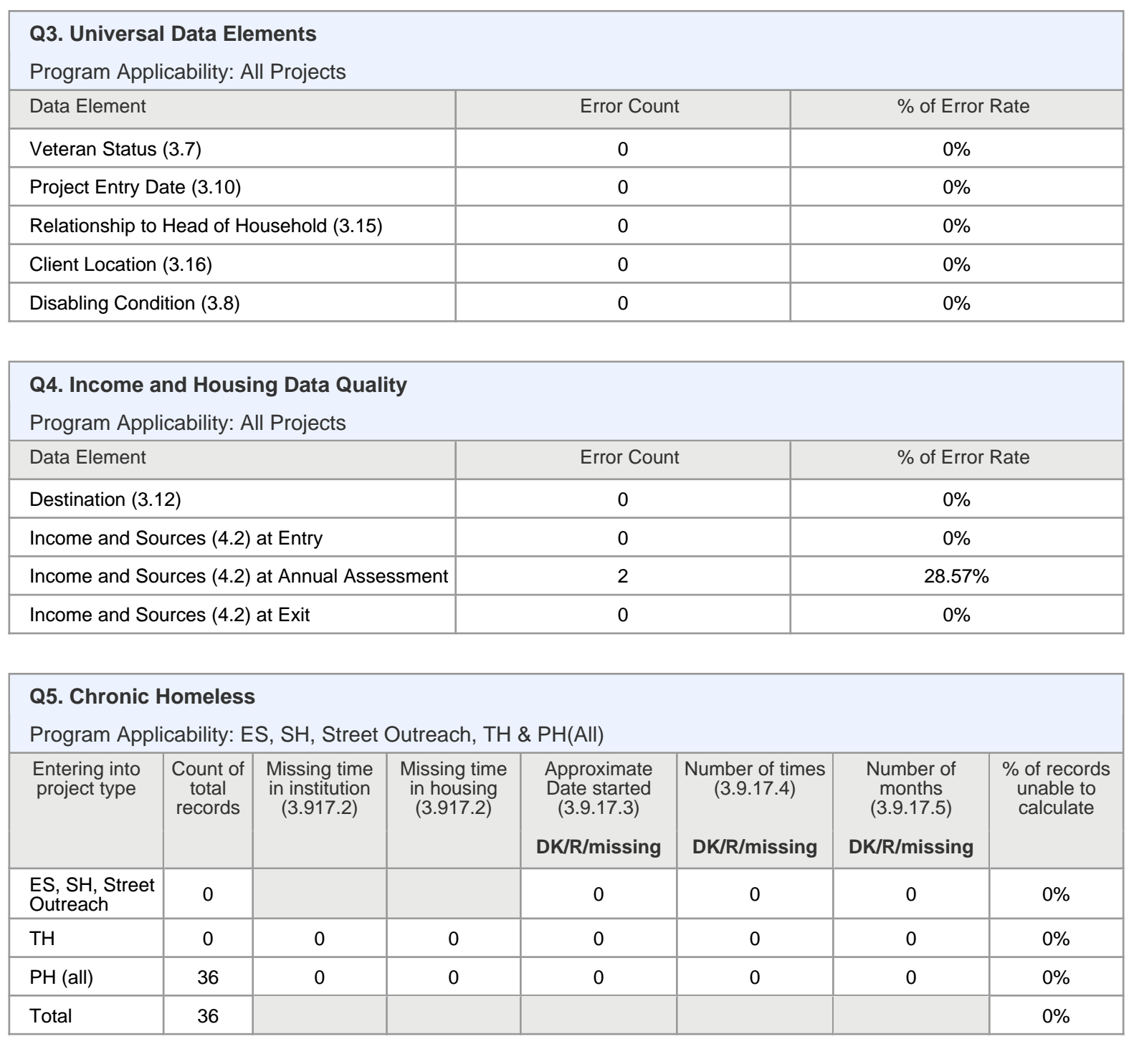
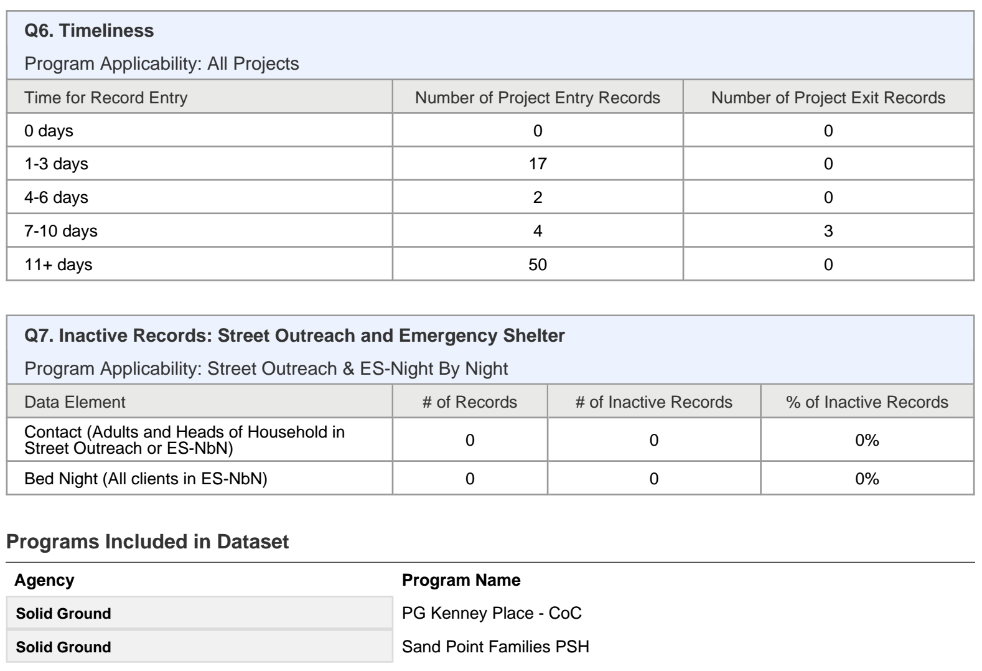
HMIS Data Quality Report

Slide 24
Reports
New and updated Coordinated Entry report coming soon!!!!

Slide 25
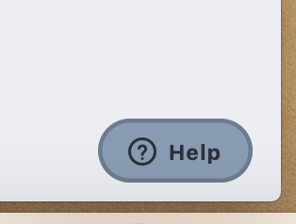
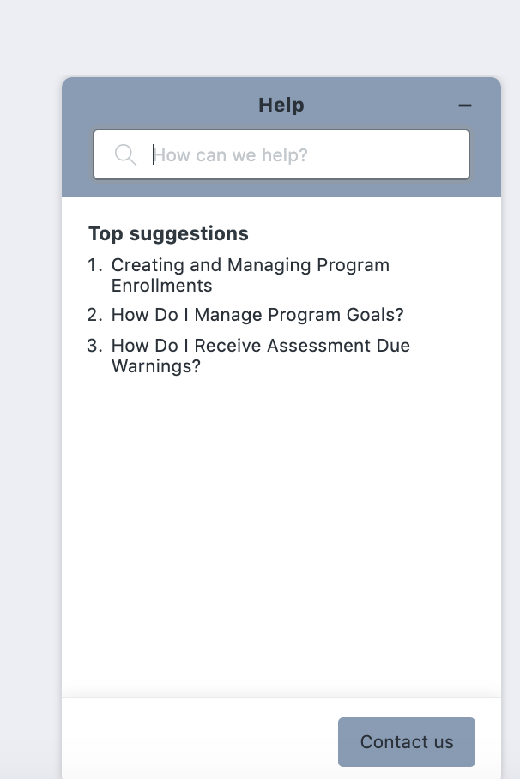
Resources
The Help Desk Widget
Bitfocus Help Desk
marin@bitfocus.com or (415) 429-4211
Marin Help Center Web Page
https://marin.clarityhs.help/hc/en-us
Coordinated Entry Training Materials

