Slide 1
Problem Solving
In the One System

Slide 2
Agenda
Agenda:
Switching Agencies
Joint Problem Solving/ Coordinated Entry Enrollment
Current Living Situation
Problem Solving Screening
Problem Solving Services
Uploading Files
Joint Problem Solving/ Coordinated Entry Exits
Reports

Slide 3
Navigating ONE
All Problem Solving work should be done under the San Francisco Coordinated Entry Agencies.

Slide 4
Joint Problem Solving-Coordinated Entry Enrollment

Slide 5
Problem Solving/CE Enrollment
Joint enrollment- Program names will remain the same in ONE.
Household seeking services must meet criteria under Homeless Status, Connection to San Francisco, and Household Type.
Access Point and Access Point partners can enroll eligible households in Access Point programs under the Coordinated Entry Agency.

Slide 6
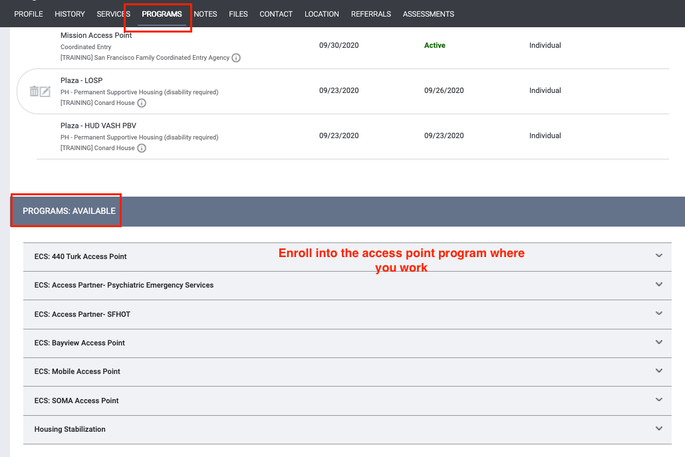
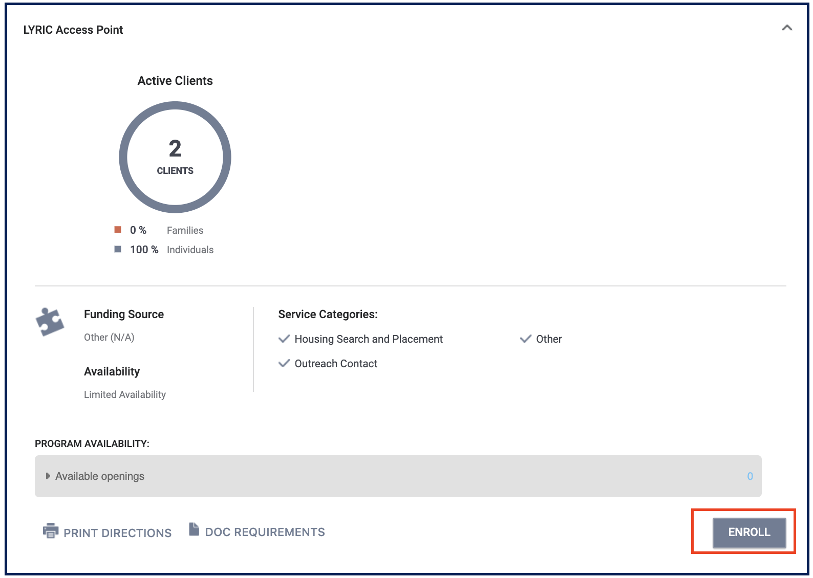
CE Enrollment

Slide 7
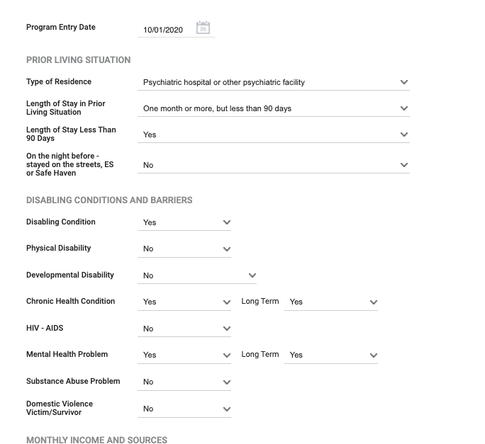
Problem Solving/ CE Enrollment
Information may auto-populate from a previous enrollment.
Make sure the information is up to date.
Complete all fields; avoid using “Data not Collected, “Client Doesn’t know,or “Client Refused” when possible.

Slide 8
Current Living Situation

Slide 9
Current Living Situation Assessment
Required as part of the 2020 HUD Coordinated Entry Data Standards
Used to regularly document the following:
The current living situation of people experiencing homelessness
Homeless chronicity
Used to understand how many times a person is engaged while experiencing homelessness.

Slide 10
Project Start
Project start is the enrollment into CE.
A CE Assessment or CE Event is recorded
For CE record a Current Living Situation anytime any of the following occurs:
The CE Assessment is the Family or Adult Primary Assessment. CE Events are services that are categorized as a CE Event.
The client’s living situation changes
If the client’s living situation has changed since their last engagement.

Slide 11
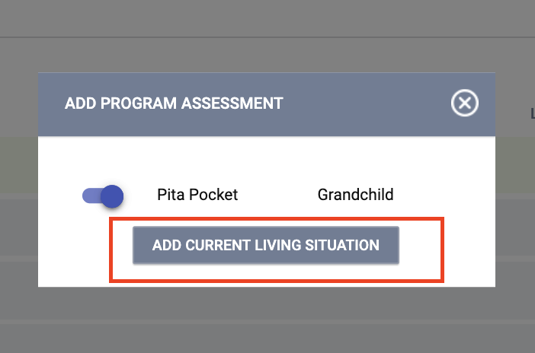
Current Living Situation Assessment

Slide 12
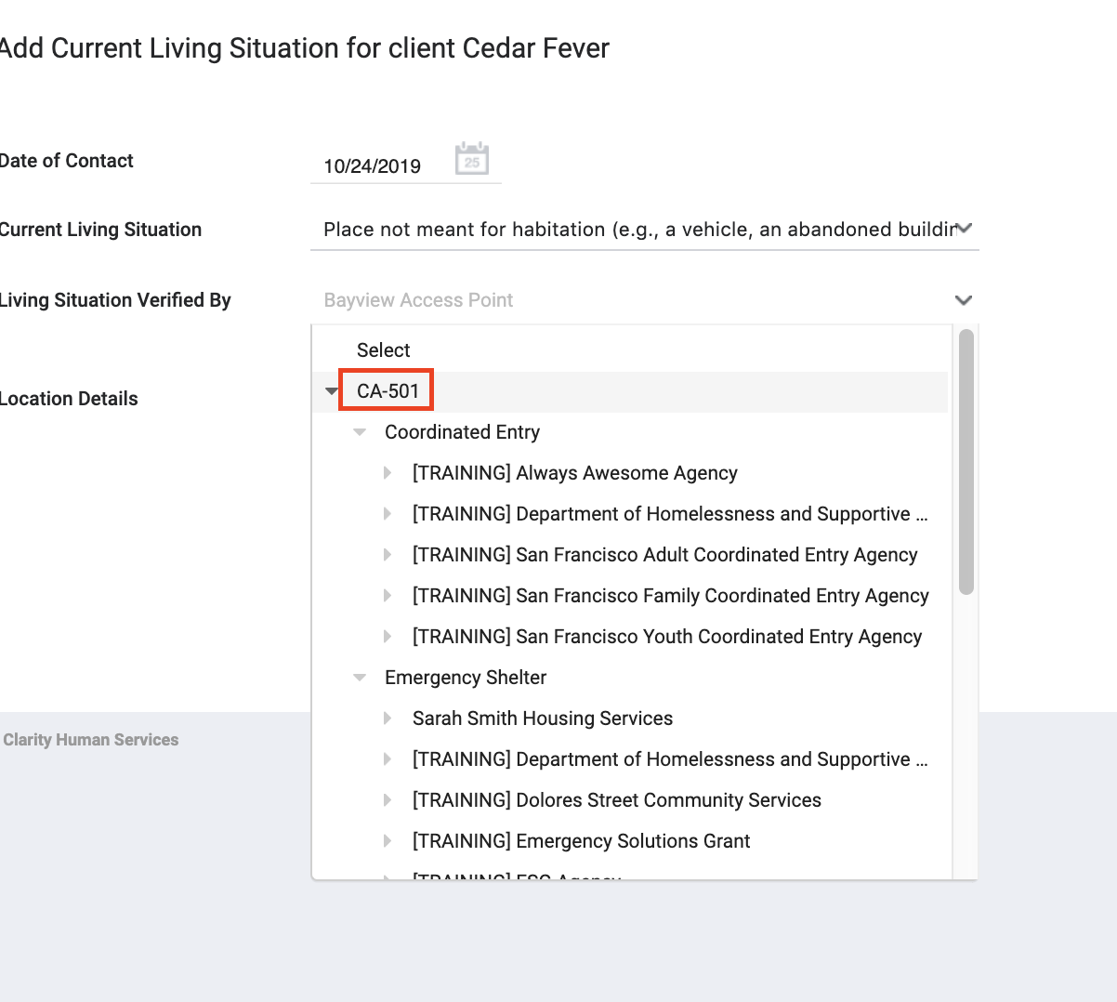
Current Living Situation Assessment
Living Situation Verified By field should be the CE agency/program.

Slide 13
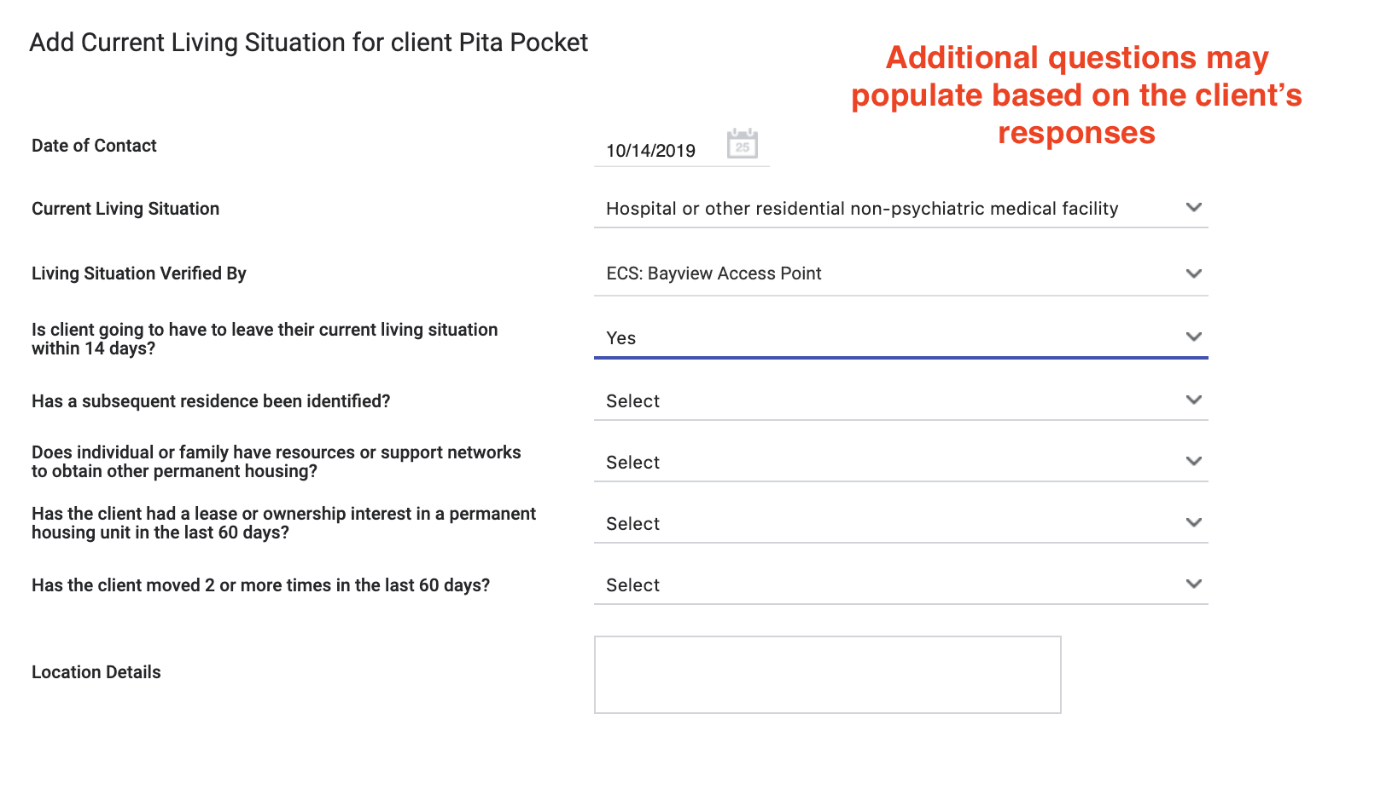
Current Living Situation Assessment

Slide 14
Problem Solving Screening

Slide 15
Problem Solving Screening
Used to quickly identify households who may be a good fit for a Problem Solving intervention.
Help to identify those households who may have factors that contribute to a successful Problem Solving intervention.
Income/income history;
Rental history; and
A support network /connections

Slide 16
Problem Solving Screening
When to complete vs update…
A Problem Solving screening should be completed at each new program enrollment.
A Problem Solving screening should be completed when there are changes to update for households who are Problem Solving status.
Please fill out a new screening each time. Do not update an existing screening.

Slide 17
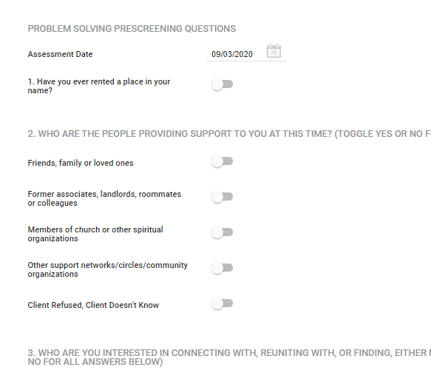
Problem Solving Screening

Slide 18
Problem Solving Services

Slide 19
Problem Solving Services
Prevent people from entering the HRS and to redirect people who can resolve their homelessness without the need for shelter or ongoing support.
Problem Solving is always the first attempt to resolve someone's housing crisis and is a continuous resource.
Problem Solving services include:
Problem Solving Financial Assistance
Problem Solving Housing Location Assistance
Problem Solving Mediation Services
Problem Solving Conversation
Problem Solving Referral to another Problem Solving Resource

Slide 20
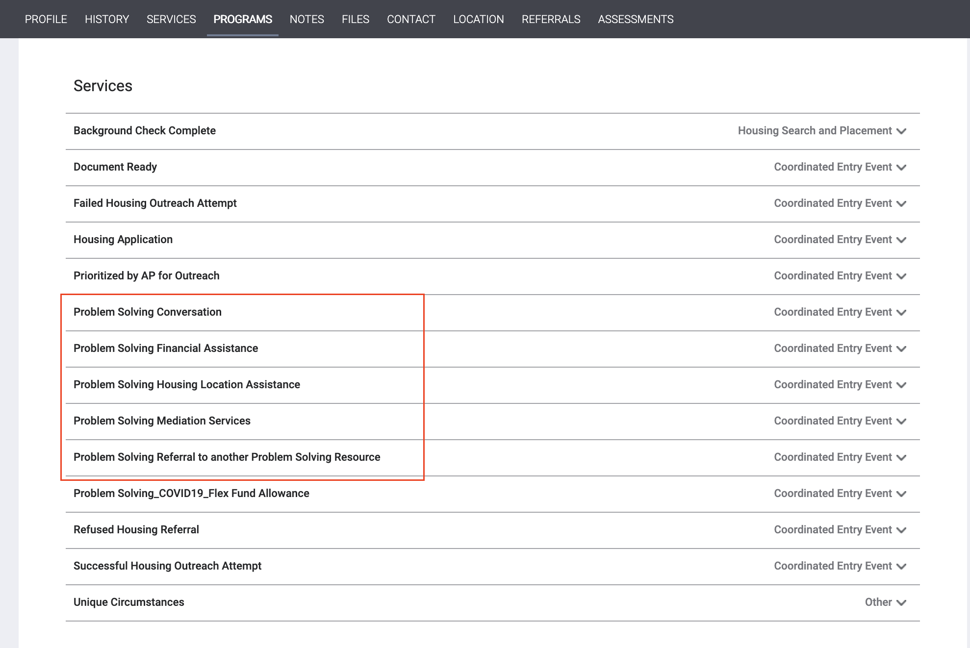
Problem Solving Services
Problem Solving services are considered CE Events. You must enter a CLS Assessment each time you enter a Problem Solving Service.

Slide 21
Problem Solving Conversation
What is a Problem Solving Conversation?
Any "housing-focused" case management conversations that was about exploring alternatives to a housing crisis outside of the homelessness response system.
Problem Solving conversations explore alternative solutions to a housing outside of the Homelessness Response System (i.e beyond shelter, Navigation Centers, getting on a waitlist, or accessing PSH/RRH from HSH/another housing-specific intervention).
Problem Solving conversations will most likely happen with only Problem Solving status households.
In the rare event that Problem Solving services are provided to a Housing Referral Status household, do input that conversation in ONE only after you’ve verified that it is indeed a Problem Solving service/conversation.

Slide 22
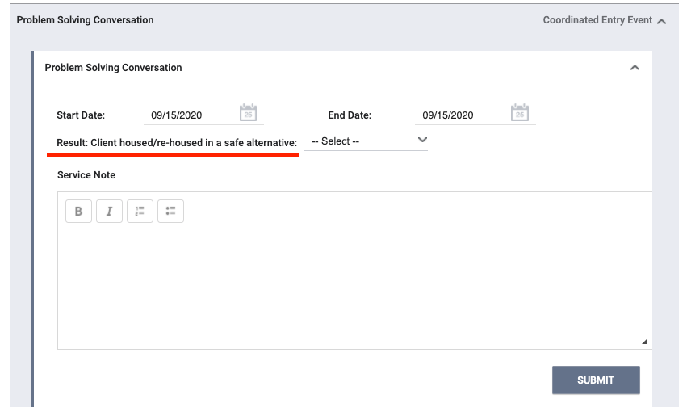
Problem Solving Conversation
An outcome should be recorded for each service.
Formerly Problem Solving Resolution has been reworded to “Client Housed/Re-Housed in a Safe Alternative”.

Slide 23
Not a Problem Solving Conversation
These following do not constitute a Problem Solving Conversation:
A conversation/interaction with a household that was more about general case management and referrals. For example:
Referral to a food pantry, behavioral health or any other community resources.
General administrative, case management duties.
A conversation with a Housing Referral Status around housing navigation services.
A conversation about shelter referrals or shelter information.

Slide 24
Notes
If staff have a significant interaction with a household that was not a Problem Solving conversation, a service should be entered (if applicable) or the interaction should be recorded under the Notes Tab.

Slide 25
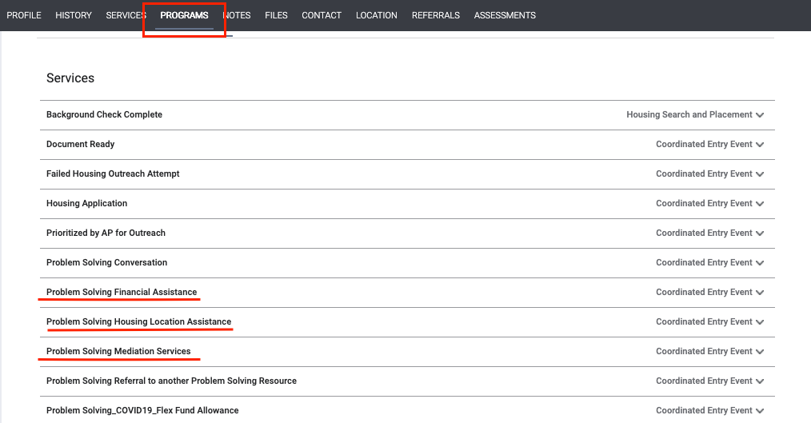
Problem Solving Services
There are financial and non-financial services.
Most services will have service items to choose from.
An outcome should be recorded for each service.
If entering more than one Problem Solving service for the same date/interaction, please make sure that only one of the services captures the Resolution/Outcome of “Yes”
Please include a note for all Problem Solving services.

Slide 26
Problem Solving Financial Assistance
Make sure that different flex grant categories are captured separately.
Ensure that flex grant funds are issued in accordance to policy limits.
$2,000 if no lease
$8,000 if lease/written agreement
Remember limits are per fiscal year. Amount easily trackable now.
Funds should only be issued when a Problem Solving resolution is achieved!
Start date, end date, result data, expense date – most likely will all be the same day.

Slide 27
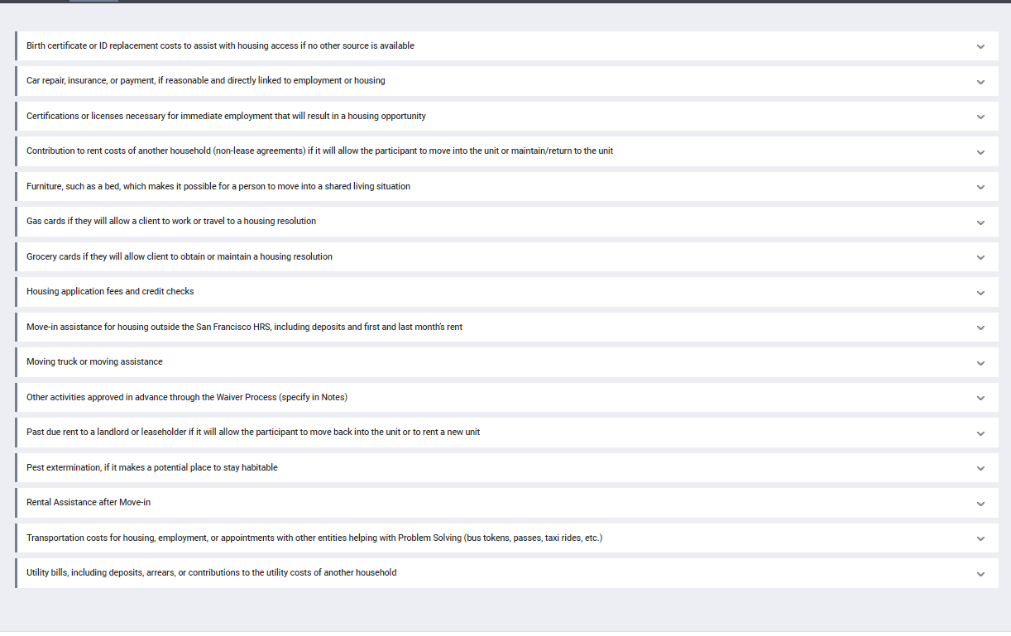
Problem Solving Financial Assistance
When financial assistance is issued, you will have to select the category of funds issued. There is a new category for Rental Assistance after Move-in.

Slide 28
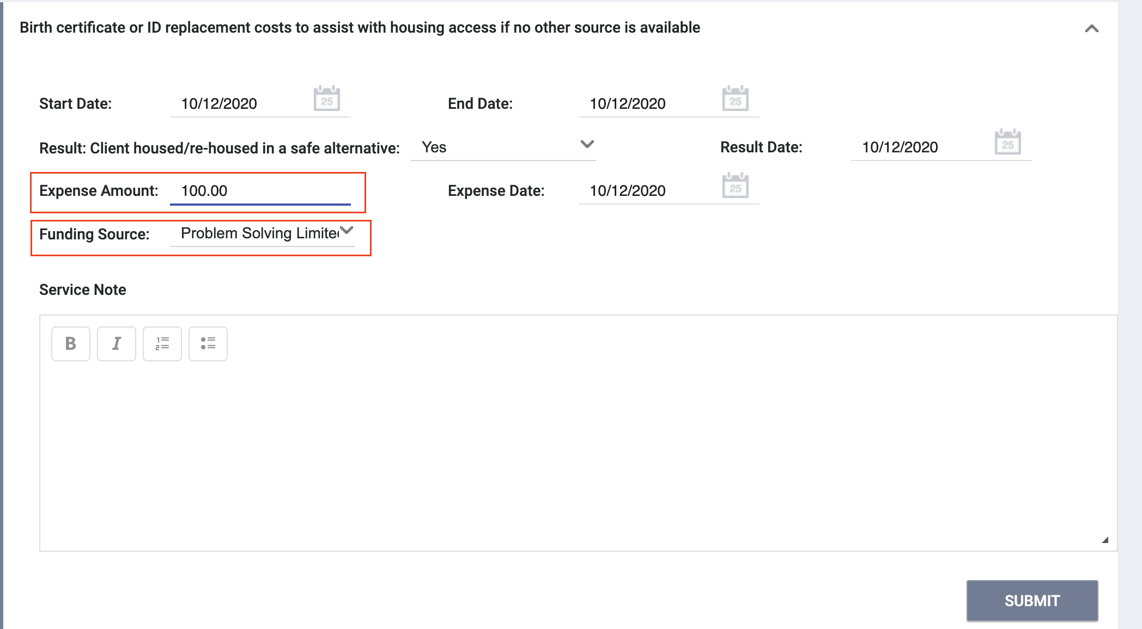
Problem Solving Financial Assistance
Expense amounts should be entered for financial services.
Funding Source will default to Problem Solving Limited Flex Fund.
Start date, end date, result date, and expense date will mostly likely be the same date.
An outcome should be recorded for each service.
If the outcome is unknown, select No.
For Financial Assistance Services, the Result should be YES. If multiple categories of financial assistance is issued, record only one with the Result YES.

Slide 29
Other Problem Solving Resources
HSH policy requires Problem Solving staff to refer to other financial resources first (if applicable and available).
“Referral to Other Problem Solving Resources” should be selected when referring to:
Homeward Bound
Eviction Prevention/Homelessness Prevention
Move-in Assistance
General referrals to community services should not be entered in this category.
The result “Client Housed/Re-Housed in a Safe Alternative” will always be No since another agency/program will issue the financial assistance.

Slide 30
Problem Solving Referrals

Slide 31
Outcome/Result
Remember for all Problem Solving Services…
If the result of Problem Solving service is “Client Housed/Re-Housed in a Safe Alternative = Yes” that is a resolution and the household should be exited from PS/CE Program in ONE.

Slide 32
Uploading Files

Slide 33
Uploading Files
Document | When to upload
Limited Financial Assistance Request Form | For all Resolutions that accessed Problem Solving Funds
Housing Resolution Plan Form | For all resolutions
Lease/Written Agreement/Intent to Rent | If appropriate for resolution
Housing Sustainability Tool | If appropriate for resolution
Housing Habitability Standards Inspection Checklist | If appropriate for resolution

Slide 34
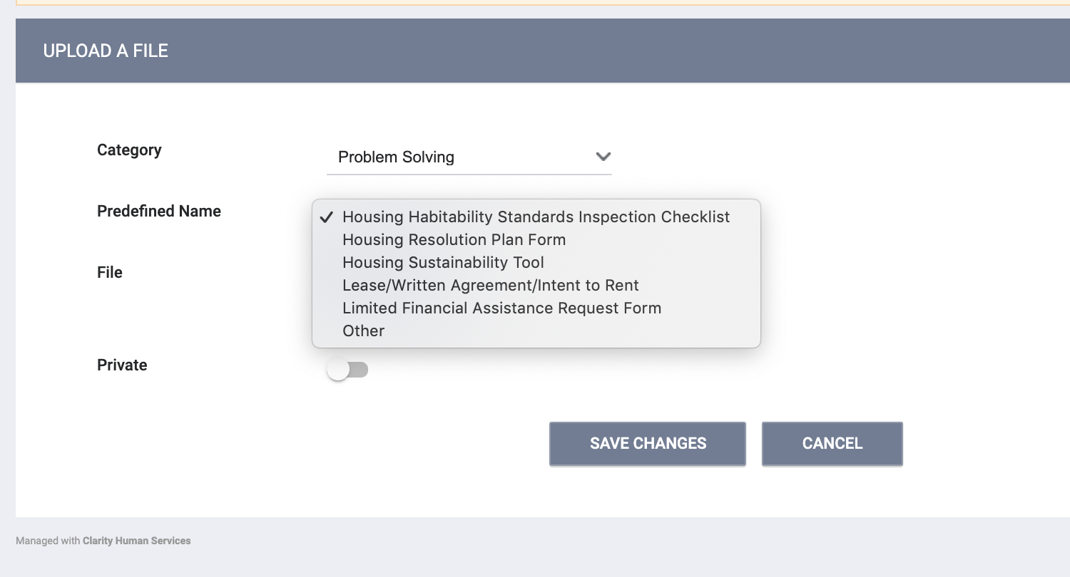
Uploading Files

Slide 35
Joint Problem Solving-Coordinated Entry Exits

Slide 36
Joint Problem Solving- Coordinated Entry Exits
In general, a household will be exited from the PS/CE Program in ONE when:
If Problem Solving Status – the client finds a Problem Solving resolution.
Client Placed in Institutional Setting
Death
Denial of Service
Exit by Client Choice
Terminated from Program due to Eligibility
If Housing Referral Status – the client is housed through CE.
Clients may be automatic or manual (auto-exits explained on a later slide)

Slide 37
Auto-Exits
Auto-exits from the CE/PS may occur if:
The household permanently housed through CE.
Any household enrolled in the PS/CE program that had no activity in ONE for 90 days.
Exit Destination will be marked as “Unknown”.

Slide 38
Auto-Exits from CE when Housed
The following events will trigger an auto-exit from CE Program:
A staff member saves a value for the field Housing Move-In Date in an enrollment screen for any program enrollment with a permanent housing program Type.
A staff member saves a “housed" exit Destination for any program exit screen.
Example 1:
The client is referred to a PSH program. The client is enrolled in the program with a move-in date of 7/30/20.
Auto-Exit from CE= YES
Example 2:
The client informs their case manager they are going to live with their aunt in Oregon.
Auto-Exit from CE=NO
The client needs to be manually exited from CE.

Slide 39
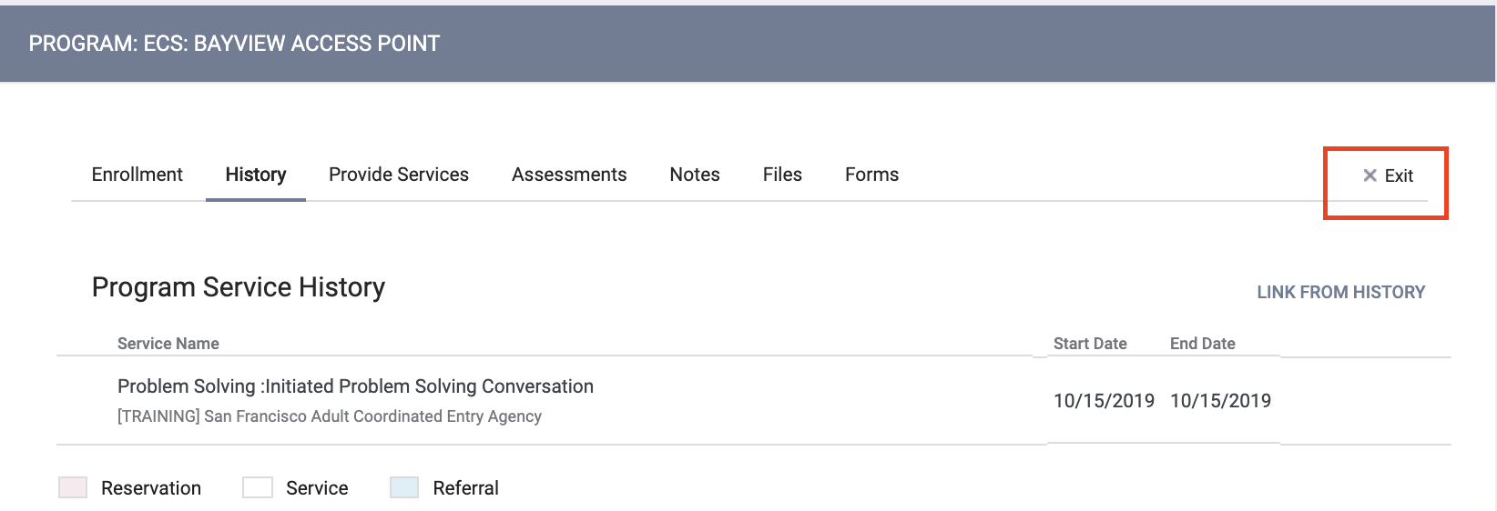
Exits
To complete the exit, you will complete the following steps.

Slide 40
Exits Reasons for Problem Solving
Housed through Problem Solving Resolution:
When a Problem Solving resolution has been reached and the household has found a safe, indoor place outside of the Homelessness Response System, Access Point staff will manually exit the household from the Access Point program.
Housed by Referral to Other Problem Solving Resource
If a household was referred to another Problem Solving Resource (specifically Homeward Bound, Move-in Assistance and Eviction Prevention/Back-rent Assistance), the Access Point staff will select the “Housed by Referral to Other Problem Solving Resource” only if the outcome of the referral is known.

Slide 41
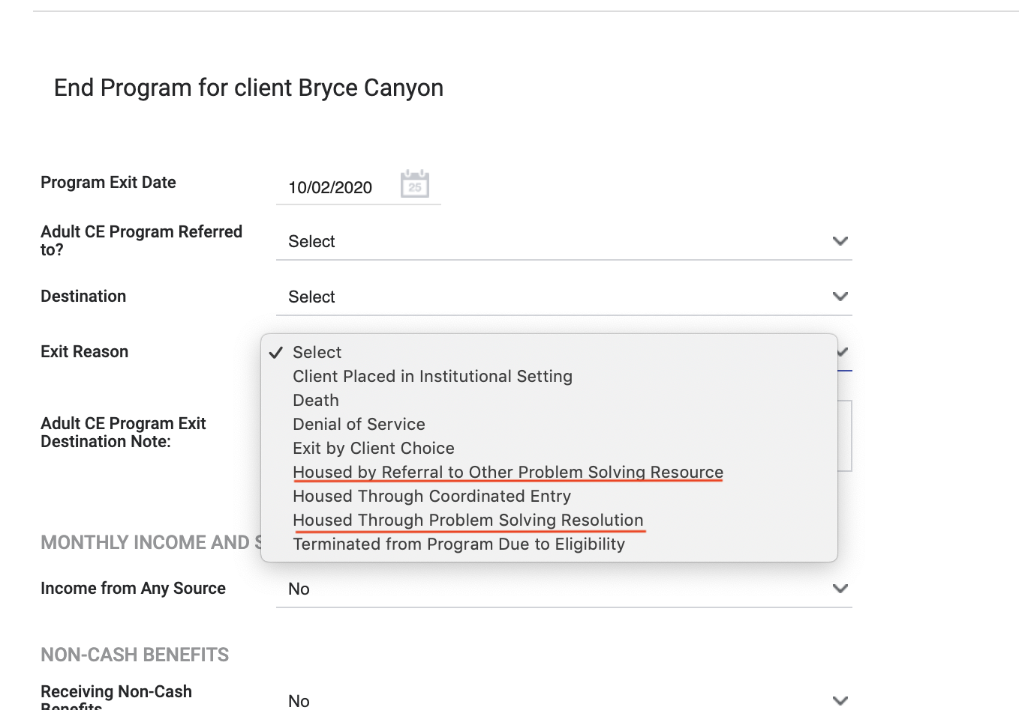
Exits Reasons for Problem Solving
There are two possible exits reasons that should be used for Problem Solving:
Housed through Problem Solving Resolution.
Housed by Referral to Other Problem Solving Resource.
Exit Destination and Exit Reason must be congruent and align.

Slide 42
Other Exit Fields
Program Exit Date – date of exit.
Destination – Select most appropriate exit destination.
Other should rarely be used.
Make sure Destination and Exit Reason are congruent.
For Problem Solving Resolutions – make sure that exit Destination is outside of the Homelessness Response System.
CE Program Referred To? – This is only to be completed for people who are exited to an HSH funded housing program that is not listed in the ONE System.
Use Data Not Collected for PS Resolutions.
CE Program Exit Destination Note –
Income, Non-Cash Benefits and Health Insurance – these fields cascade from the enrollment screen. Please update with most accurate information at time of Exit.

Slide 43
Who is responsible for exiting?
If Housed through CE: auto-exited from CE. This includes RRH and PSH.
If Housed through Problem Solving: manual exit
If Housed through Referral to Another Problem Solving Resource – manually exit if:
The status of referral is known (if staff know with certainty that referral worked out)
If referred to the three specific Problem Solving Referrals (Homeward Bound, Move In Assistance, Back Rent Assistance).
If Death/Institutionalized/No longer Eligible/Etc: manually exited or auto-exited if no activity.

Slide 44
Reports

Slide 45
Program Roster
[GNRL-106] Program Roster (Program Based Report)
Who’s stayed in the program.
Lists program stay information for clients with the selected status in the selected program.

Slide 46
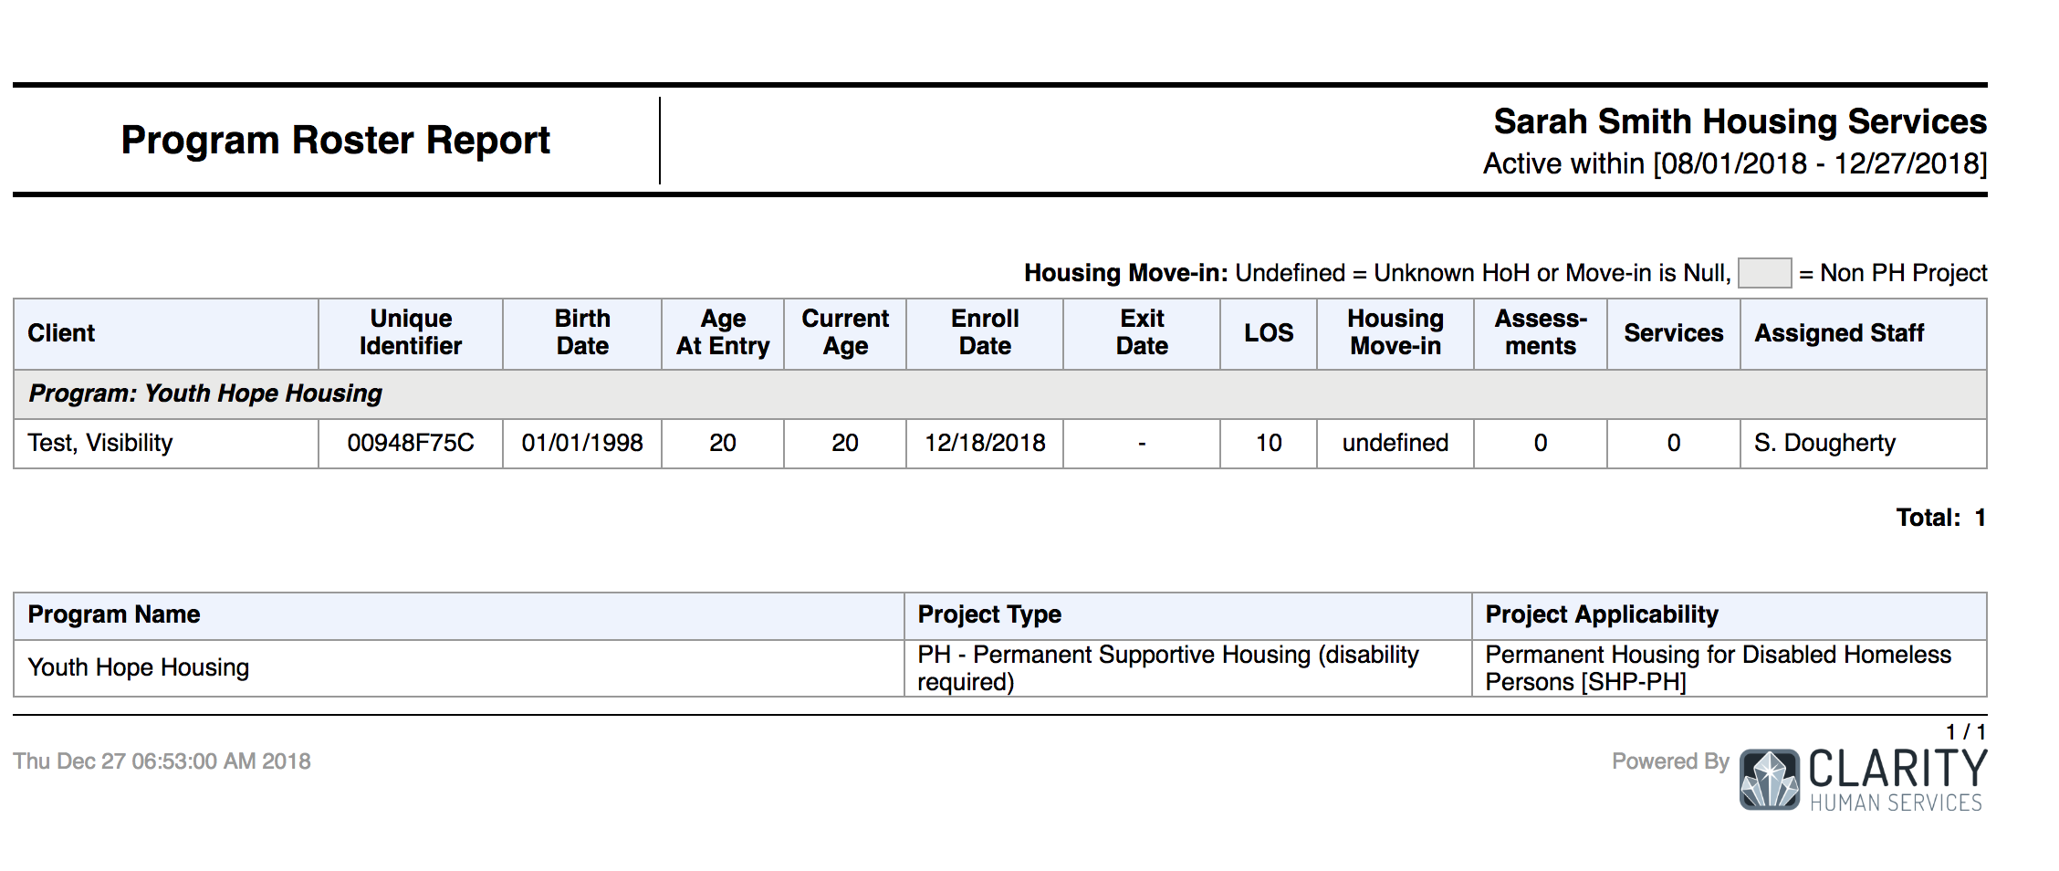
Program Roster

Slide 47
Financial Details Report
[EXPS-101] Funding Source Financial Detail (Service Based Report)
Provides details of an agency’s funding source(s)
A detailed history of an agency’s associated service transactions for a specified date range.

Slide 48
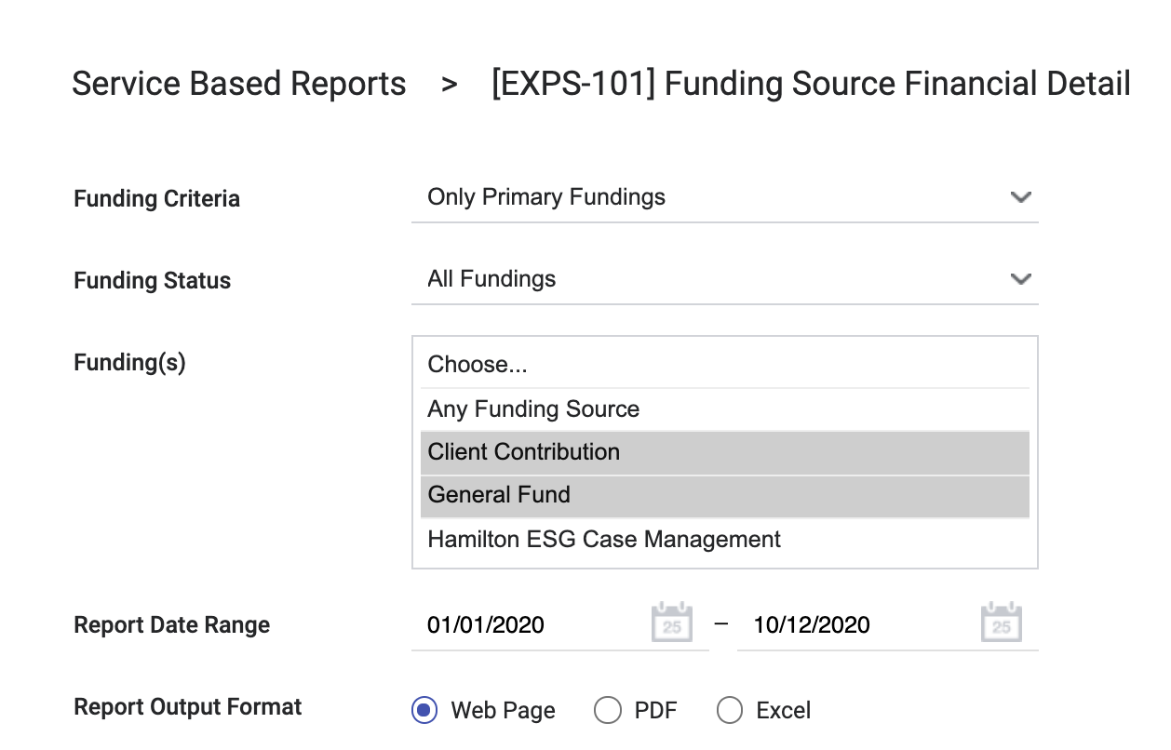
Financial Details Report
Select the specific services you want included in the report.

Slide 49
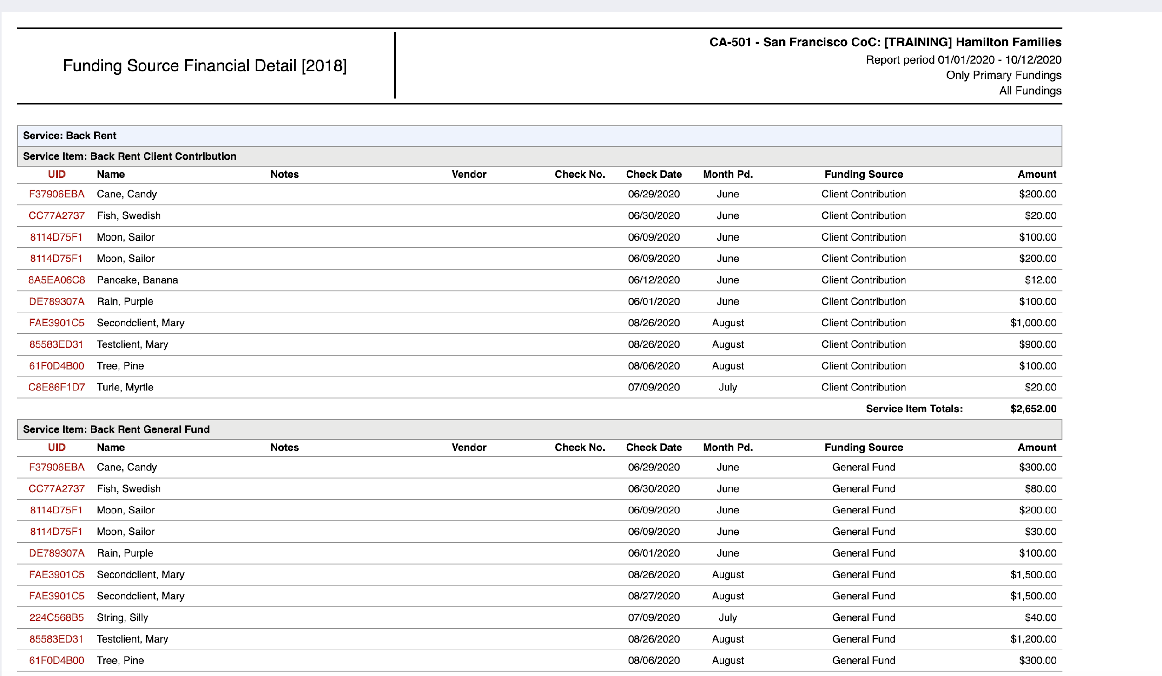
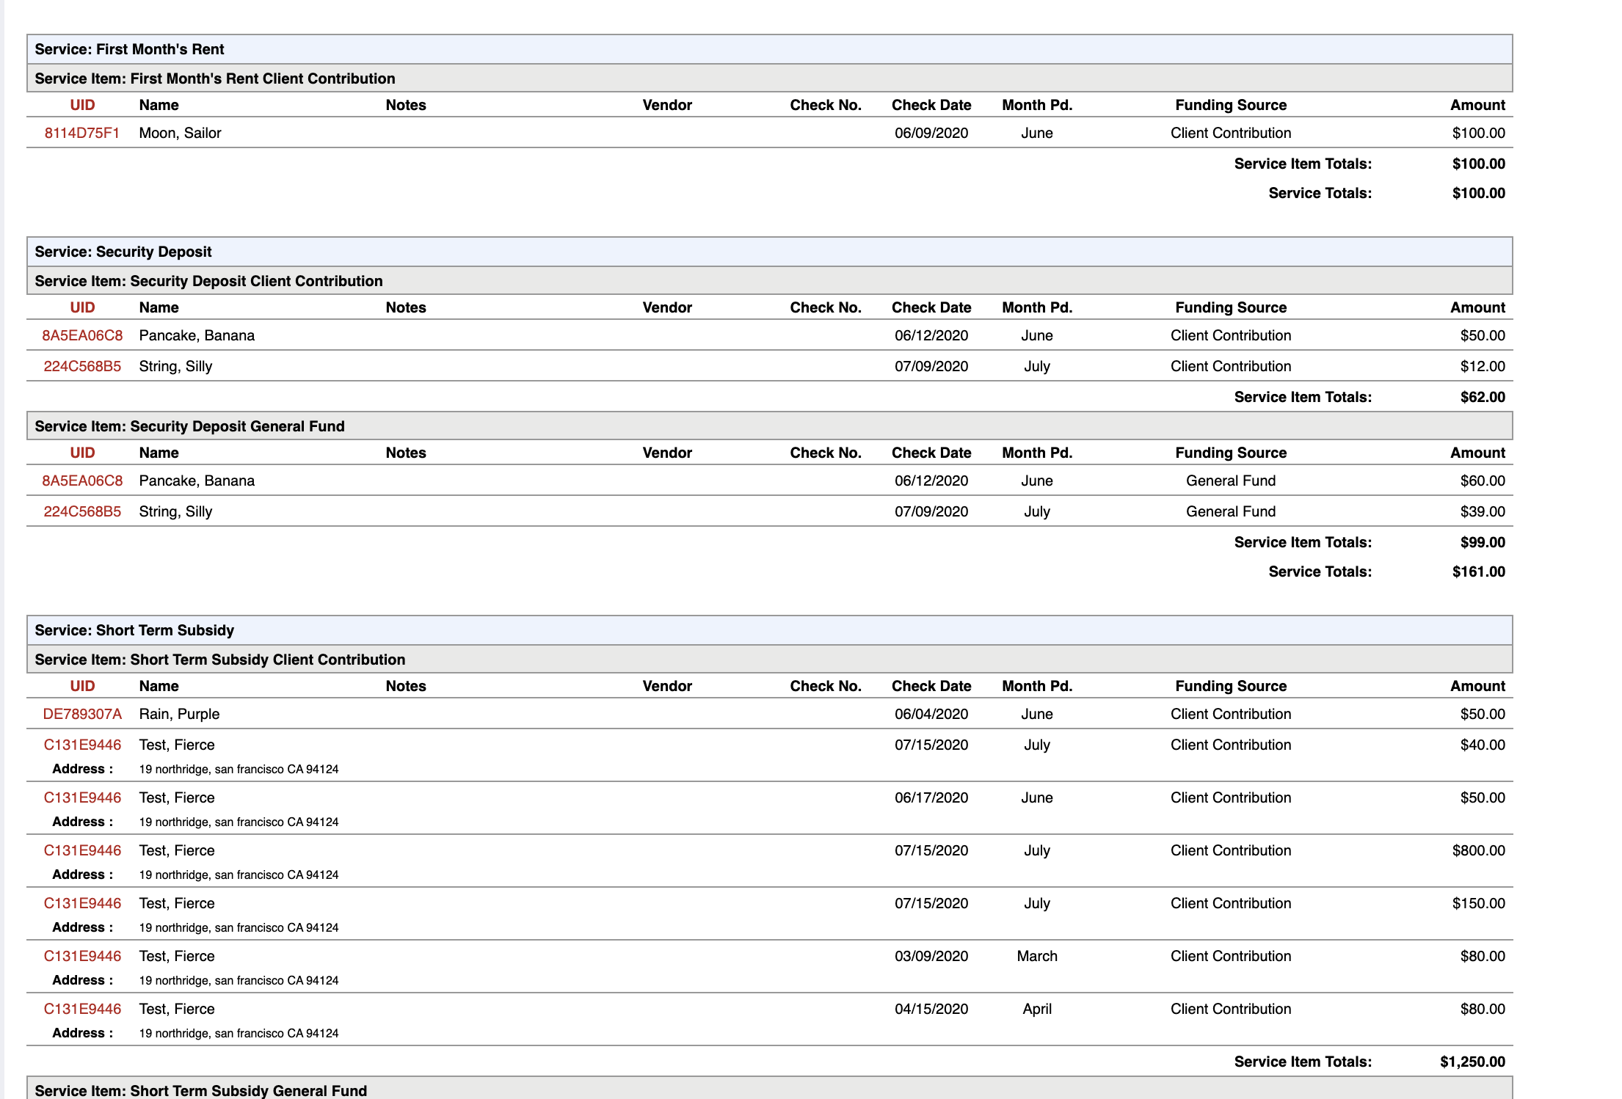
Financial Details Report

Slide 50
Service Summary
[GNRL-104] Service Summary (Service based reports)
Total number amount of clients.
Including the total number of unique clients.
Who received selected services during the report data range.

Slide 51
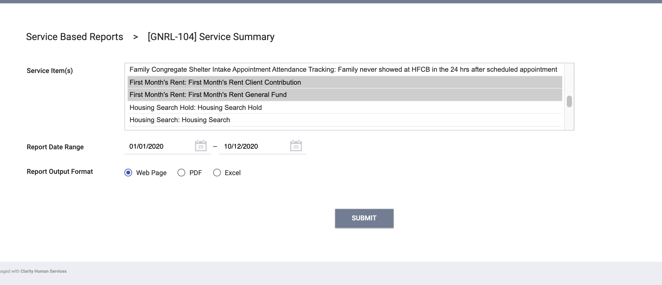
Service Summary
Select the specific services you want included in the report.

Slide 52
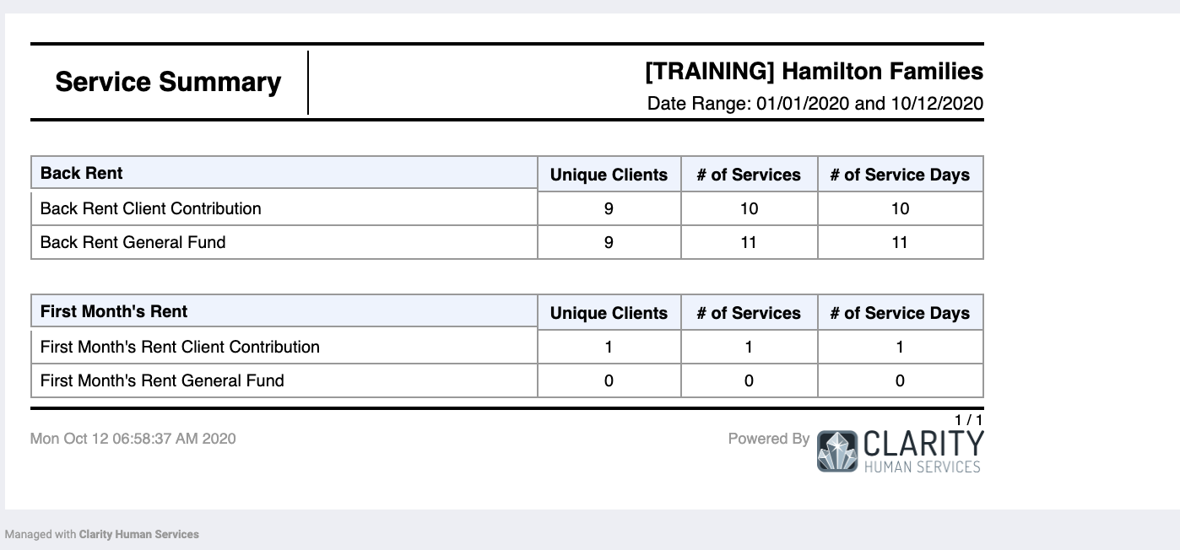
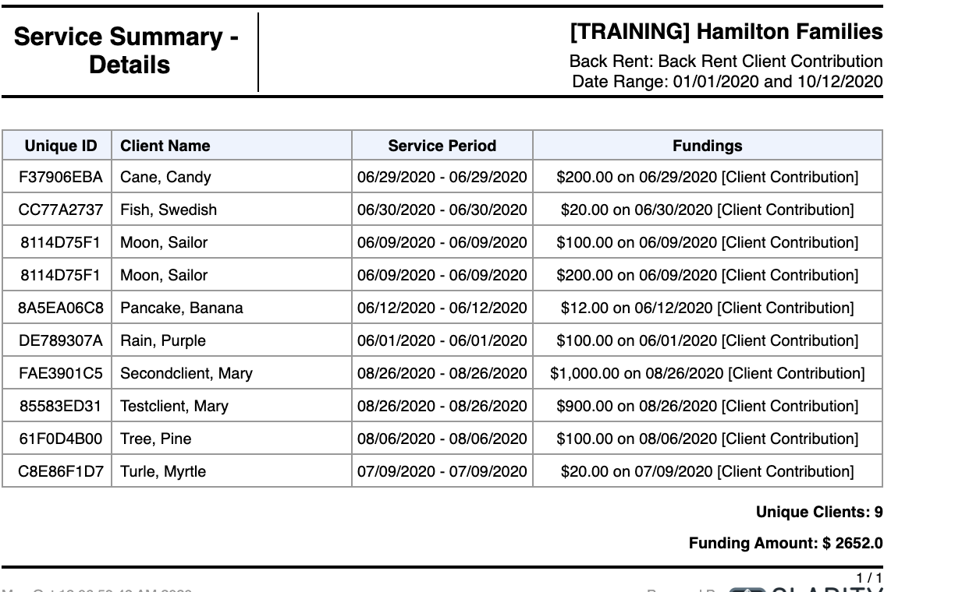
Service Summary

Slide 53
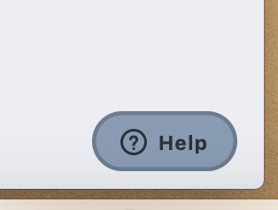
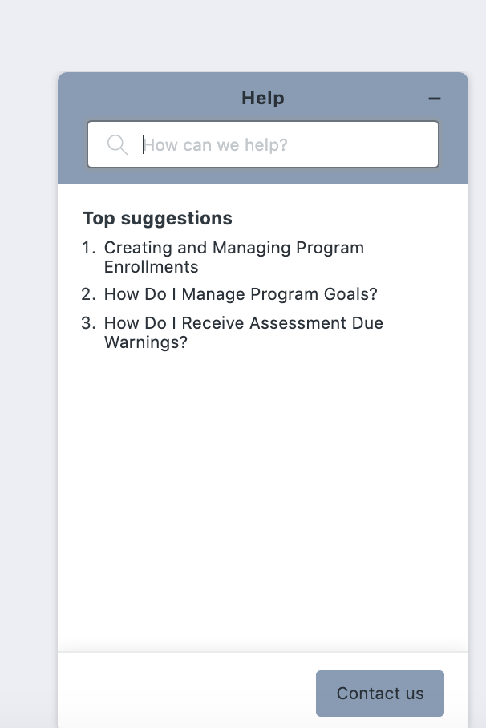
Resources
Bitfocus Help Desk
onesf@bitfocus.com or (415) 429-4211
ONESF Help Center Web Page
https://onesf.clarityhs.help/hc/en-us
The Help Desk Widget

