Slide 1
Homelessness Prevention Training
ONE System

Slide 2
Learning Objectives
Enroll a client in the program
Document service provision
Exit a client from the program
Merge Duplicate Profiles
Reports
Client Files
Notes:
Brand new enroll

Slide 3
Searching for Clients in ONE
Search for client/ head of household
Search by name, , partial name, DOB and SSN
If unable to find head of household, create a new client profile

Slide 4
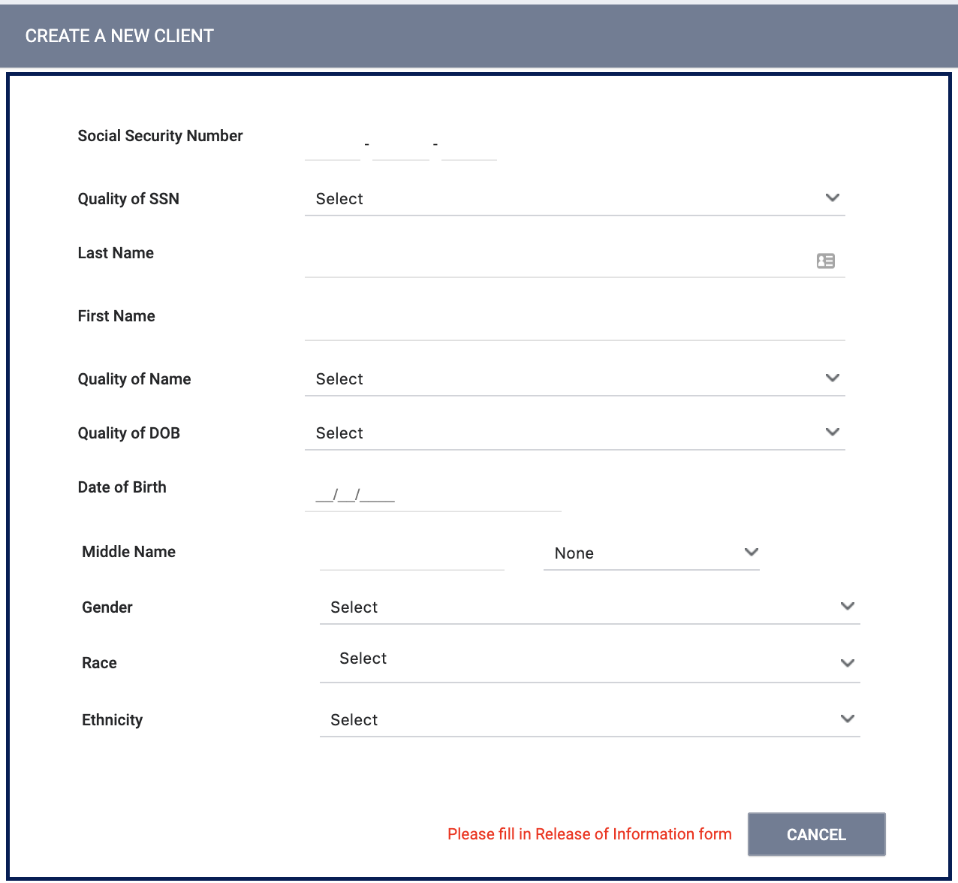
Creating New Profiles
Please make sure to collect as much information as possible, and avoid using “Client refused” or Data Not Collected” whenever possible
For existing profiles, confirm that all information is correct
Profiles must be created for all members of a household

Slide 5
Duplicate Profiles
Duplicate client records occur when staff members create two or more records for the same client.
How to merge duplicate profiles
Contact the Help Desk at onesf@bitfocus.com
Unique identifiers of primary and secondary profiles
Indicate which is the primary profile
Merges cannot be reversed so please make sure to review the profiles to determine the primary profile
Notes:
Client profile from primary profile takes precendence, unique identifier of primary record, the system merges households from secondary record to merged record, Any program enrollments, service items, notes, public alerts, files, location records, assessments, and referrals in secondary client record(s) are transferred to the newly merged record and display in their corresponding tabs and the client history of the primary record.
This may result in duplicate activity (for example, if the client has an enrollment for the same program in two different records). Review the newly merged record. If you identify duplicate activity contact the Help Desk to delete the duplicate.

Slide 6
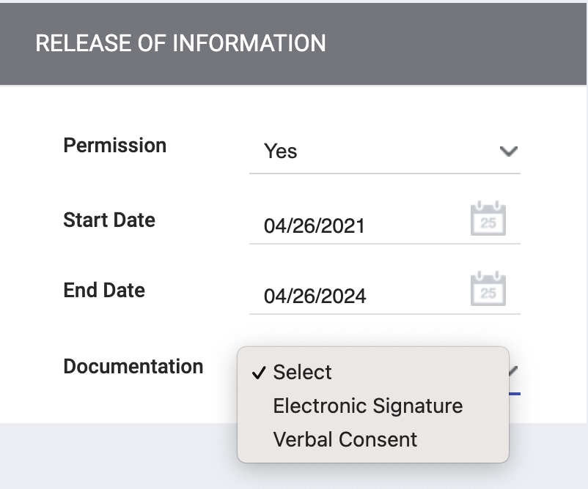
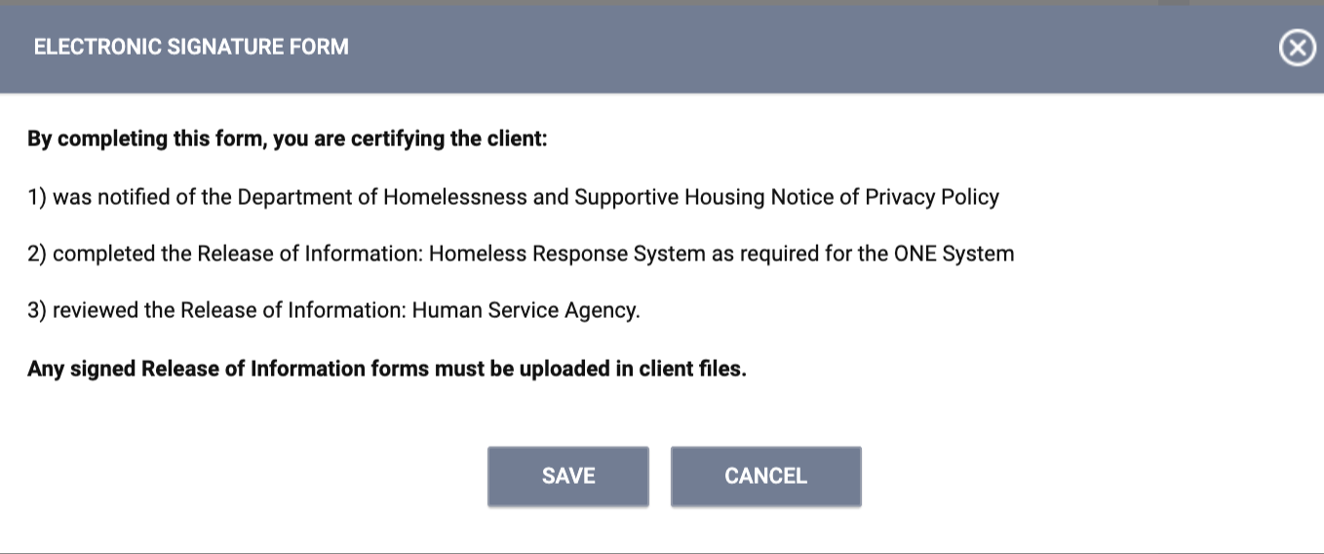
Release of Information
When creating a new client profile, ONE will prompt you to have the client sign a Release of Information.
The Release of information enter date, should correspond with both the date that the client signed the release and the date you created the client profile.
In the next slide we will demonstrate where you can upload the corresponding release of information.

Slide 7
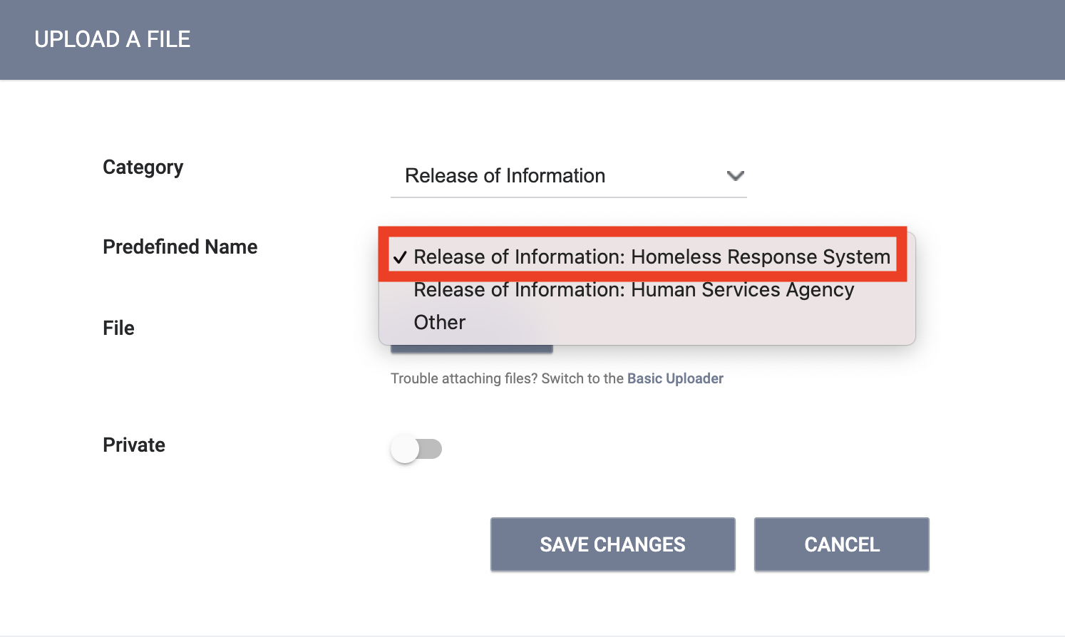
Uploading ROIs
To upload an ROI, select the files tab
Select the category for Release of Informaton
Notes:
Now show the process

Slide 8
ROI Process During COVID
Given that services may now be provided remotely, the Homeless Response System ROI can be completed as follows:
Staff to review ROI with household and offer to provide a written copy.
Client/participant to provide meaningful verbal consent.
Staff to document that this process has happened via note in ONE.
Notes:
Now show the process

Slide 9
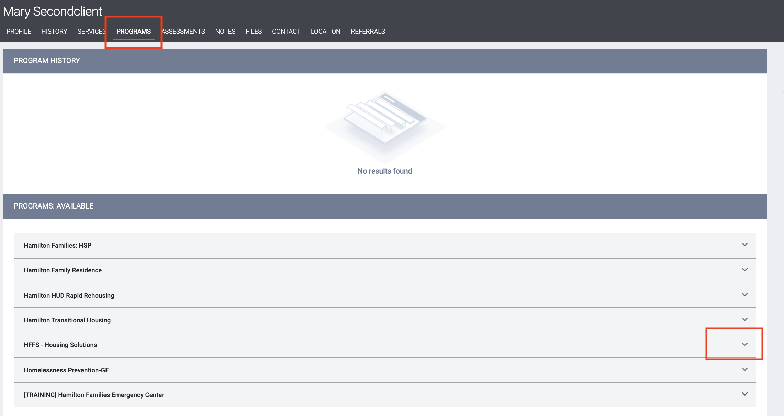
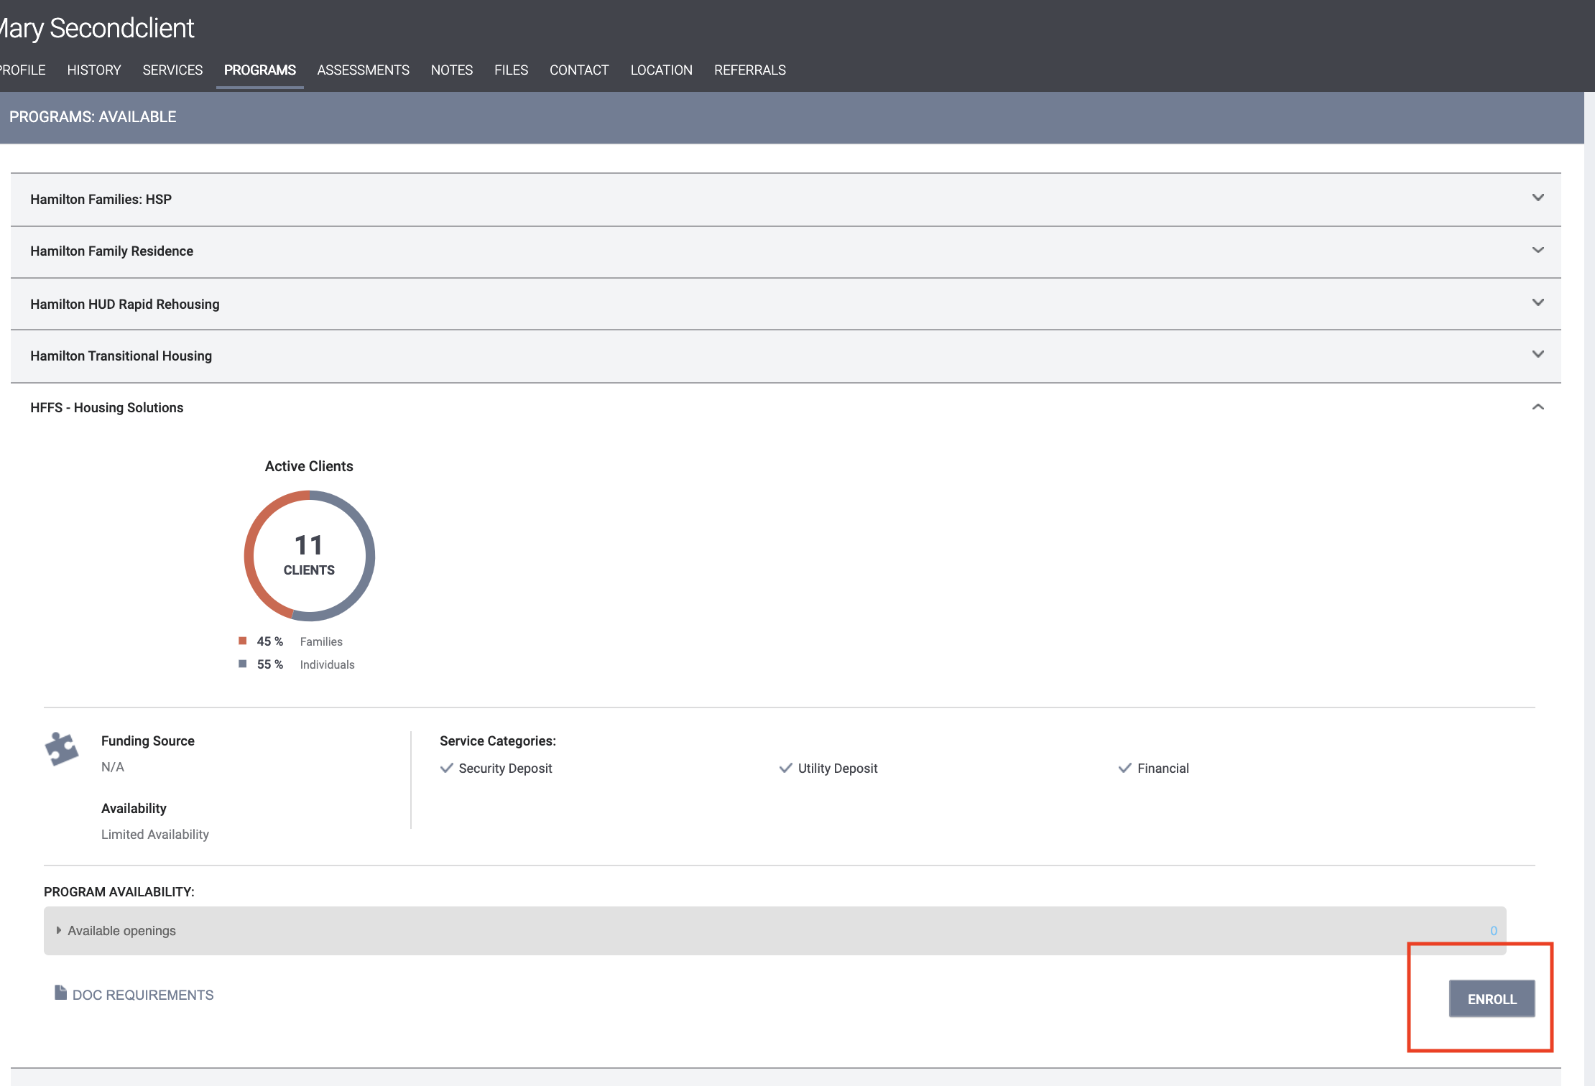
Program Enrollment
All members of the household should be enrolled in ONE
Enrollments indicate that a client is being served by a particular program
Data from enrollments are also used to compile reports for funders
Notes:
On the client’s profile screen, click Programs. You will see a list of the programs available at your agency. Click on the down caret next to the program you for the client. Information about the program will display. Click Enroll.

Slide 10
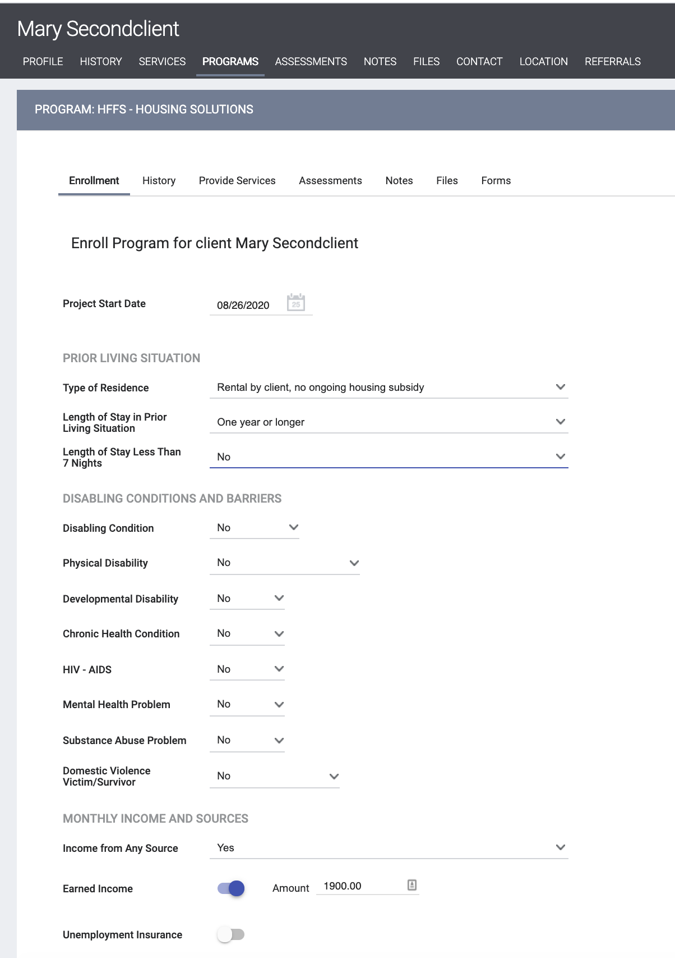
Program Enrollment
When doing enrollments, please make sure to collect as much information as possible
Please avoid using “Client refused” or Data Not Collected” whenever possible
Notes:
Complete all information on the enrollment screen and click save.

Slide 11
Hints/Clarifications: Program Enrollment
Info can cascade from another enrollment in another program in the last 6 months
Disability questions and health insurance questions – HSH has to keep due to internal and external reporting
One-time data collection burden.
If yes to disabling condition field, then subsequent questions are mandatory.
For family members in household - a bit shorter of an enrollment screen; though it does ask for disability per person.
Notes:
Complete all information on the enrollment screen and click save.

Slide 12
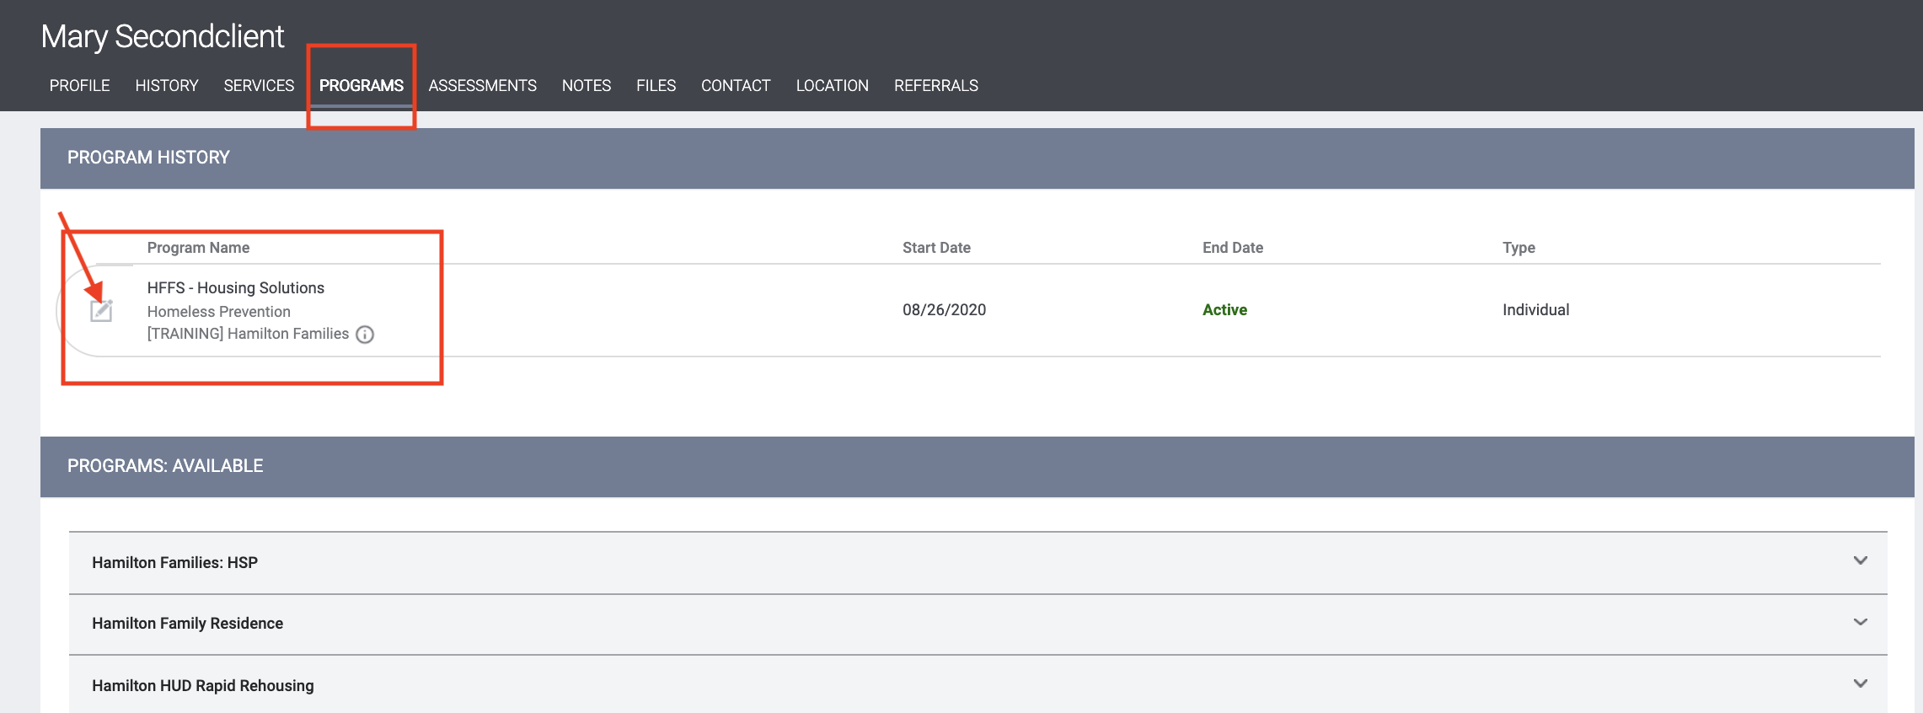
Entering Services
Notes:
To return to the program record for the client later, click on the programs tab from the client’s profile screen. Then find the program enrollment and click on the edit icon that appears when you hover over the program name.

Slide 13
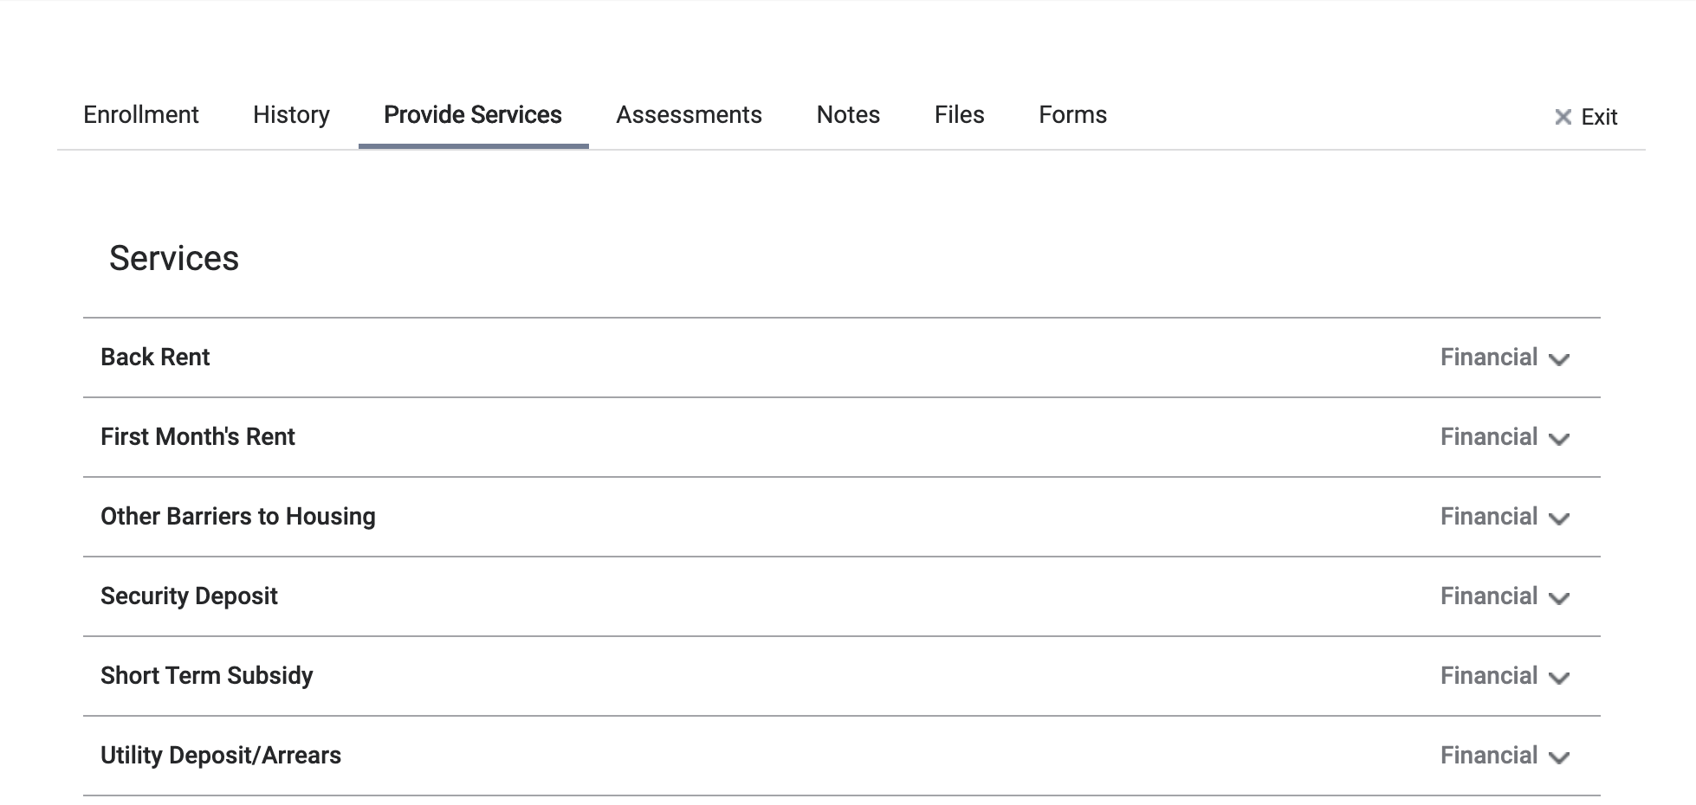
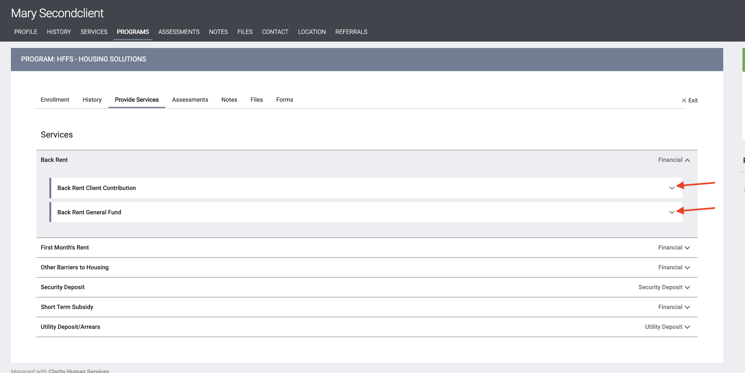
Entering Services
Notes:
In the program record, click on Provide Services. Then find the service you want to record in the list and click on the down caret to the right of the service name. This will open a list of service items. There should be two service items for each prevention service. You will record both of these service items one at at time by clicking on the down caret and completing the service item form that displays.

Slide 14
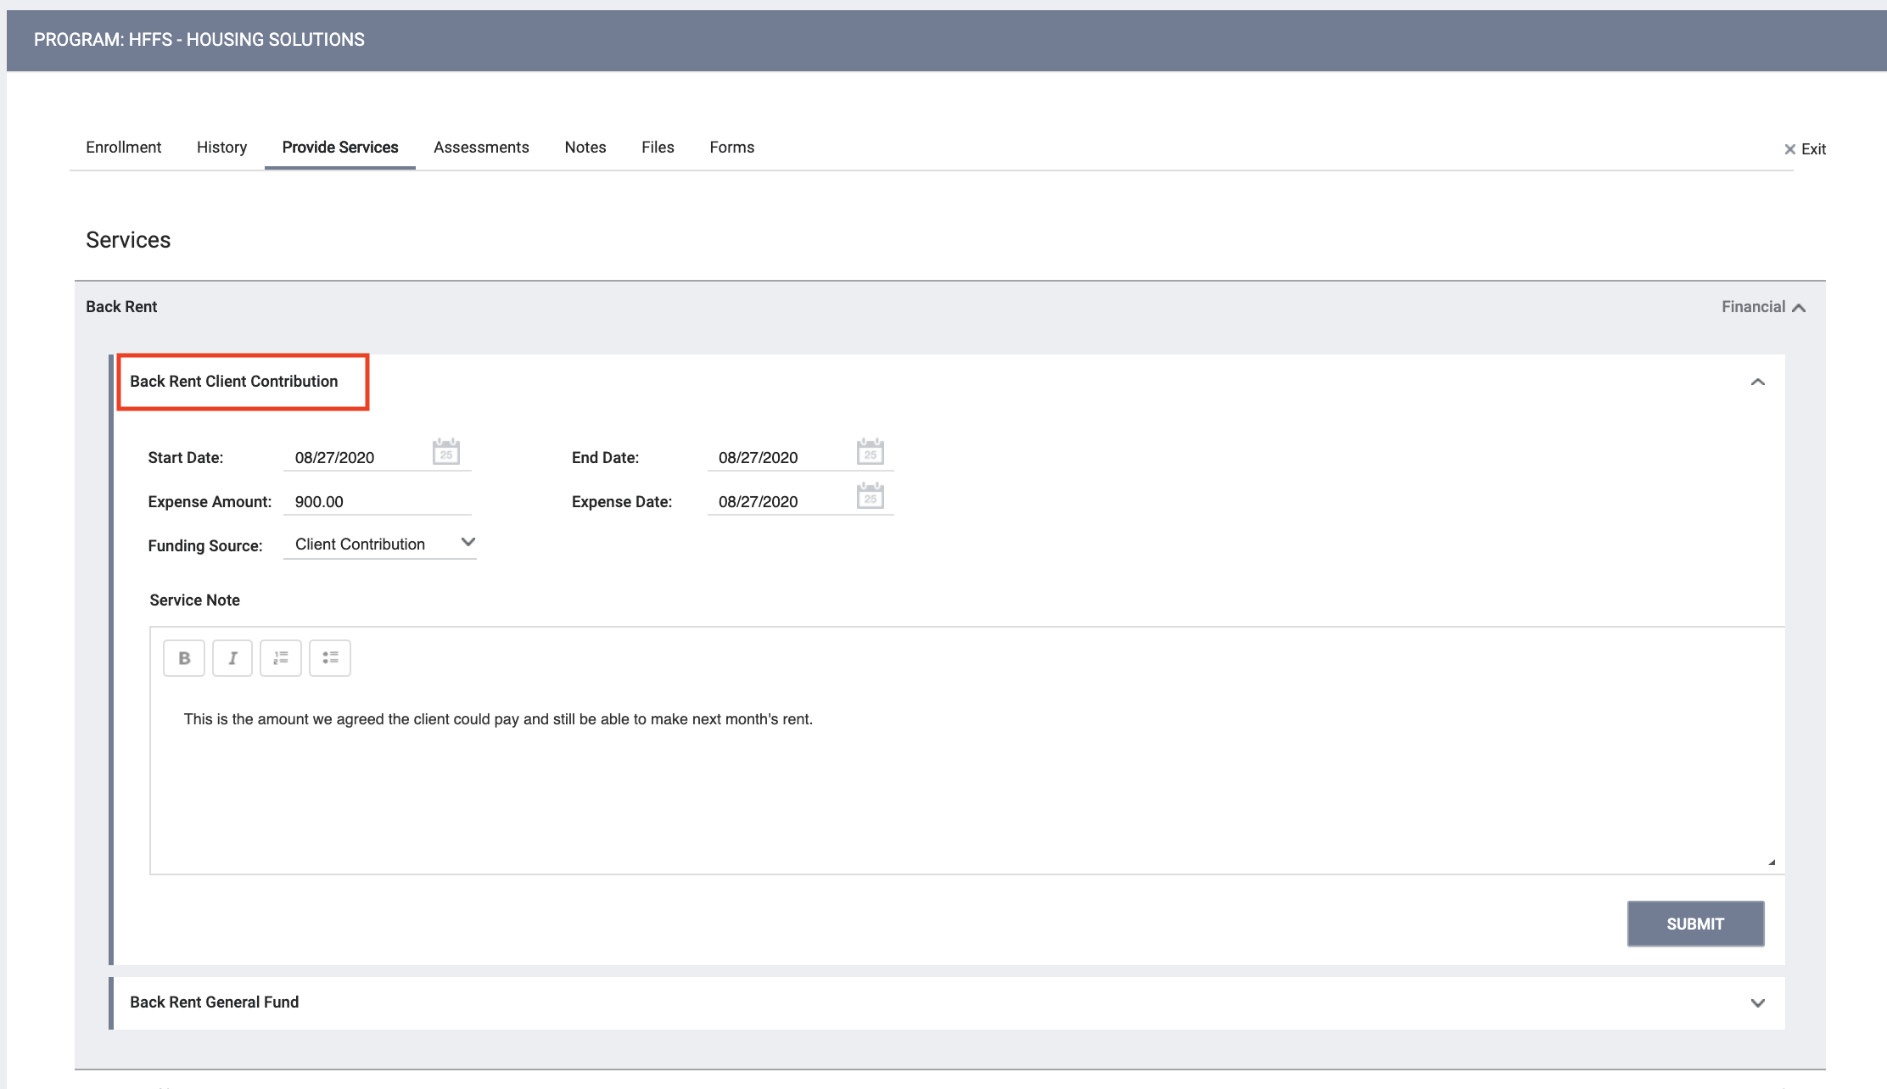
Entering Services
Enter the information for the client contribution
Then enter the information for the agency expense
The service-end date and expense date will most likely be the same.
Data entry should happen as services occur
For short-term subsidies, service should be entered once
Then date and amount updated for subsequent months
Notes:
Be sure to update all three dates to the accurate dates of service provision and expenditure. The service end date and expense date will most likely be the same
Enter the expense amount and select the appropriate fund source. Enter a note with any necessary information for the record, Be sure to provide a service at least once every 90 days or exit the client if services are complete.

Slide 15
Hints/Clarifications: Entering Services
Date of service- same as current policy = day that financial assistance is disbursed
Data entry should happen as services occur
In general, please, make sure everything is in by 10th of the month.
Program enrollments must be active in order to enter a service
Funding source – just like in the spreadsheet, you are asked to identify what is the funding source for the assistance (General Fund or client contribution).
Auto-populates client contribution in client contribution; and general fund in general fund

Slide 16
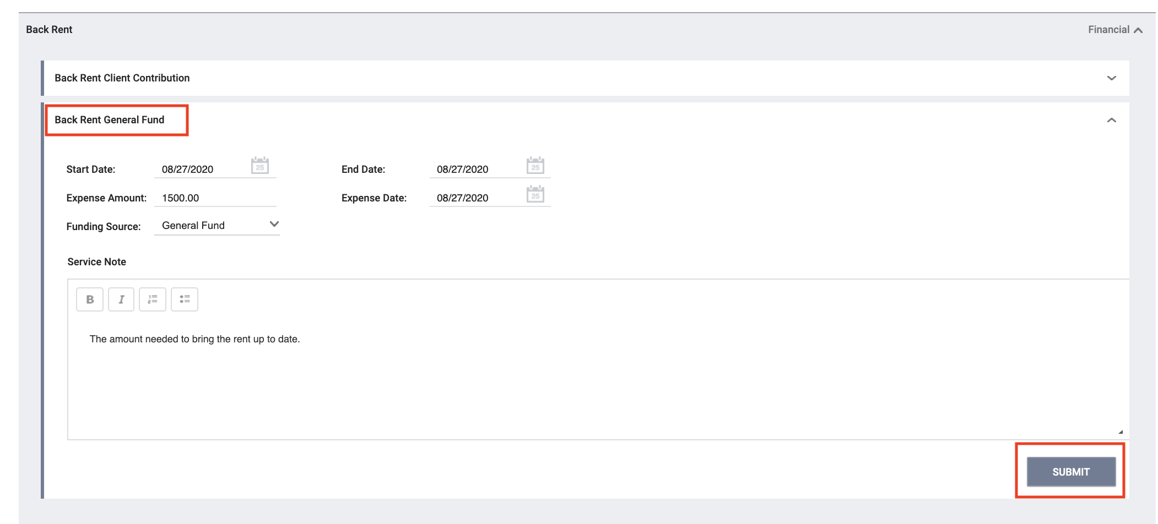
Services and Auto-Exits
Clients who don't have a service entered within 90 days will be auto-exited from the program.
Notes:
Be sure to provide a service at least once every 90 days or exit the client if services are complete. Clients who have no service entered for 90 days will be auto-exited on the last day a service was provided.

Slide 17
Reports- [EXIT-101] Potential Exits
Clients who don't have a service entered within 90 days will be auto-exited.
Staff can run a report to see which clients are close to being auto-exited to make sure the information is correct
The “cut-off date” should be 90 days from the date you are running the report
Staff are encouraged to run this report at least once per month

Slide 18
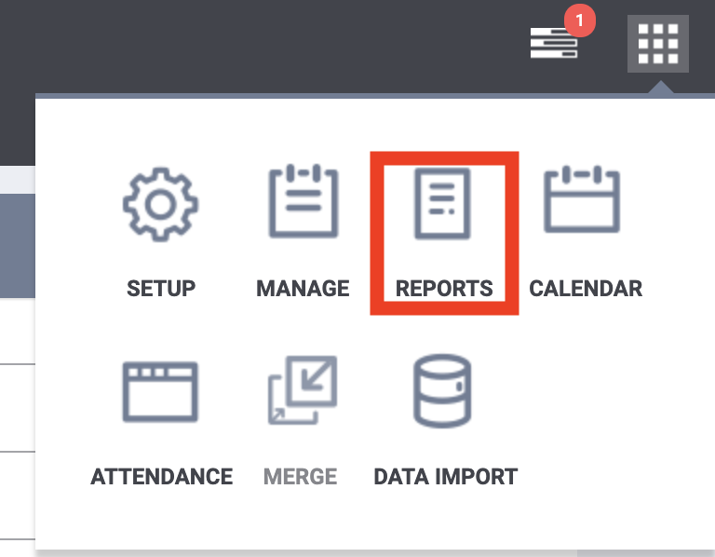
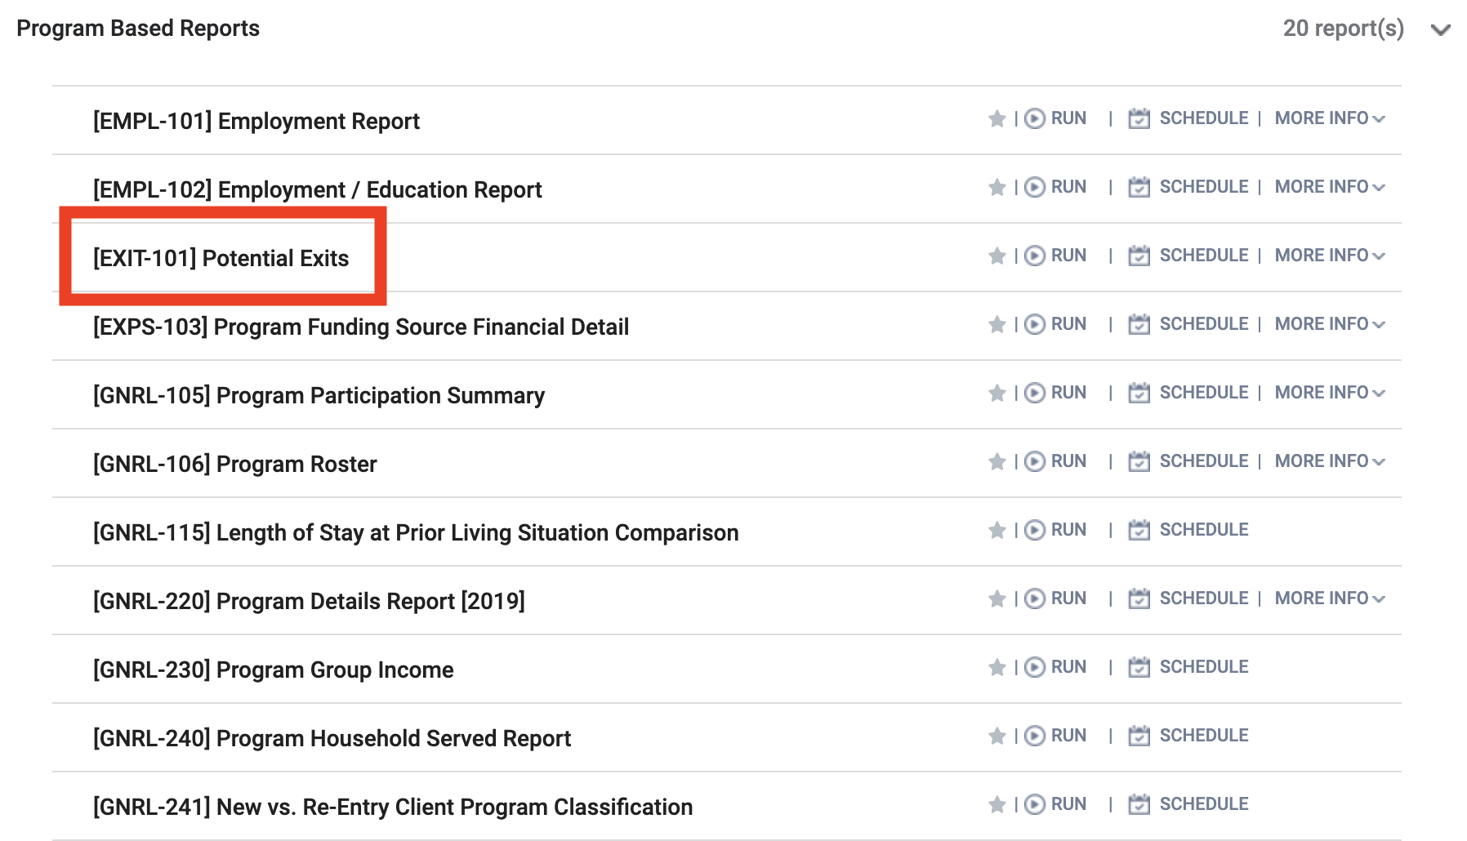
Reports- [EXIT-101] Potential Exits

Slide 19
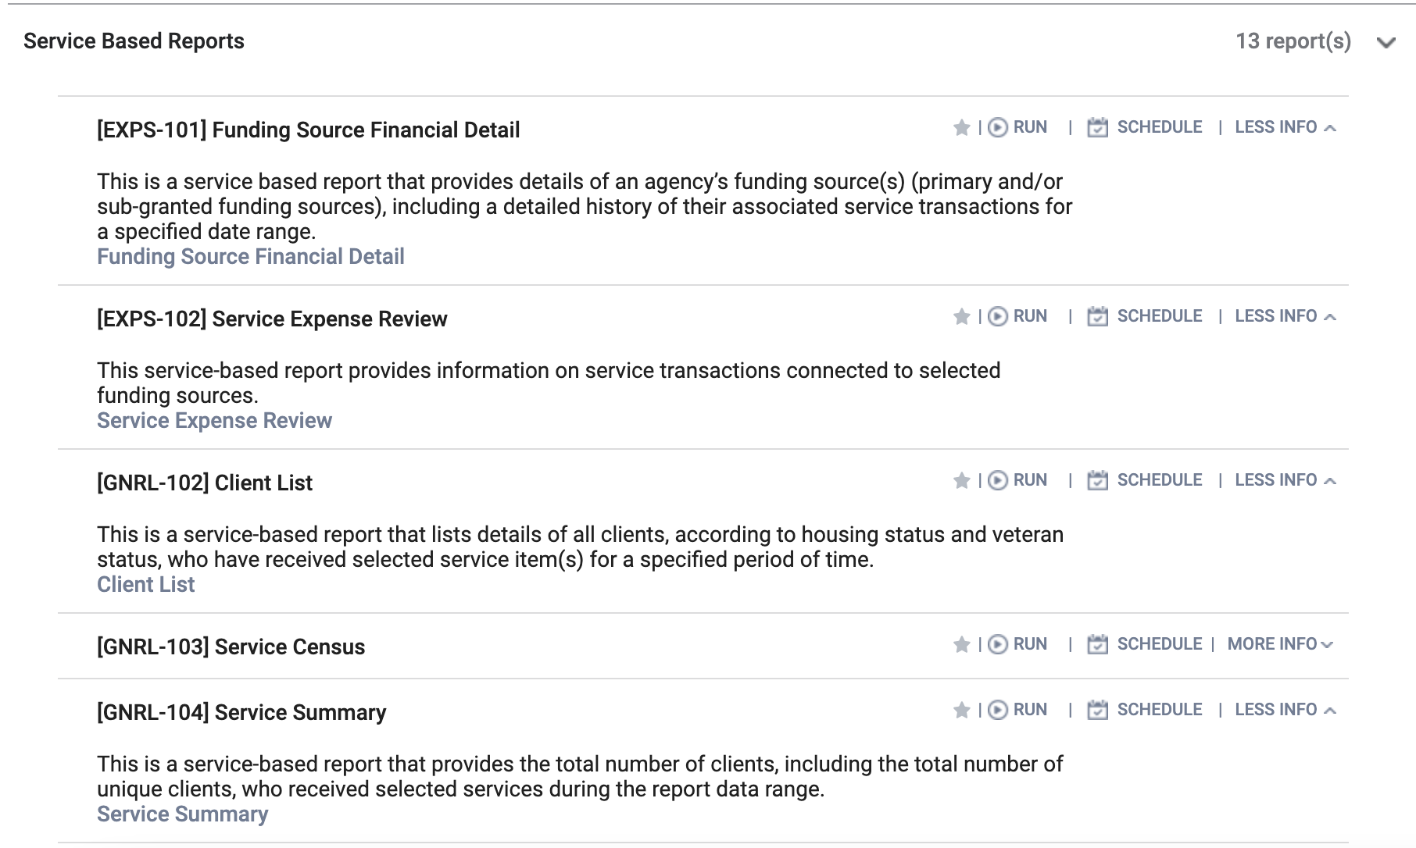
Service Based Reports
Service based reports provide information related to service transactions

Slide 20
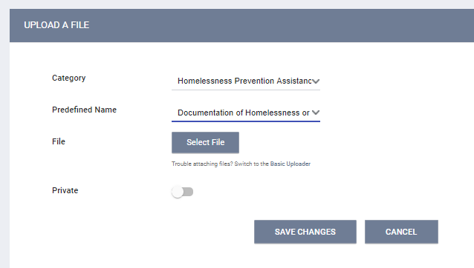
Uploading Client Files
To upload client files, select the files tab
Select the category for Homelessness Prevention Providers
Notes:
SHow live : enter Paula and son

Slide 21
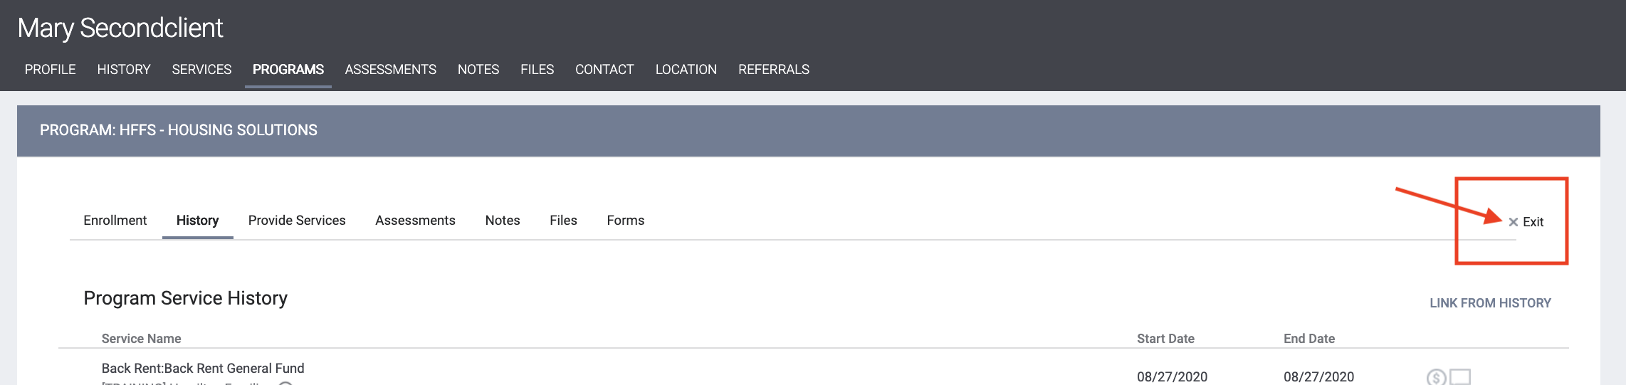
Program Exit
A client should be exited from the program, when they are no longer being served by the program
Notes:
To exit the client, return to the program enrollment record and click Exit on the far right side of the program enrollment tabs bar.

Slide 22
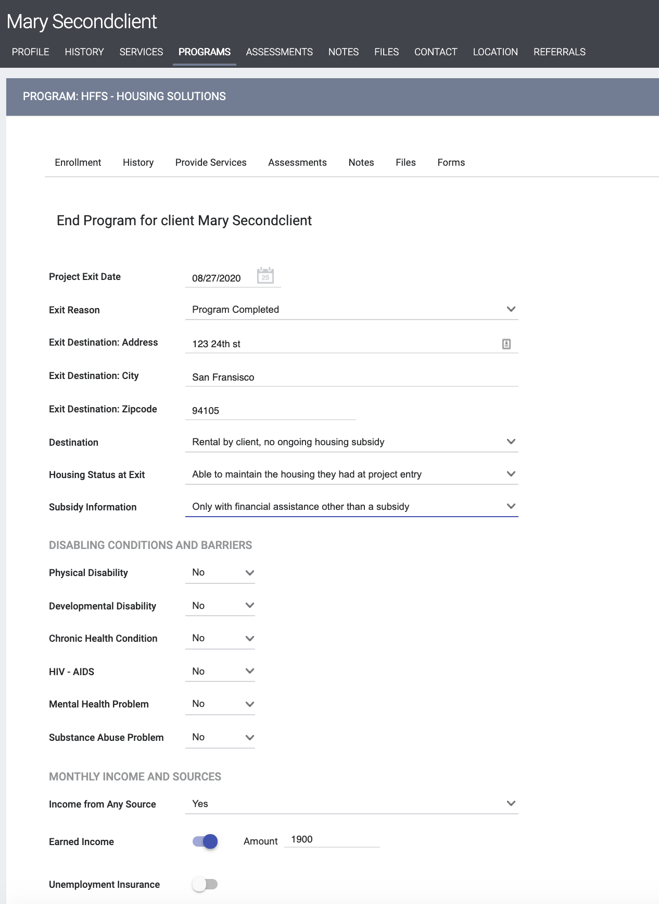
Program Exit
Be sure to include the Exit Destination Address, Destination, Housing Status at Exit and Subsidy Information
Update Disability, Income, Benefits and Insurance information
Please avoid using “Client refused” or Data Not Collected” whenever possible
Notes:
** Good news about exits is that a lot of your information will cascade forward, but pay close attention to what new information you will need to accurately record.. Make sure the exit date and all other information on the screen is complete and correct.

Slide 23
Hints/Clarifications: Program Exit
Most likely when payment is disbursed
Housing assessment field - purpose is to find out more about housing stability. Keeping due to HSH internal and external reporting requirements.
If household is receiving budgeting services or services after payment, then exit when household no longer receives services
A lot of the information on this screen will cascade from the enrollment screen
Exit Destination: same categories right now as the spreadsheet
Housing status is different and depends on the drop down selected before
Address optional; zip code mandatory- just like spreadsheet now
Notes:
** Good news about exits is that a lot of your information will cascade forward, but pay close attention to what new information you will need to accurately record.. Make sure the exit date and all other information on the screen is complete and correct.

Slide 24
Questions? Thank you!

