Slide 1
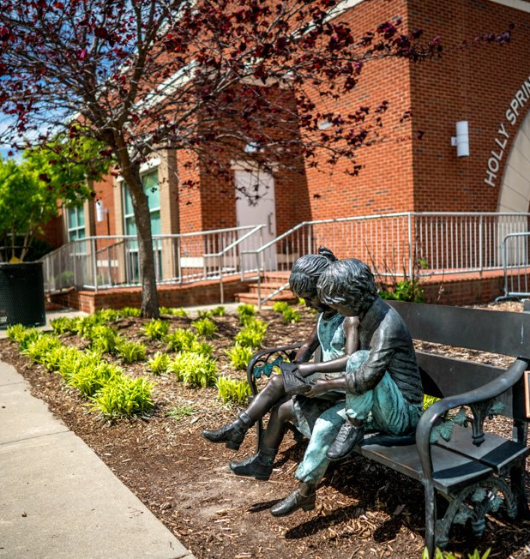
Wake County NC-507
March 2025 - Monthly Agency Administrators Meeting

Slide 2
Ice Breaker
What is your go-to karaoke song?

Slide 3
Agenda
Inactive User Process
Federal Reporting: HIC/PIT
Helpful Reports

Slide 4
User Request Process

Slide 5
User Request Process
The user must complete the required training
General Training
Privacy and Security Training
The request must come from the Agency Administrator.
Include:
Users Full Name
Email

Slide 6
Inactive Users
Users should be deactivated on their last day with the agency or as soon as possible.
Inactivate user account requests must come from the Agency Administrator.
For users who accounts that have been inactive, and need to be reinstated, the request must come from the Agency Administrator.

Slide 7
HIC/PIT

Slide 8
HIC/PIT
Outreach – Workbooks
Schedule time with Bitfocus
Resolve Data Quality Issues

Slide 9
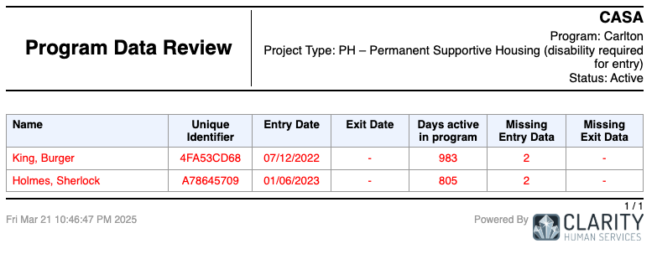
Helpful Reports
[DQXX-102] Program Data Review
Report: Highlights Data Quality Errors

Slide 10
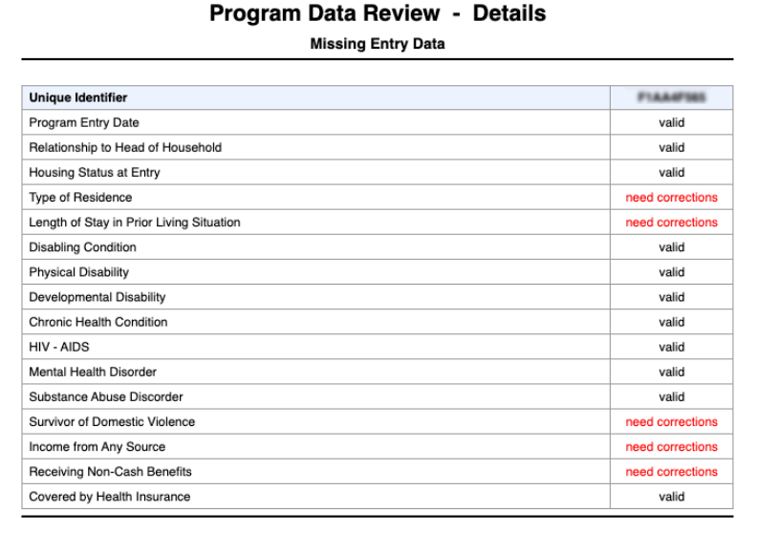
Helpful Reports
[DQXX-102] Program Data Review
(Data Quality Reports)
Missing Entry and Exit Data
Errors Displayed in RED
Includes errors for:
Data Not Collected
Client Prefers Not to Answer
Data Not Collected
NULL

Slide 11
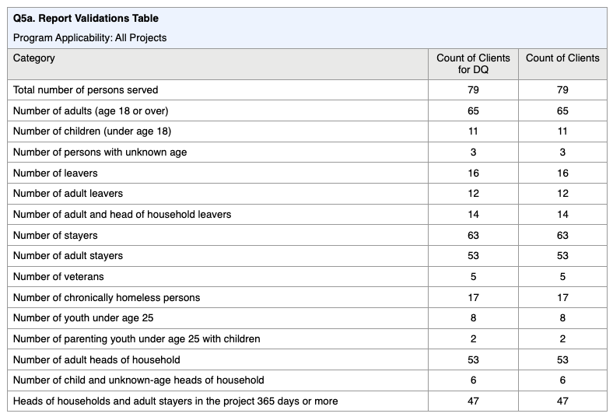
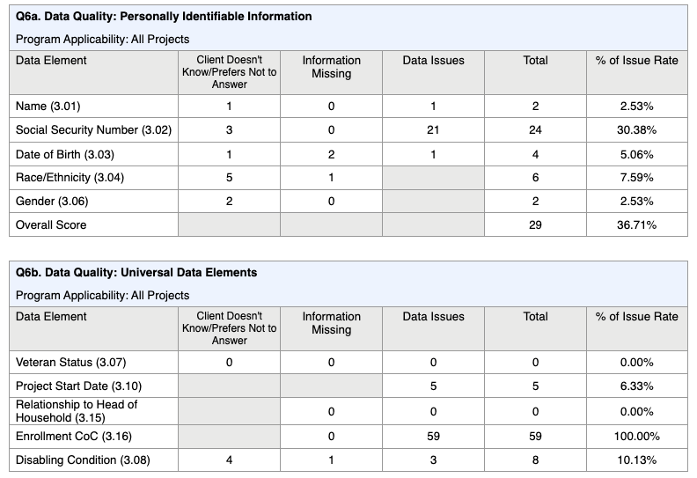
[HUDX-227] Annual Performance Report
(HUD Reports)
Evaluate Data Quality Issues
Analyze Program Performance
Review Clients Served

Slide 12
Questions?

Slide 13
For Support:
Bitfocus Help Desk Support:
Email: support@bitfocus.com
Phone: 800.594.9854 x1
Bitfocus Community Administrators
Email: wake-admin@bitfocus.com

