Slide 1
MHSA Workflow Training
San Francisco

Slide 2
Agenda
Enrollment
MHSA Service
Annual and Status Assessment
Exit
Report

Slide 3
Enrollments

Slide 4
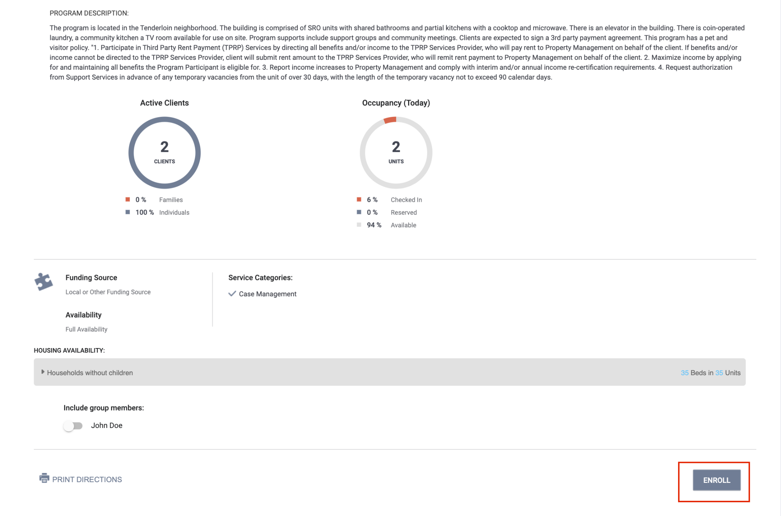
Enrollment
An enrollment is completed when the client begins receiving services.
Collect as much information as possible.
  Avoid using Client Refused and Data Not Collected

Slide 5
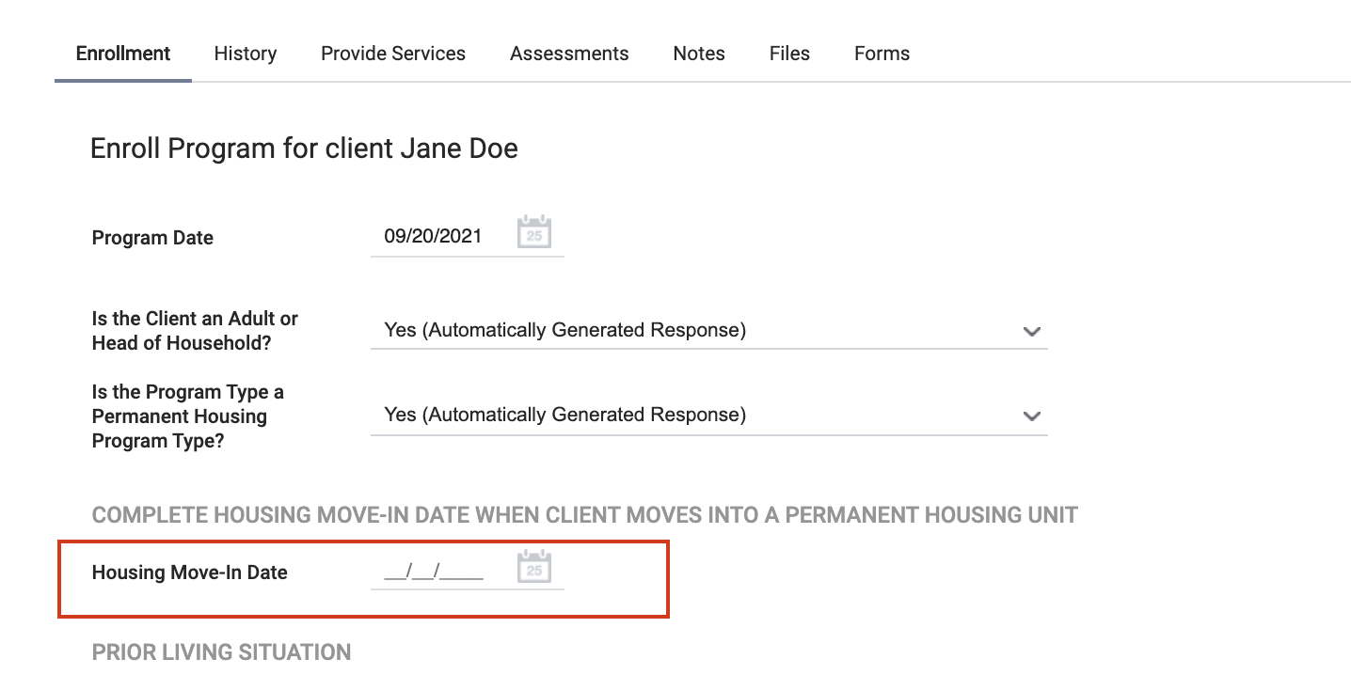
Enrollment- Move-in Date
The move-in date may usually aligns with the enrollment date.
If not, the move-in date should be entered when the client moves in.

Slide 6
Services

Slide 7
Services
The MHSA Service should only be entered for MHSA client.
The service should be entered one time- at enrollment.

Slide 8
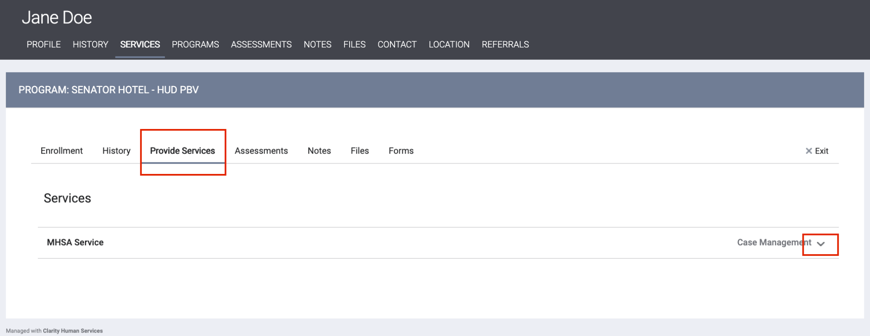
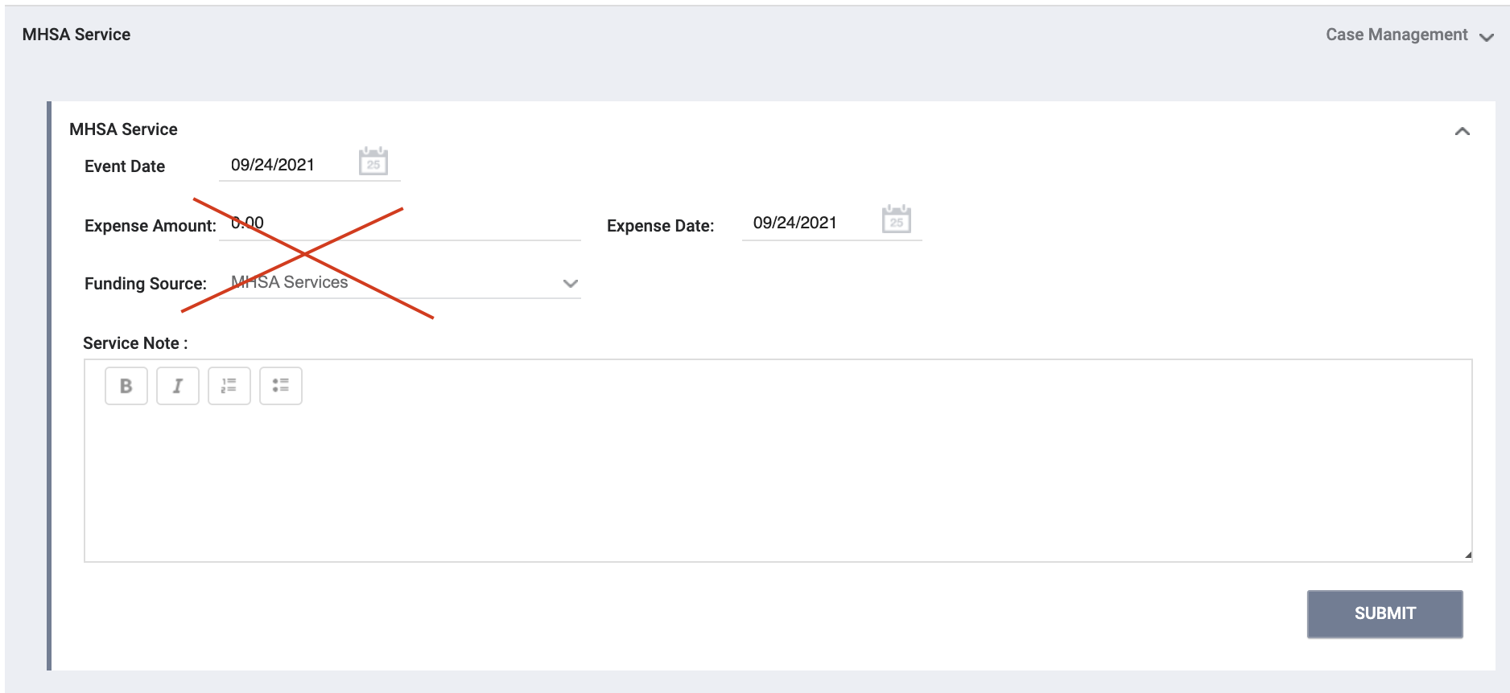
Services
Funding source and expense amount are not adjustable.
Expense date will populate to the date the service is entered.

Slide 9
Annual and Status Assessments

Slide 10
Annual and Status Assessment
Add an annual assessment every year within +/- 30 days of enrollment anniversary.
Status assessments are completed if there is a significant change in the client’s situation between annual assessments.

Slide 11
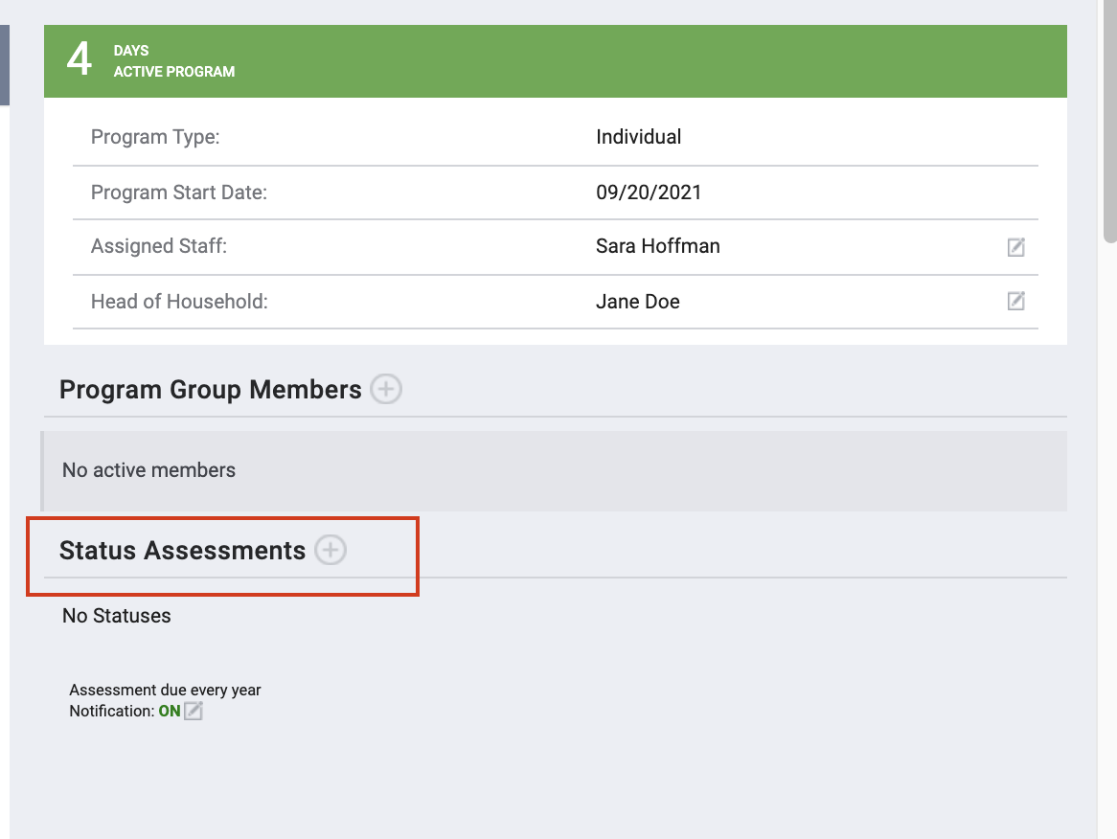
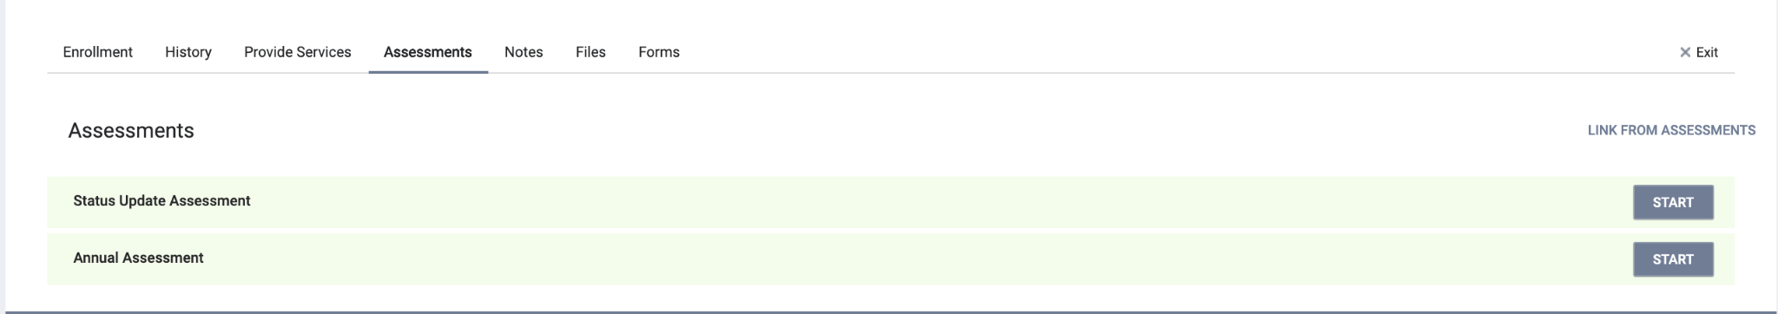
Annual/Status Assessments- User Account Settings
There are two ways to access annual and status assessments in ONE.

Slide 12
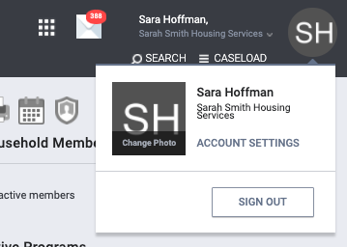
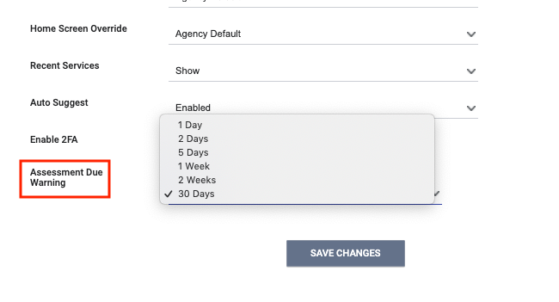
Assessment Warnings- Staff Account
Staff can set assessment warnings for client’s on their caseload.

Slide 13
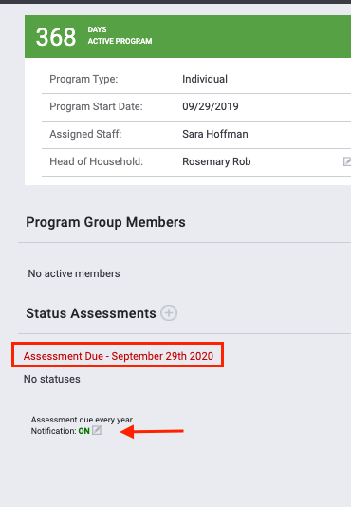
Assessment Warnings- Program-level
Program-level warnings can be set under the enrollment screen.
Enabling warnings at this level will enable them for all case managers assigned to this enrollment.

Slide 14
Exits

Slide 15
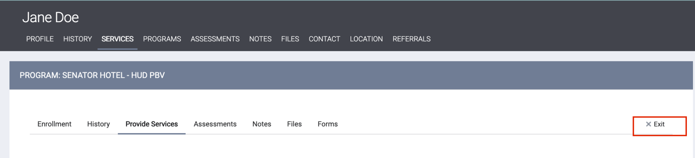
Exit
An exit should be completed when the client is no longer in housing.

Slide 16
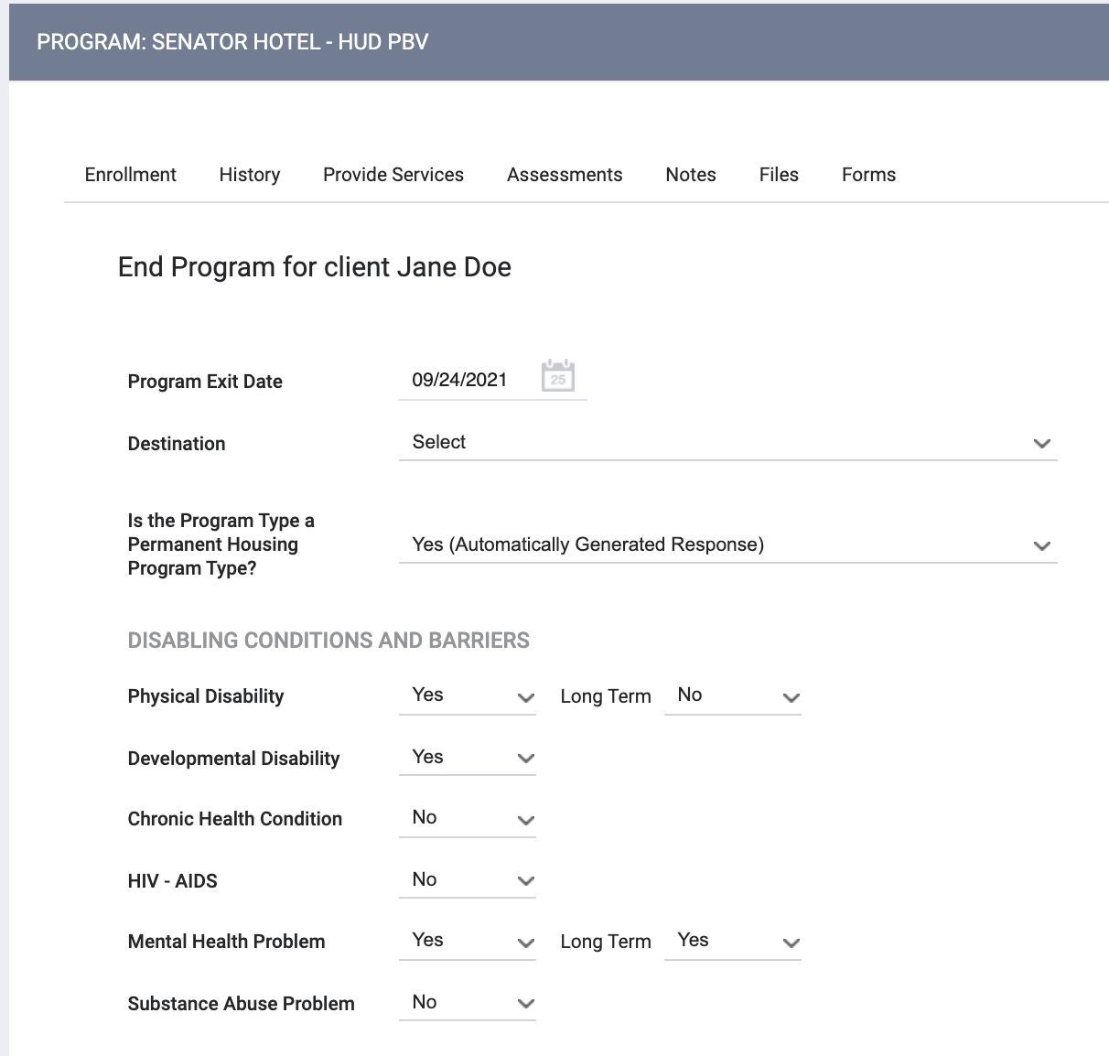
Exit
Destination should reflect the client’s housing circumstance when they left.
Some fields may auto-populate with information from the enrollment.

Slide 17





Review of Workflow
Enrollment
Move-in Date
MHSA Service
Annual Assessment
Exit

Slide 18
Reports

Slide 19
MHSA Report: Active Client List
  The MHSA Active Client List
  Holistic view of client interactions with MHSA programs and services.
  Accessed under the Data Analysis Tab

Slide 20
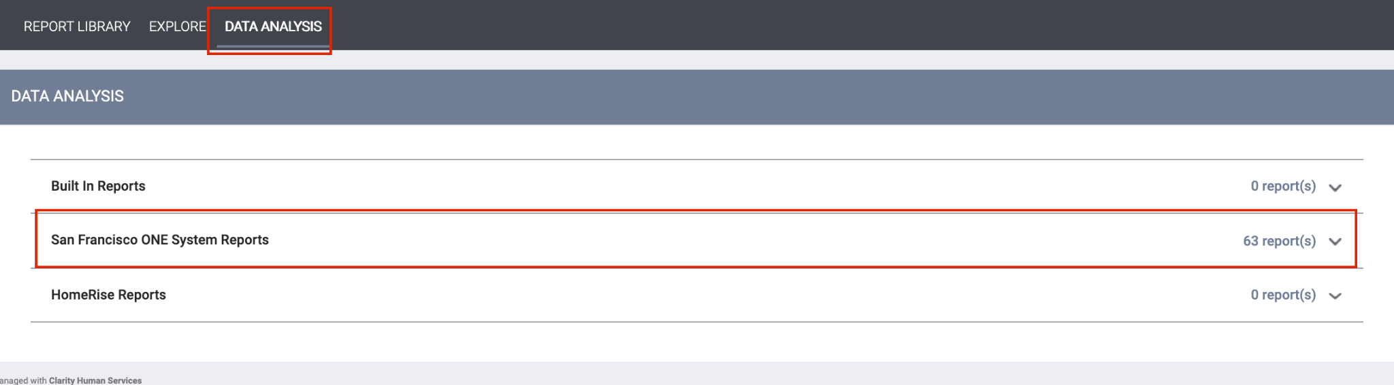
MHSA Report: Active Client List
Access the report under the Data Analysis Tab.
Under San Francisco ONE System Reports> MSHA Reports

Slide 21
Program Roster
[GNRL-106] Program Roster (Program Based Report)
  Who’s stayed in the program
  Lists program stay information for clients with the selected status in the selected program
  Accessed in the Report Library

Slide 22
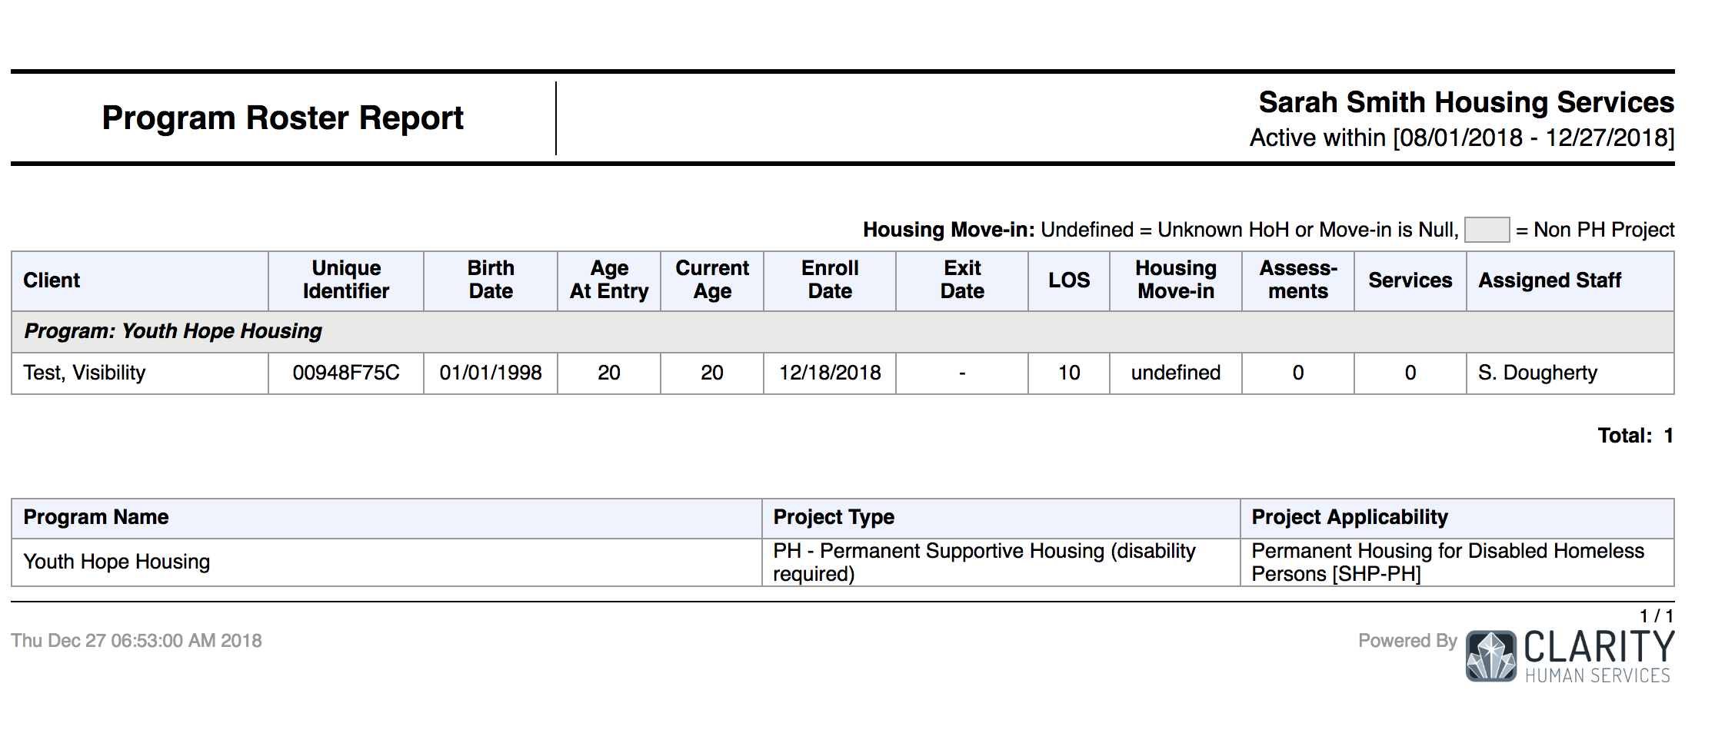
Program Roster

Slide 23

Questions??

