Slide 1
MHSA Workflow Training San Francisco

Slide 2
Agenda
Enrollment
MHSA Service
Annual and Status Assessment
Exit
Report

Slide 3
Enrollments

Slide 4
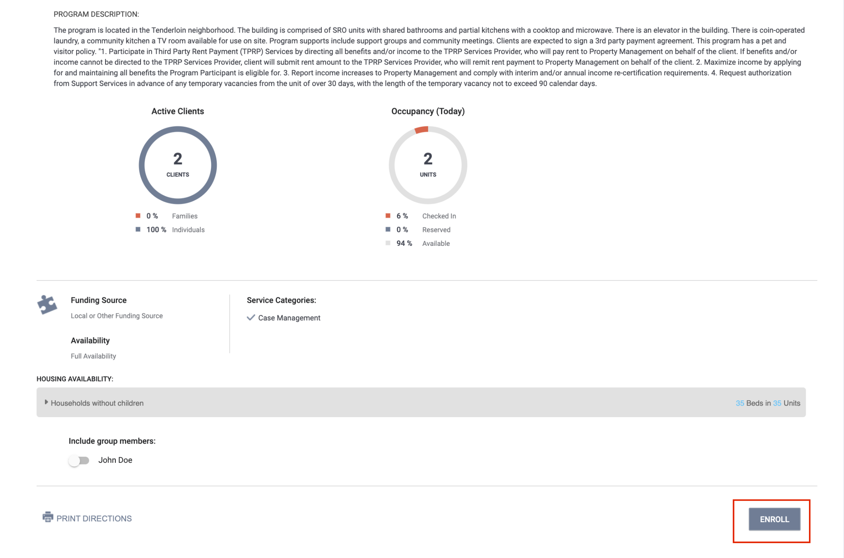
Enrollment
An enrollment is completed when the client begins receiving services.
Collect as much information as possible.
Avoid using Client Refused and Data Not Collected

Slide 5
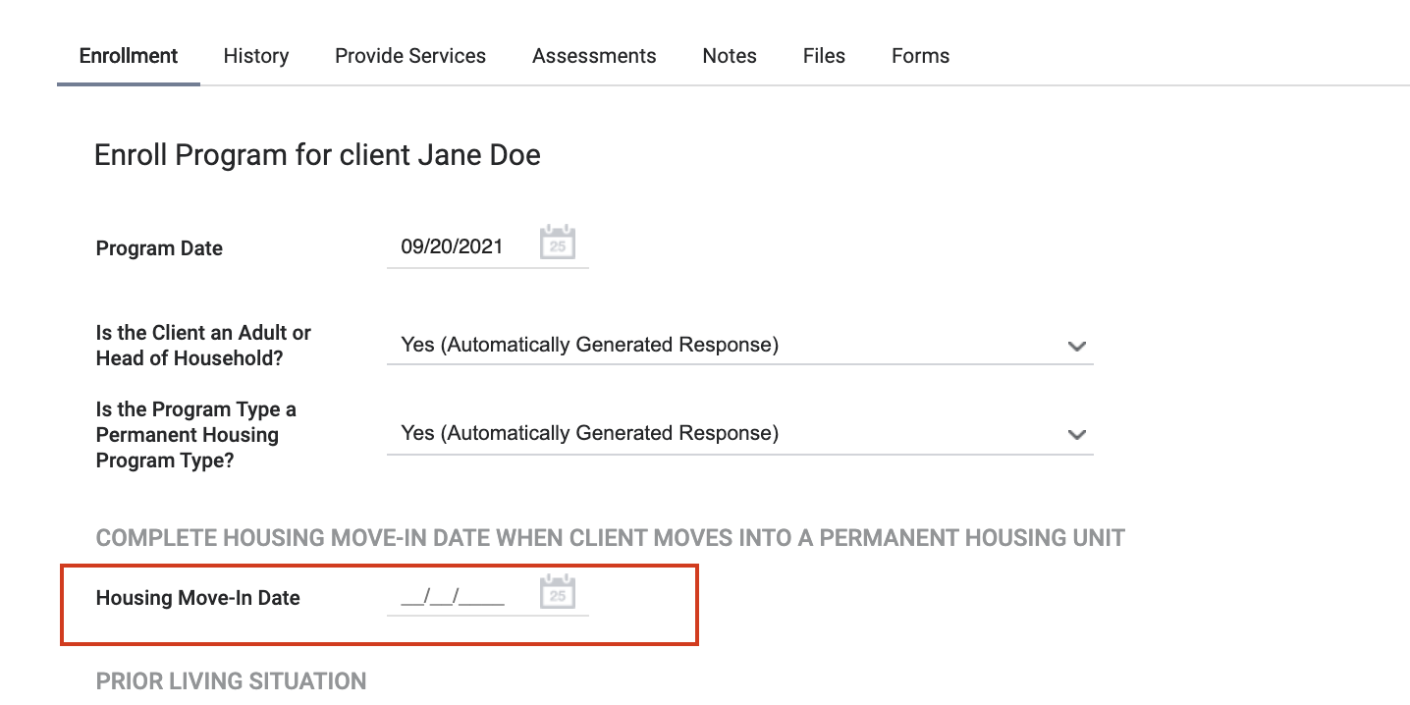
Enrollment
The move-in date may usually aligns with the enrollment date.
If not, the move-in date should be entered when the client moves in.

Slide 6
Annual and Status Assessments

Slide 7
Annual and Status Assessment
Add an annual assessment every year within +/- 30 days of enrollment anniversary.
Status assessments are completed if there is a significant change in the client’s living situation between annual assessments.

Slide 8
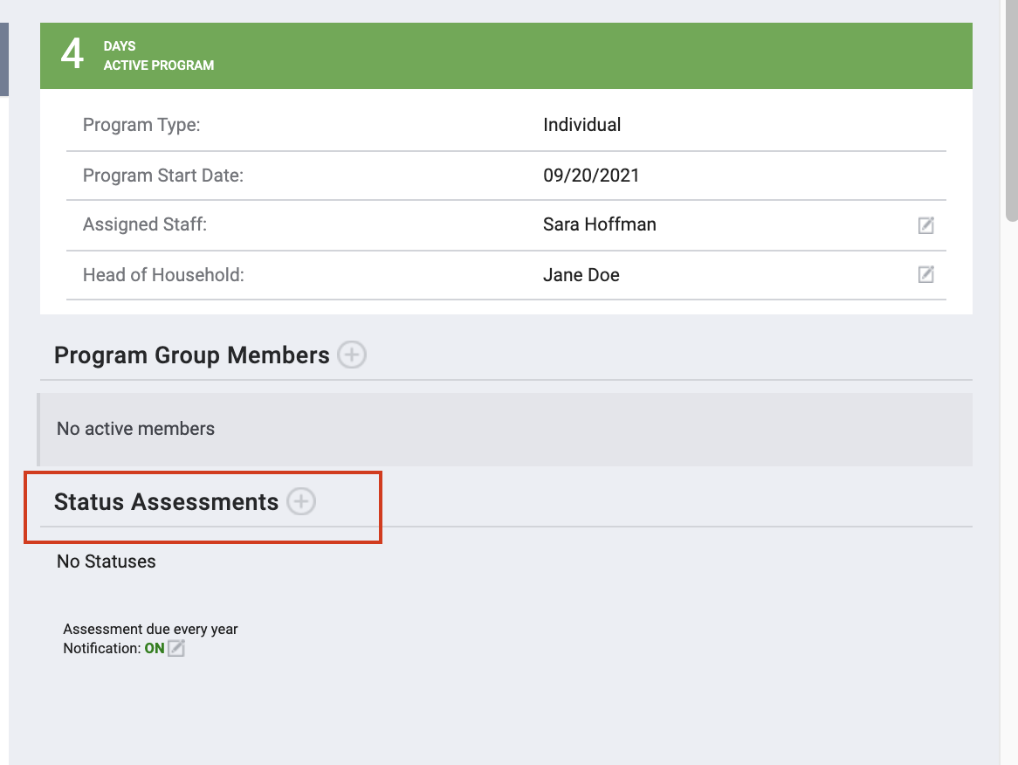
Annual/Status Assessments- User Account Settings
There are two ways to access annual and status assessments in ONE.

Slide 9
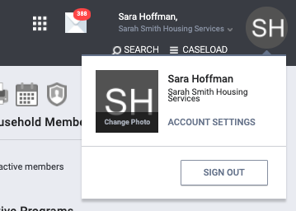
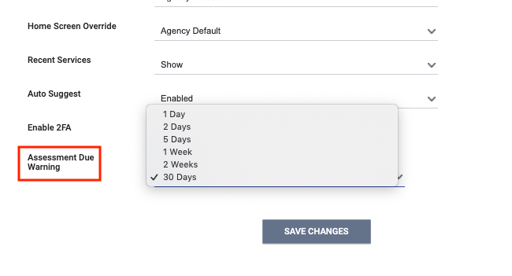
Assessment Warnings
Staff can set assessment warnings to notify them when a client’s annual assessment is due.

Slide 10
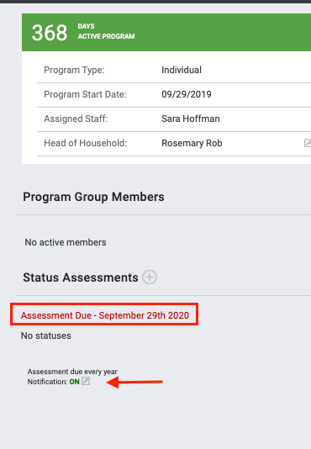
Assessment Warnings- Program-level
Program-level warnings can be set under the enrollment screen.
Enabling warnings at this level will enable them for all case managers assigned to this enrollment.

Slide 11
Exits

Slide 12
Exit
An exit should be completed when the client is no longer in housing.

Slide 13
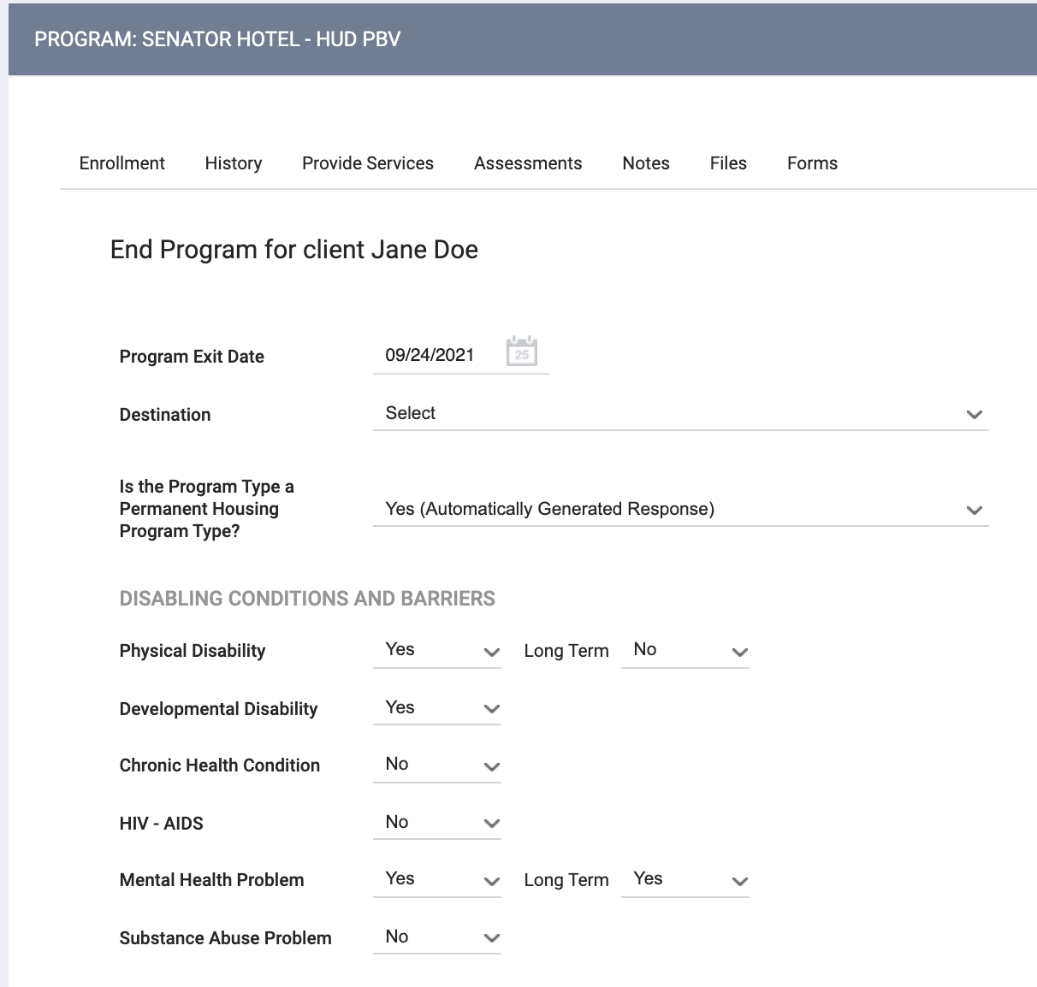
Exit
Destination should reflect the client’s housing circumstance when they left.
Some fields may auto-populate with information from the enrollment.

Slide 14
Review of Workflow
Enrollment
Move-in Date
MHSA Service
Annual Assessment
Exit

Slide 15
Reports

Slide 16
MHSA Report: Active Client List
The MHSA Active Client List
Holistic view of client interactions with MHSA programs and services.
Accessed under the Data Analysis Tab

Slide 17
MHSA Report: Active Client List
Access the report under the Data Analysis Tab.
Under San Francisco ONE System Reports> MSHA Reports

Slide 18
Program Roster
[GNRL-106] Program Roster (Program Based Report)
Who’s stayed in the program
Lists program stay information for clients with the selected status in the selected program
Accessed in the Report Library

Slide 19
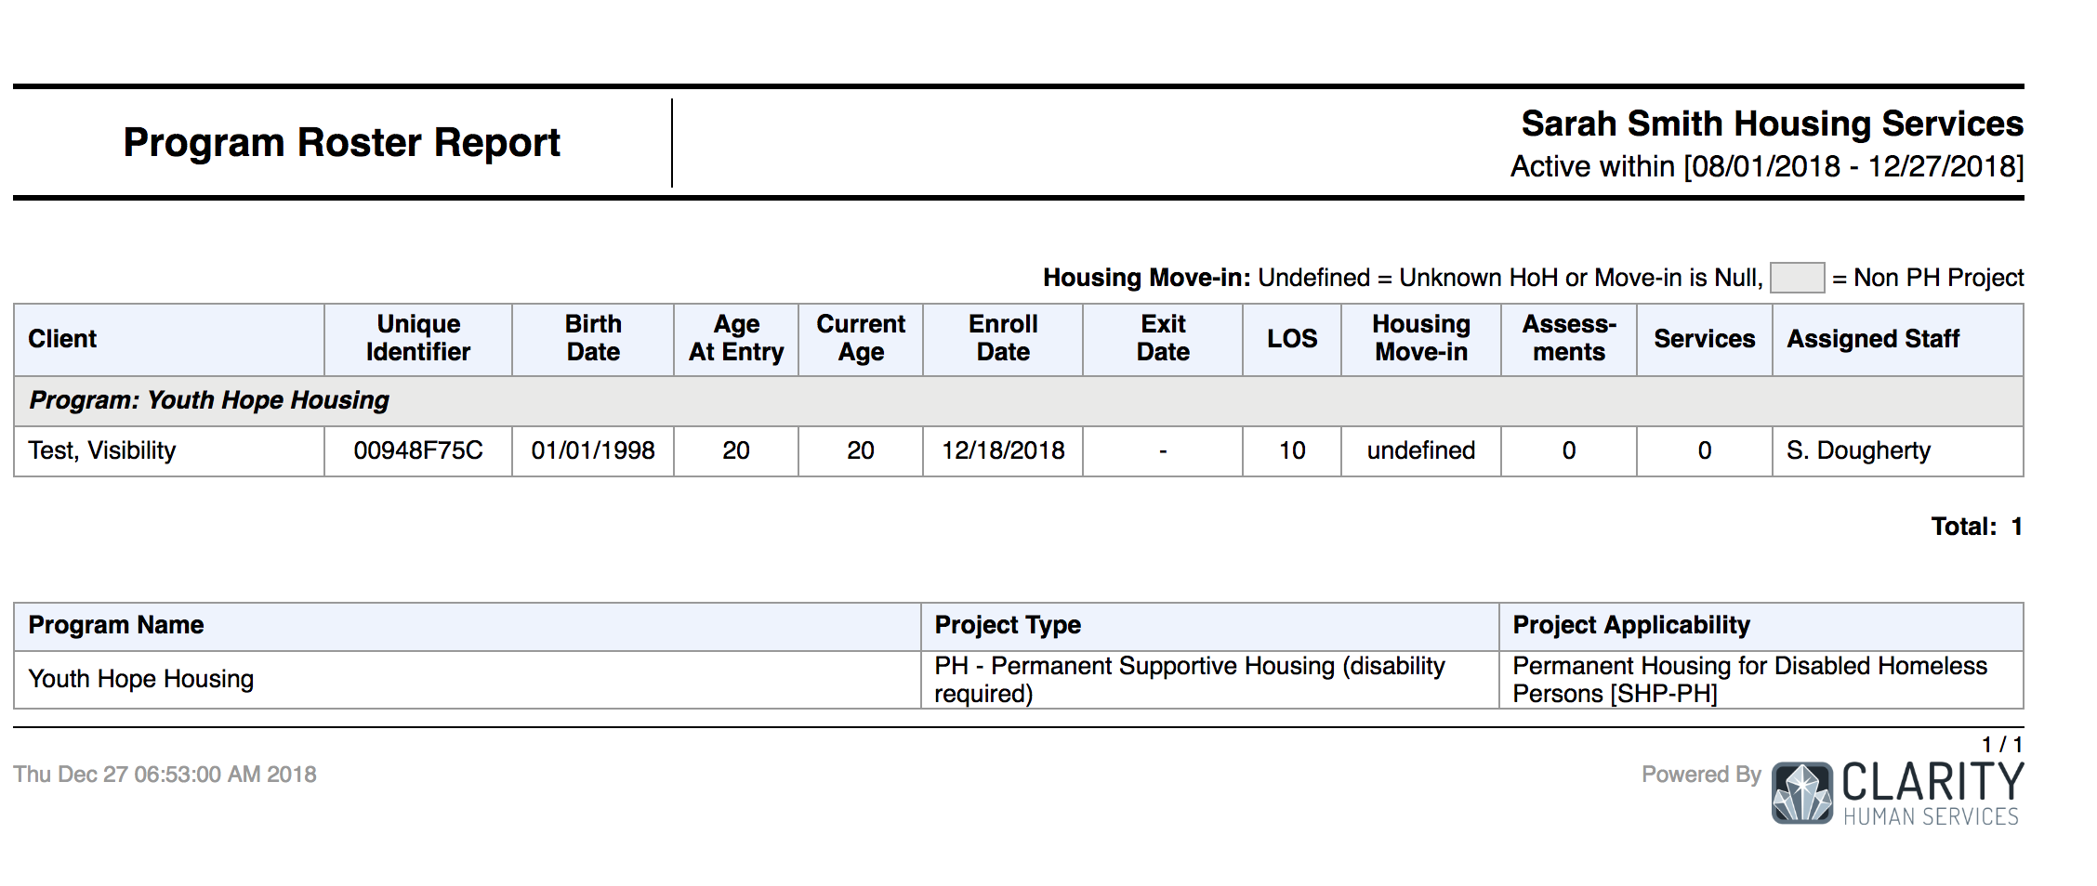
Program Roster

Slide 20
Questions??

